Slide 1
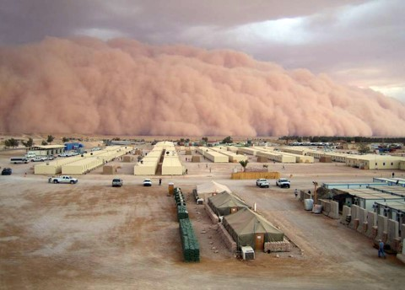
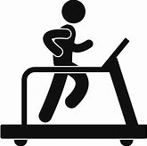
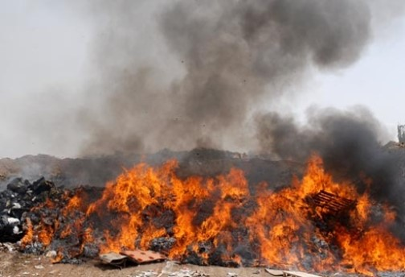
Exercise-Induced Bronchoconstriction (EIB) in Iraq/Afghanistan Veterans
Study Population
Study Population
Method
Outcome
≥10% fall in FEV₁
+ two additional criteria
% veterans w/EIB
≥10% fall in FEV₁ only
Spirometry tests before and after an exercise challenge using standard vs. less conservative criteria for diagnosis
The number of veterans with exercise-induced bronchoconstriction doubled using less conservative criteria
Deployed veterans exposed to fine particulate matter
Exercise-Induced Bronchoconstriction should be considered when evaluating veterans deployed to Iraq and Afghanistan
Klein-Adams et al. Military Medicine. In press.

