Slide 1
Chronic Multi-Symptom Illness and OEF/OIF/OND Veterans
Lisa McAndrew, PhD
Nyasanu Barbee, PhD

Slide 2
Outline
Understand diagnosis of Chronic Multi-Symptom Illness.
Understand importance of investigating Chronic Multi-Symptom Illness in Veteran population.
Understand studies on the prevalence of Chronic Multi-Symptom Illness among OEF/OIF/OND Veterans.
Understand the impact of Chronic Multi-Symptom Illness among OEF/OIF/OND Veterans.
Understand and apply assessment strategies.

Slide 3
CMI is a significant problem in OEF/OIF/OND Veterans.
CMI causes significant functional difficulties.
OEF/OIF/OND Veterans should be assessed for CMI.
Veterans with CMI need personalized patient centered care.

Slide 4
What are Medically Unexplained Symptoms?

Slide 5
Medically Unexplained Symptoms
Physical symptoms with no adequate medical explanation
Physical symptoms that are common across comorbid diagnoses (e.g. headaches)

Slide 6
Unexplained Symptoms are Common in the U.S. Population
Healthy adults report an average of 20 symptoms a week (Egan & Beaton,1987).
Over a 3-year period, 38% of patients seen in primary care report common physical symptoms (e.g. headaches). 80% are unexplained or psychological (Kroenke, 1989).

Slide 7
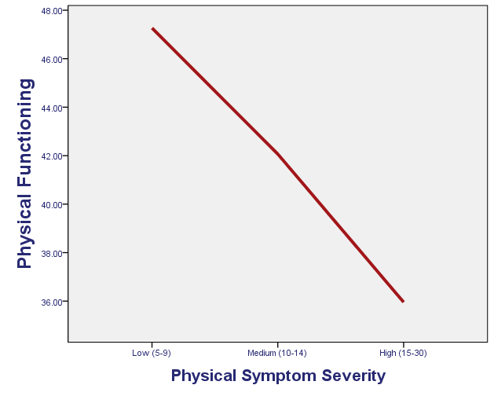
When do unexplained symptoms become a problem?

Slide 8
Labels
Fibromyalgia
Multiple Chemical Sensitivity
Chronic Fatigue Syndrome
Non-cardiac chest pain
Irritable bowel syndrome
Temporomandibular joint disorder

Slide 9
Chronic Multi-Symptom Illness
1 or more chronic symptoms (≥6 months) from at least 2 of 3 categories (fatigue, mood-cognition, and musculoskeletal)
If each case-defining symptom is rated as severe,
the case is severe.
(Fukuda, et al., 1998)

Slide 10
Medically Unexplained Symptoms and Chronic Multi-symptom Illness
Medically unexplained symptoms are physical symptoms with no known cause or common across diagnoses
Medically unexplained symptoms are common and experienced by most of us regularly
Chronic Multi-symptom Illness is a label used to identify clinically relevant levels of medically unexplained symptoms

Slide 11
Case Example
“Sam”

Slide 12
Case Example – “Sam”
24 year old OEF/OIF Veteran
Chronic Fatigue
Chronic Pain (joints and muscles)
Short-term memory/concentration
Depression/PTSD

Slide 13
Case Example – “Sam”
Reduced Activities
Unemployment
Social Withdrawal
Frustration
Hopelessness

Slide 14
Case Example – “Sam”
Revolving Door
“Misunderstood”
Provider Frustration
What can we do?

Slide 15
The Importance of Chronic Multi-Symptom Illness in Veterans

Slide 16
Combat and Physical Symptoms
There has been an increased reporting of physical symptoms after every war since the US Civil War (Hyams, 1996).
Fatigue
Shortness of Breath
Headaches
Sleep disturbances
Impaired Concentration
Forgetfulness

Slide 17
Gulf War Veterans
Approximately 30% of Gulf War Veterans are afflicted with CMI (Fukuda, 1998; Wolfe, 2002).
Gulf War Veterans continue to have symptoms 10 years after the end of the war (Blanchard, 2006; Ozakinci, 2006).

Slide 18
Gulf War Veterans
Gulf War Veterans have significantly more disability than Gulf War-era Veterans. (Voelker, 2002).
24,409 Gulf War Veterans have been awarded disability compensation through the VA (VA, 2011).

Slide 19
The Prevalence and Impact of Chronic Multi-Symptom Illness among OEF/OIF/OND Veterans

Slide 20
OEF/OIF/OND
Over two and a half million OEF/OIF soldiers have been deployed with 30% having more than one deployment.
Many of these soldiers have endured complex psychological and physical challenges.
E.g. 90% of soldiers reported being shot at (Hoge, 2004) and 99% of OEF/OIF Veterans reported an exposure to an environmental toxin (McAndrew, 2012).

Slide 21
OEF/OIF/OND
The focus of research for OEF/OIF Veterans has been on PTSD and mTBI. (Department of Defense Task Force on Mental Health, 2007)
IOM report on Gulf War Illness (2013) reports an increase in CMI among OEF/OIF Veterans from pre to post deployment.

Slide 22
CMI among OEF/OIF Veterans
Hoge et al. (2007) found 10% of a sample of 2,863 US soldiers who deployed to Iraq had “high” physical symptoms.

Slide 23
CMI among OEF/OIF Veterans
Horn et al. (2006) found UK soldiers deployed to Iraq did not report increased prevalence of symptoms, fatigue, and poorer self-assessed health compared to soldiers not deployed.
Same study population did not find an increase in mental health symptoms among Iraq War Veterans.

Slide 24
Chronic Multisymptom Illness (OEF/OIF)
(McAndrew, et al., 2012; Data from the HEROES study)

Slide 25
Is it PTSD?
CMI
Neither CMI nor PTSD
40.4%
38.9%
Severe CMI
5.0%
PTSD
7.8%
5.6%
2.2%
(McAndrew, et al., 2012)

Slide 26
CMI is related to poorer Function
(McAndrew, et al., 2012; HEROES Study)
SF-36 Scores
* All differences between means are clinically and statistically significant

Slide 27
Rates of Chronic Fatigue Syndrome among OEF/OIF Veterans seen at the WRIISC
 | OEF/OIF (N=334)
CFS | 57 (17%)
No CFS | 225 (67%)
Excluded | 52 (16%)

Slide 28
Health Function of WRIISC Patients: Comparison of OEF/OIF Veterans with CFS as compared to Gulf War Veterans with CFS *controlling for PTSD symptoms

Slide 29
CMI and OEF/OIF Veterans
There are little data on the rates and impact of CMI on OEF/OIF/OND Veterans.
The little data out there suggests that CMI is a significant problem for OEF/OIF/OND Veterans.

Slide 30
Understand and apply assessment strategies.

Slide 31
High Comorbidity
PTSD 68.2% (232/340)
2.9%
5.3%
10.3%
16.5%
6.8%
42.1%
12.6%
Chronic Pain 81.5% (277/340)
Persistent Post- concussive Symptoms (PPCS)
66.8% (227/340)
(Lew, et al., 2009)

Slide 32
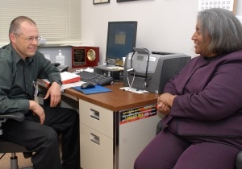
Assess Veterans for CMI or other Medically Unexplained Symptoms
http://www.healthquality.va.gov/mus/mus_sum.pdf

Slide 33
Beliefs about CMI
Patient
Physician
Mental Health Provider

Slide 34
Shared Beliefs Lead to Improved Self-Management
Patient
Physician
Mental Health Provider
(Phillips, et al., 2011)

Slide 35
Beliefs May be More Similar Than Previously Thought
43% of Gulf War Veterans with CMI seen at the WRIISC report that the nature of their illness is both physical and psychological.

Slide 36
How Do You Develop Shared Beliefs?
Physical Symptoms
Stress
Depression
PTSD

Slide 37
Small Changes Can Lead to Improved Communication
Cause?
Physical Symptoms
Stress, Depression, PTSD

Slide 38
Focus on Goals
Veterans goals are to improve the quality of their daily life, social relationships, vocation, etc. (McAndrew, et al. 2013).
Practitioners need to acknowledge patients’ symptoms and functional impairments first and slowly work with patients to set goals to improve quality of life.

Slide 39
Case Example – “Sam”
24 year old OEF/OIF Veteran
Chronic Fatigue
Chronic Pain (joints and muscles)
Short-term memory/concentration
Depression/PTSD

Slide 40
Case Example
Determine Sam’s views of his symptoms
Present concept of Chronic Multi-Symptom Illness
Discuss implications of Chronic Multi-Symptoms Illness
Discuss goals and management Strategies

Slide 41
Assessment
Veterans with CMI need personalized patient centered care.
This can be achieved through
Communication,
Understanding, and
Shared illness beliefs.
Providers can promote shared illness beliefs through
Listening,
Acknowledging that the symptoms of Chronic Multi-symptom Illness are real-despite our not understanding the cause, and
Developing shared goals.

Slide 42
Conclusions
CMI is a significant problem in OEF/OIF/OND Veterans.
CMI causes significant functional difficulties.
OEF/OIF/OND Veterans should be assessed for CMI.
Veterans with CMI need personalized patient centered care.

Slide 43
Thank you
Any Questions?
www.WarRelatedIllness.va.gov
800-248-8005

