Slide 1
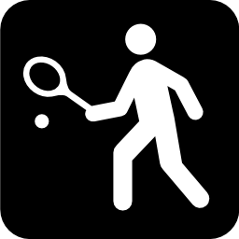
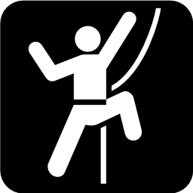
Exercise as Medicine
Michael J. Falvo, PhD, RCEP
Jacquelyn C. Klein, MS, RCEP

Slide 2
Effects of Physical Inactivity
Cardiorespiratory Fitness
Effects of Chronic Exercise Training
Components of an Exercise Prescription
Individualizing Exercise Prescription
Provider Resources

Slide 3
Effects of Physical Inactivity
Cardiorespiratory Fitness
Effects of Chronic Exercise Training
Components of an Exercise Prescription
Individualizing Exercise Prescription
Provider Resources

Slide 4
Physical inactivity accounts for
3.2 – 5 million
deaths per year
By reducing physical inactivity 10-25%
0.5 – 1.3 million
premature deaths could be averted
Lim et al. Lancet 2012; 380: 2224–60
Lee et al. Lancet 2012; 380: 219–29

Slide 5
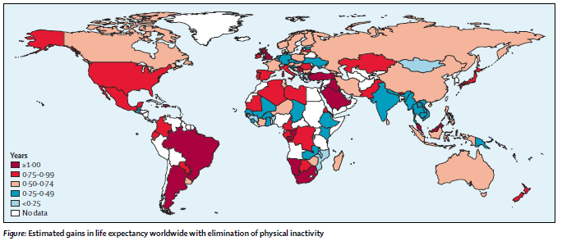
Gains in Life Expectancy
Lee et al. Lancet 2012; 380: 219–29

Slide 6
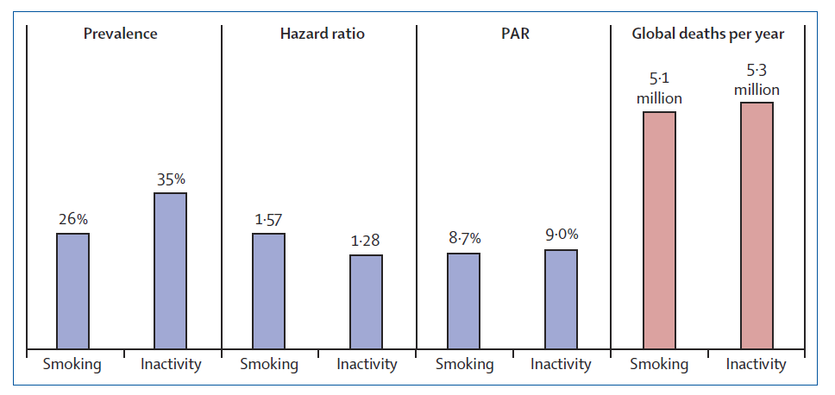
Global Burden – Smoking vs. Inactivity
Wen and Wu. Lancet 2012; 380 (9838), pp. 192-193. S0140-6736(12)60954-4

Slide 7
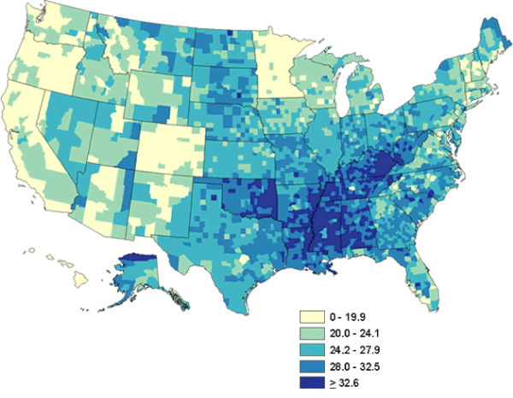
Physical Inactivity in US Adults
http://www.cdc.gov/physicalactivity/data/facts.html

Slide 8
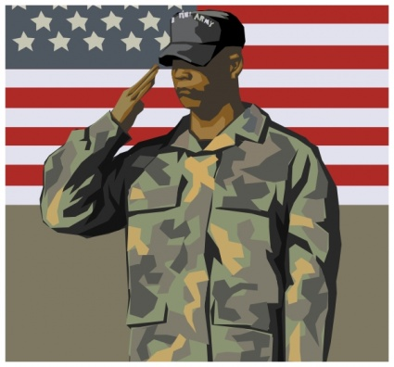
Uniqueness of Veterans
Compared to civilian patient population, the VA patient population
15-fold poorer health
14-fold more conditions
5-fold more admissions
Physical Activity?
Agha et al. Arch Intern Med 2000; 160(21):3252-3257.

Slide 9
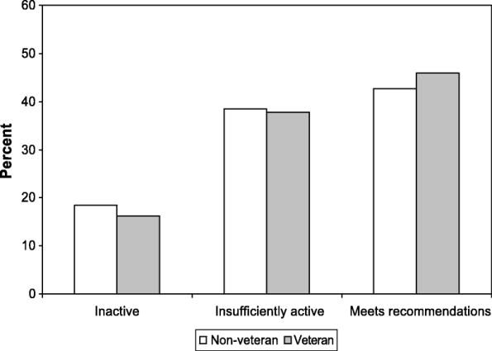
Veterans vs. Civilians
Littman et al. Med Sci Sports Exerc 2009; 41 (5), pp.1006-1013

Slide 10
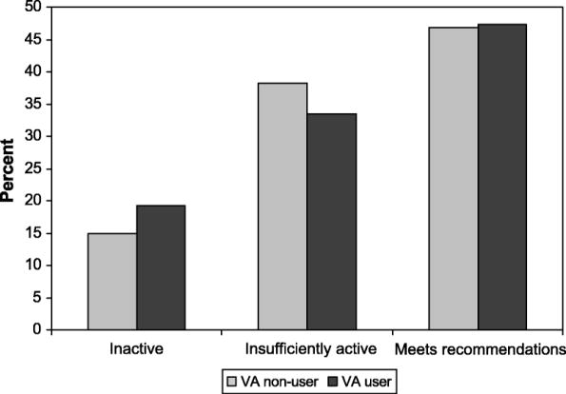
VA Users vs. Non-Users
Littman et al. Med Sci Sports Exerc 2009; 41 (5), pp.1006-1013

Slide 11
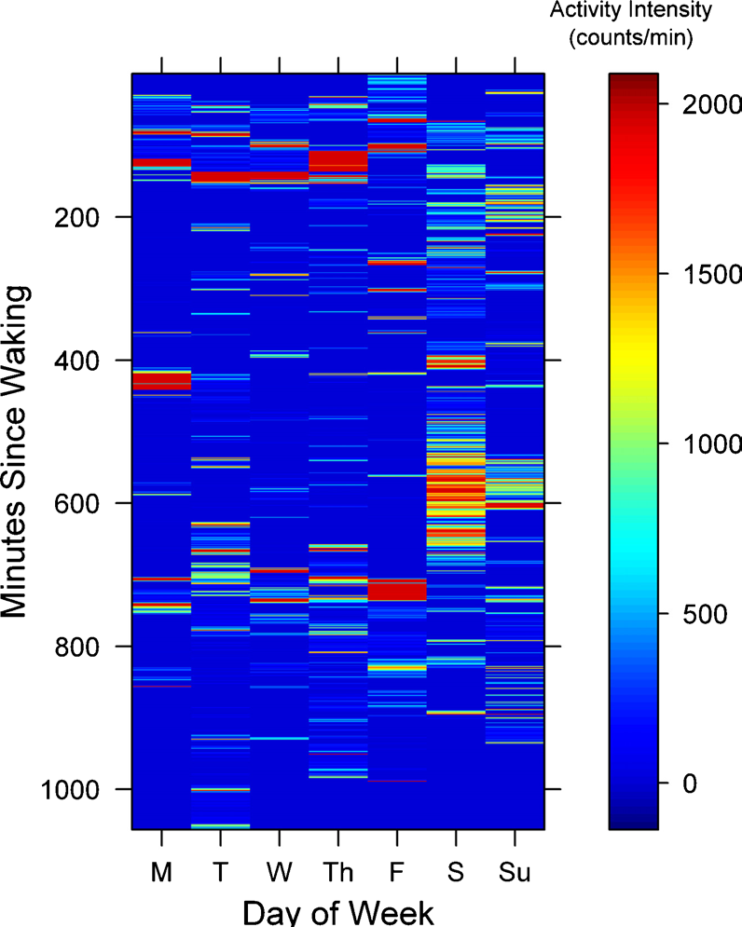
The “Active Couch Potato”
✓
30 min·day⁻¹ of moderate intensity physical activity
71% of waking hours being sedentary
✓
Owen et al. Exerc Sport Sci Rev 2010; 38:105-113

Slide 12
Designed to Sit?
55 - 70% of waking hours are spent sedentary
TV viewing associated with obesity, diabetes, insulin resistance, impaired glucose uptake
“Medical Hazards of Prolonged Sitting” – Bassett et al. Exerc Sport Sci Rev 2010; 38 (3): 101-2
juststand.org

Slide 13
Sedentary Time – Independent Risk?
Sedentary Time
Physical Activity
Maher et al. PLoS ONE 2014; 9(1): e86403.

Slide 14
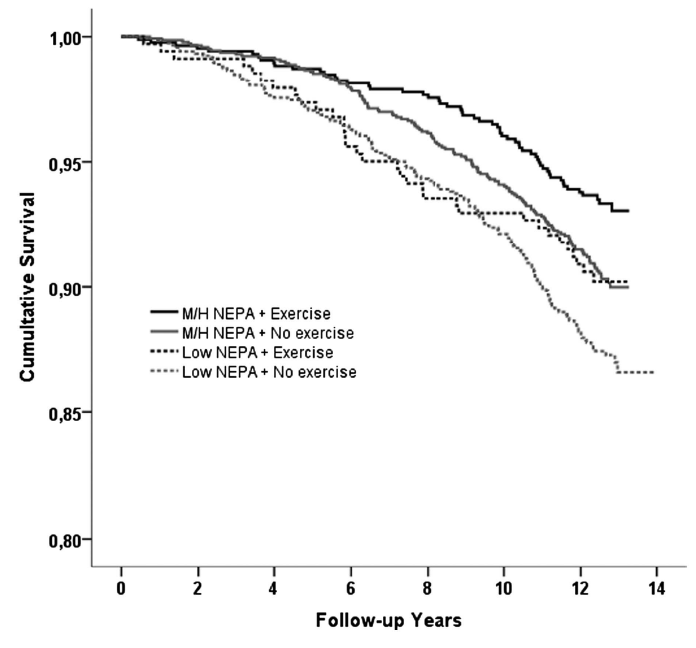
Non-Exercise Physical Activity
Ekblom-Bak E, et al. Br J Sports Med 2013;48:233–238

Slide 15
Physical Inactivity – Risky Business
Katzmarzyk & Janssen. Can J Appl Physiol 2004; 29, 90-115

Slide 16
Effects of Physical Inactivity
Cardiorespiratory Fitness
Effects of Chronic Exercise Training
Components of an Exercise Prescription
Individualizing Exercise Prescription
Provider Resources

Slide 17
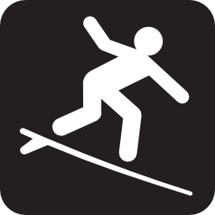
Cardiorespiratory Fitness (CRF)
“CRF is a health-related component of physical fitness defined as the ability of the circulatory, respiratory, and muscular systems to supply oxygen during sustained physical activity.”
METs
VO₂ max
Aerobic capacity
Lee et al. J Psychopharm 2010; 24:27-35

Slide 18
CRF and Mortality
Increasing METs
Myers et al. NEJM 2002 ; 346(11):793-801

Slide 19
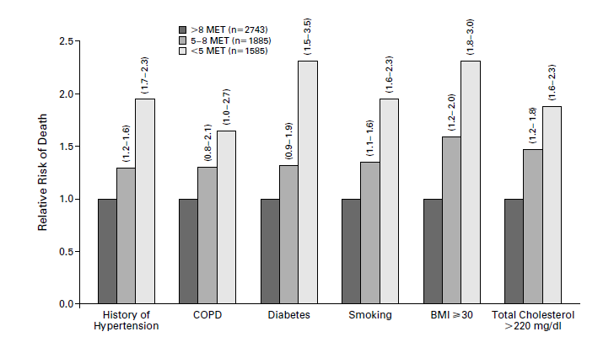
What about Risk Factors?
Myers et al. NEJM 2002 ; 346(11):793-801

Slide 20
CRF and Mortality (n = 15,660)
Kokkinos P, Myers J. Circulation 2010;122(16):1637-1648

Slide 21
What about Risk Factors?
Kokkinos P, Myers J. Circulation 2010;122(16):1637-1648

Slide 22
Survival Benefit per MET ↑
Redrawn from: Kokkinos & Myers; Circulation 2010; 122(16): 1637-1648

Slide 23
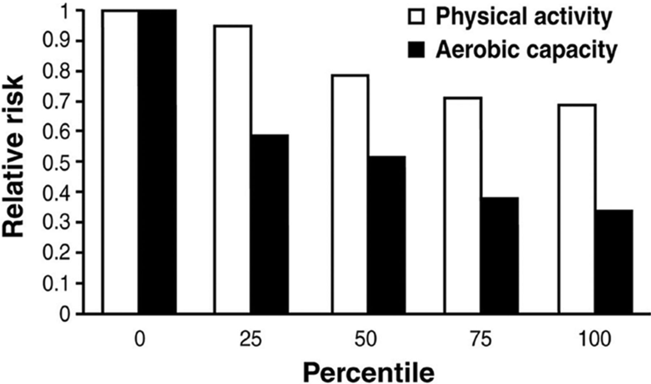
And the winner…
Kaminsky L A et al. Circulation. 2013;127:652-662

Slide 24
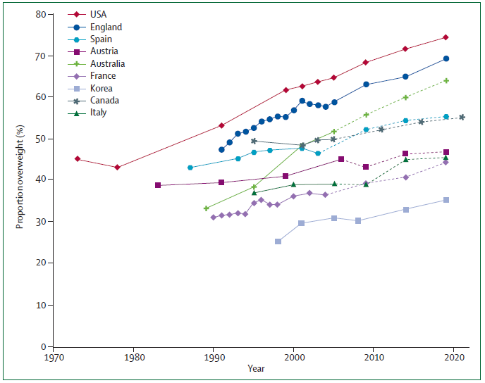
What about Obesity?
Wang et al. Lancet 2011; 378 (9793): 812-825.

Slide 25
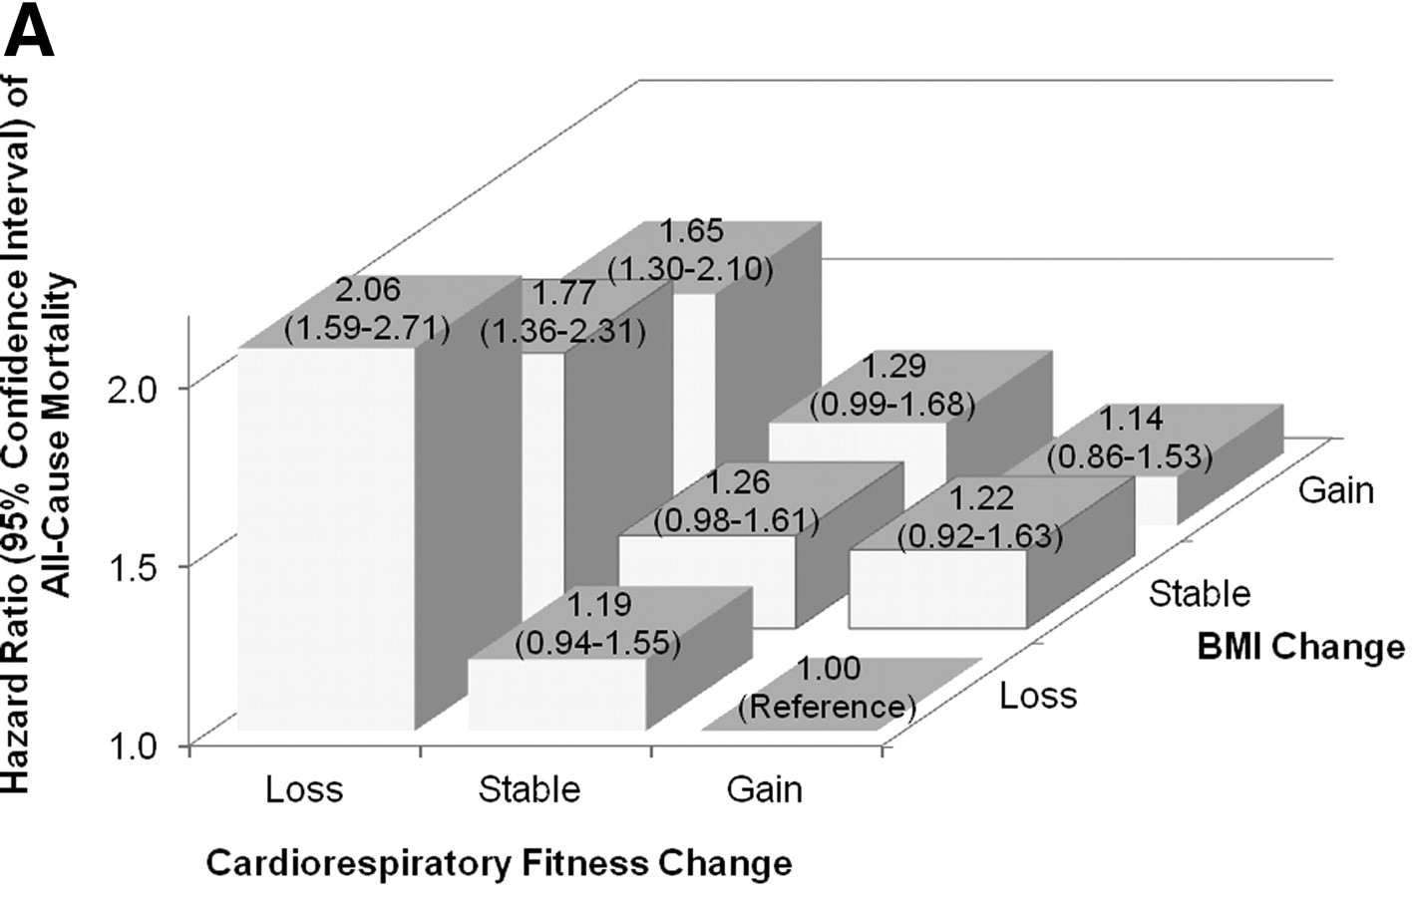
All-Cause Mortality
n = 14,345
Lee D et al. Circulation 2011;124(23): 2483-2490

Slide 26
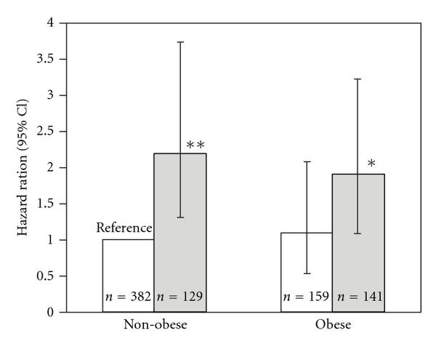
Obesity Paradox
Unfit
Fit
McAuley et al. Mayo Clin Proc 2010: 85(2):115-121.

Slide 27
Medicalize Obesity or Deconditioning?
AMA classifies obesity as a disease
Did they forget deconditioning?
“If deconditioning were a recognized syndrome or diagnosis like hypertension, diabetes and POTS, it would be easier to educate the general public and medical community about the one universally effective treatment for it – exercise training” Dr. Joyner – Mayo Clinic
Joyner, MJ. J Physiol 2012; 590 (pt 15):3413-4

Slide 28
Effects of Physical Inactivity
Cardiorespiratory Fitness
Effects of Chronic Exercise Training
Components of an Exercise Prescription
Individualizing Exercise Prescription
Provider Resources

Slide 29
Initiative focused on encouraging primary care physicians and health care providers to include exercise into their treatment plans

Slide 30
Evidence → Pathogenesis
 | STRONG | MODERATE | LIMITED | NONE
T2DM, Insulin Resistance
Dyslipidemia
Hypertension, Obesity
COPD
Heart Disease/Failure
Intermittent Claudication
Rheumatoid Arthritis
Osteoporosis
Fibromyalgia
Chronic Fatigue Syndrome
Depression
Pedersen & Saltin. Scand J Med Sci Sport 2006;16 Suppl 1: 3-63.

Slide 31
Evidence → Symptoms
 | STRONG | MODERATE | LIMITED | NONE
T2DM, Insulin Resistance
Dyslipidemia
Hypertension, Obesity
COPD
Heart Disease/Failure
Intermittent Claudication
Rheumatoid Arthritis
Osteoporosis
Fibromyalgia
Chronic Fatigue Syndrome
Depression
Pedersen & Saltin. Scand J Med Sci Sport 2006; 16 Suppl 1:3-63.

Slide 32
Evidence → Quality of Life
 | STRONG | MODERATE | LIMITED | NONE
T2DM, Insulin Resistance
Dyslipidemia
Hypertension, Obesity
COPD
Heart Disease/Failure
Intermittent Claudication
Rheumatoid Arthritis
Osteoporosis
Fibromyalgia
Chronic Fatigue Syndrome
Depression
Pedersen & Saltin. Scand J Med Sci Sport 2006;16 Suppl 1: 3-63.

Slide 33
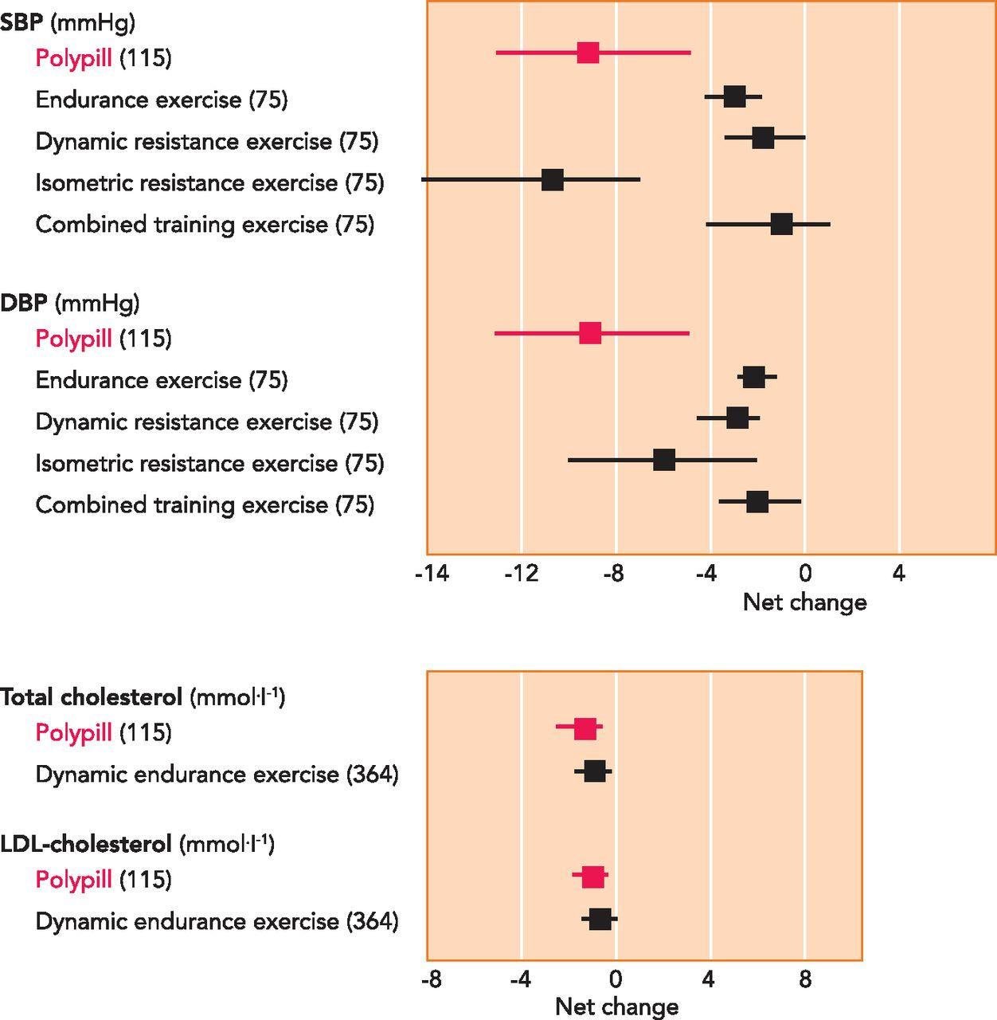
Exercise: “The real Polypill”
Fiuza-Luces C et al. Physiology 2013;28(5):330-358

Slide 34
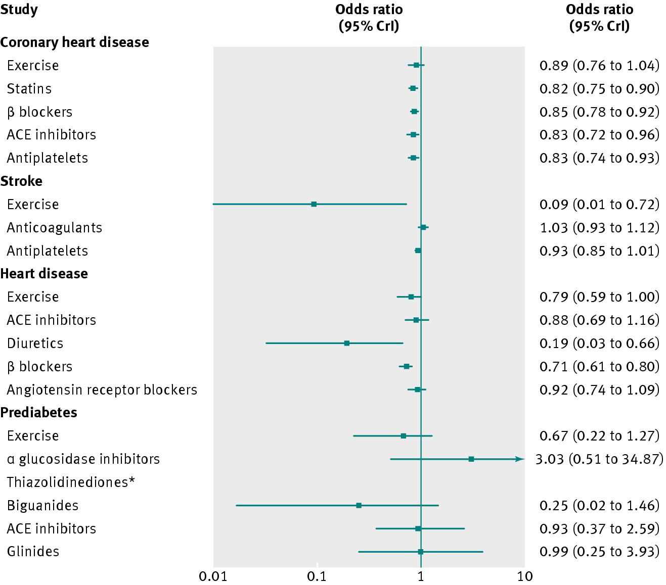
Exercise as Effective as Drugs
Naci, H and Loannidis, JP. BMJ 2013; 347:f5577

Slide 35
Take-Home Points
Any activity is good activity, activity enhancing CRF is best
Deconditioning – perhaps more than obesity – deserves greater attention
Exercise IS medicine – embrace it

Slide 36
Effects of Physical Inactivity
Cardiorespiratory Fitness
Effects of Chronic Exercise Training
Components of an Exercise Prescription
Individualizing Exercise Prescription
Provider Resources

Slide 37
An Optimal Ex R_{x} should address:
Cardiorespiratory Fitness (aerobic training)
Muscular strength and endurance (resistance training)
Flexibility
Body Composition
(ACSM Guidelines for Exercise Testing and Prescription 9th ed)

Slide 38
Prescribing Exercise: The FITT Principle
5 components:
Frequency – # of times per week
Intensity – how challenging
Time – how long
Type– modes of exercises
Progression – change over time
“A program of regular exercise for most adults should include a variety of exercise beyond activities performed as a part of daily living. An exercise prescription should include a plan to decrease periods of physical inactivity as well as increasing physical activity.”
(ACSM Guidelines for Exercise Testing and Prescription 9th ed)

Slide 39
FITT Principle | Aerobic Exercise | Resistance Exercise
Frequency | ≥5 days/week of moderate exercise, or ≥3 days/week of vigorous exercise, or a combination of moderate and vigorous exercise on ≥3-5 days/week. | Each major muscle group should be trained on 2-3 days per week, with at least 48 hours in between sessions.
Intensity | Moderate and/or vigorous intensity is recommended for most adults. Light-to-moderate intensity exercise may be beneficial in most deconditioned individuals. | Moderate to vigorous intensity for novice to intermediate exercisers to improve strength. Vigorous to very vigorous intensity for experienced strength trainers to improve strength. Very light to light intensity for older individuals beginning exercise to improve strength and for previously sedentary individuals beginning a resistance training program.
Time | 30-60 minutes/day of purposeful moderate exercise, or 20-60 minutes/day of vigorous exercise, or a combination of moderate and vigorous exercise per day. Exercise may be performed in one (continuous) session per day or in multiple sessions of ≥10 minutes to accumulate the desired duration per day. <20 minutes of exercise per day can be beneficial, especially in previously sedentary individuals. | No specific duration of training has been identified for effectiveness
Type | Regular, purposeful exercise that involves large muscle groups and is continuous and rhythmic in nature. | Resistance exercises involving each major muscle group are recommended A variety of exercise equipment and/or body weight can be used to perform these exercises.
Progression | A gradual progression of exercise volume by adjusting exercise duration, frequency and/or intensity is reasonable until the desired exercise goal (maintenance) is attained. | A gradual progression of greater resistance, and/or more repetitions per set, and/or increasing frequency is recommended.
(ACSM Guidelines for Exercise Testing and Prescription 9th ed. )

Slide 40
For Important Health Benefits Adults need at least:
Frequency: 5 days
Intensity: Moderate intensity
Time: 30 minutes
Type: Aerobic activity (i.e. brisk walking)
AND
Muscle strengthening activities on 2 or more days a week that work all major muscle groups.
Frequency: 3 days
Intensity: Vigorous intensity
Time: 20-25 minutes
Type: Aerobic activity (i.e. jogging or running)
AND
Muscle strengthening activities on 2 or more days a week that work all major muscle groups.
OR

Slide 42
For even greater health benefits adults should increase their activity to:
Frequency: 5-6 days
Intensity: Moderate intensity
Time: 50-60 minutes
Type: Aerobic activity (i.e. brisk walking)
AND
Muscle strengthening activities on 2 or more days a week that work all major muscle groups.
Frequency: 5-6 days
Intensity: Vigorous intensity
Time: 25-30 minutes
Type: Aerobic activity (i.e. jogging or running)
AND
Muscle strengthening activities on 2 or more days a week that work all major muscle groups.
OR

Slide 43
Effects of Physical Inactivity
Cardiorespiratory Fitness
Effects of Chronic Exercise Training
Components of an Exercise Prescription
Individualizing Exercise Prescription
Provider Resources

Slide 44
Exercise Prescription for Veterans
Do physicians prescribe the same medicine for all patients?
Each Veteran is unique
“One size fits all” and “off-the-shelf” exercise programs are inappropriate
Individually tailored programs improve exercise adherence (Cox et al. 2003; Hillsdon et al. 2005; Kahn et al. 2002; Smith & Leon 2003; Marcus et al. 2006; Seguin et al. 2010)

Slide 45
Individualizing an Exercise Rx
Follow the FITT guidelines.
For very deconditioned or novice exercisers beginning at a lighter intensity is beneficial.
When progressing an exercise program always increase Frequency and/or Time BEFORE increasing Intensity.

Slide 46
Individualizing an Exercise Rx
Ask the Veteran what he/she likes and dislikes about exercise. Focus the program around activities that will be enjoyed and what will help to accomplish his/her goals.
Come up with strategies for avoiding relapse and overcoming the common ‘Barriers to Physical Activity.’

Slide 47
Barriers to Physical Activity
No time
Not convenient
Lacking self-motivation
Not fun
Low self-efficacy
Fear of injury
Lack of encouragement/support
Access to equipment
Sallis and Hovell 1990; Sallis et al. 1992

Slide 48
Overcoming Barriers to Physical Activity
Be active during TV commercials
Mark times for physical activity into a personal calendar
Join an exercise group or class
When traveling- pack a jump rope, or walk the hotel halls and/or climb the stairs.
Take the stairs
Park far away
Get off the bus/subway a station earlier and walk the remainder
Get a dog
Get dance fever
Get up to change the TV channel

Slide 49
Improving Exercise Adherence
“Most adults in the United Sates do not engage in the recommended amounts of physical activity. For individuals who choose to engage in an exercise program, greater than 50% will drop out over the first 6 months.”
(ACSM Guidelines for Exercise Testing and Prescription, 9th ed.)

Slide 50
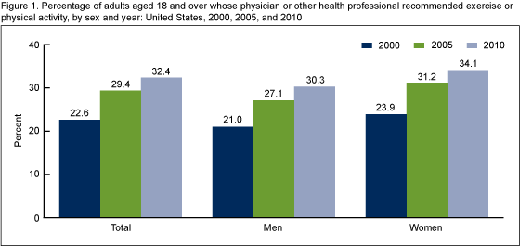
Are we recommending Physical Activity/Exercise?
About 1 in 3 adults who saw a physician or other health care professional in 2010 were advised to begin or maintain exercise or physical activity.
Barnes & Schoenborn, NCHS Data Brief, 2012; 86: 1-8

Slide 51
Does it make a difference?
Yes.
Even simple and brief advice can improve physical activity levels among adults.
Anokye et al. Br J Sports Med 2014; 8: 202-206.

Slide 52
Recommendations to Improve Adherence
Home-based activities are associated with higher adherence than facility-based activities.
Being physically inactive at the start of a prescription is associated with lower adherence.
Some form of personal counseling or motivational techniques may be beneficial in addition to an individualized exercise prescription for those who are previously sedentary.
Leijon et al. BMC Family Practice. 2010; 11: 38

Slide 53
Developing an Exercise Prescription: An Example

Slide 54
Mr. Jones is a 45 y/o male who has come in for his annual physical.
Overweight with a BMI of 29
Currently sedentary
No other adverse health conditions

Slide 55
Questions to ask Mr. Jones
What are your goals?
Are you doing any kind of activity right now? What do you like to do?
Do you have a lot of time in your weekly schedule?
Are you interested in a program that requires more structure? Or flexibility?

Slide 56
Mr. Jones says that he would like to lose some weight and be more active to set a good example for his kids.
Other than walking the dog and chasing his kids around he does not do much physical activity.
Works a standard 9 to 5 job, then comes home and cares for his family- time is tight.
Prefers to avoid joining a gym to save on time and money.

Slide 57
Exercise Prescription: Frequency
Aim for 5 to 6 days a week of activity. Combine leisure activities with more purposeful activity such as brisk walking and resistance training.
Resistance training can be done 2 to 3 times a week to supplement the walking.

Slide 58
Exercise Prescription: Type
Due to time constraints walking is probably Mr. Jones best method for activity.
Encourage brisk walking.
Encourage Mr. Jones to pursue some easy resistance training in addition to the walking- as this will help with his weight loss goals.
A set of resistance tubing is light and compact and can be easily performed in the comfort of one’s own home. Most resistance tubing exercises also do not take much more than 20 minutes to complete.

Slide 59
Exercise Prescription: Intensity
Brisk walking should be done at a moderate intensity. A good method to monitor this is through the talk test.
The talk test is a subjective way of measuring intensity that does not require any skill or equipment.
The resistance exercises should feel hard for the duration of the sets. When it becomes easy a heavier resistance will be required.

Slide 60
Exercise Prescription: Time
Aim for at least 30 minutes of moderate activity on 5 to 6 days a week.
On days when time is an issue break up the 30 minutes into three 10 minute bouts spread out throughout the day.
For example- a brisk 10 minute walk after breakfast, a 10 minute walk after lunch, and a 10 minute walk after dinner = 30 MINUTES

Slide 61
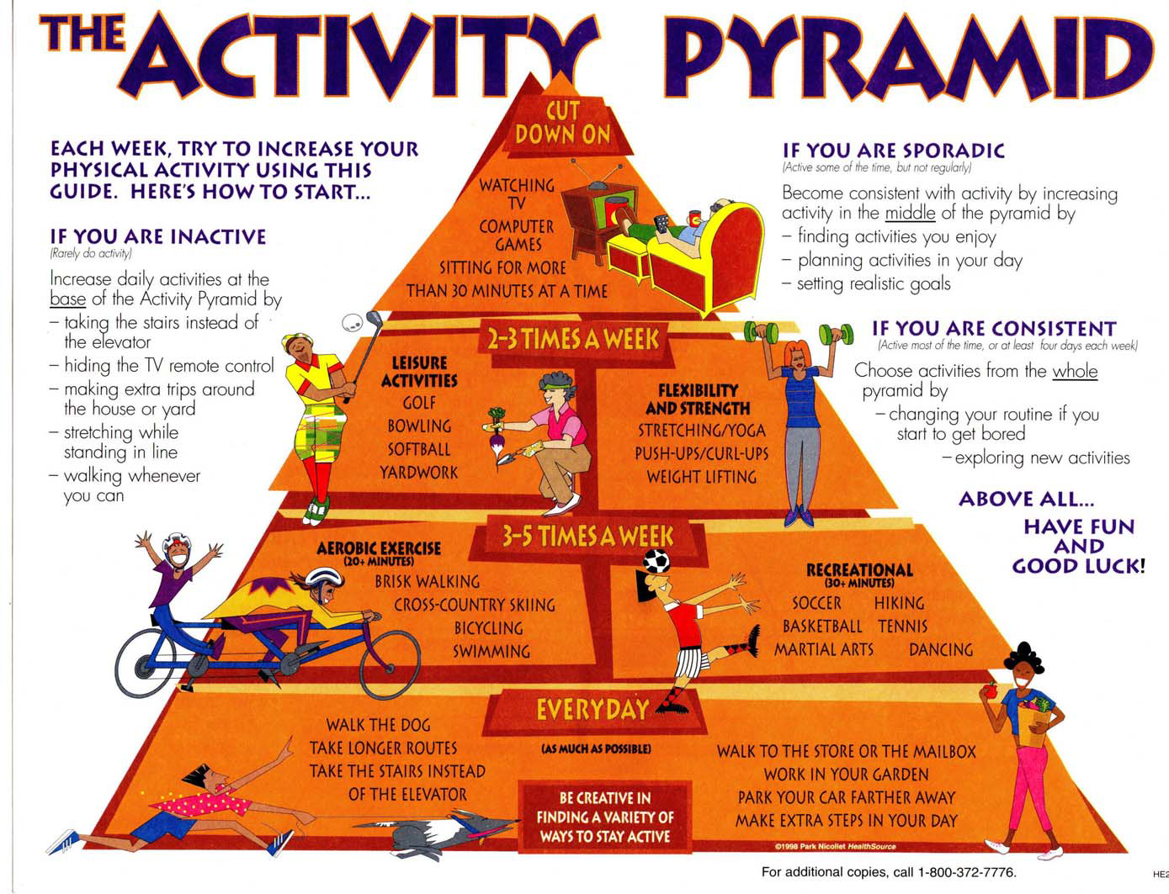

Slide 62
Effects of Physical Inactivity
Cardiorespiratory Fitness
Effects of Chronic Exercise Training
Components of an Exercise Prescription
Individualizing Exercise Prescription
Provider Resources

Slide 63
Internet Resources
Keys to Exercise Videos:
http://exerciseismedicine.org/keys.htm
Free Assessment Tools/Custom Exercise Plan:
http://www.myexerciseplan.com/assessment/
CDC Physical Activity Videos:
http://www.cdc.gov/physicalactivity/everyone/videos/index.html
Where to Walk:
http://www.walkinginfo.org/
AHA Walking Guide:
http://www.startwalkingnow.org/
ACSM Free Health/Fitness Fact Sheets:
http://www.acsm.org/access-public-information/brochures-fact-sheets/fact-sheets
CDC Weekly Exercise Examples:
http://www.cdc.gov/physicalactivity/downloads/pa_examples.pdf

Slide 64
Guidelines, Position Stands, Calculators
Physical Activity Guidelines:
http://www.cdc.gov/physicalactivity/everyone/guidelines/index.html
http://www.health.gov/PAGuidelines/
Dietary Guidelines for Americans:
http://health.gov/dietaryguidelines/
NHLBI BMI Calculator
http://www.nhlbisupport.com/bmi/
ACE Fitness Tools & Calculators
http://www.acefitness.org/calculators/default.aspx
Exercise is Medicine Campaign:
http://exerciseismedicine.org/
VA MOVE Program:
http://www.move.va.gov/
ACSM Position Stands:
http://www.acsm.org/access-public-information/position-stands

Slide 65
Pre-Participation Checklist (PAR-Q)
Has your doctor ever said you have a heart condition and that you should only do physical activity recommended by a doctor?
Do you feel pain in your chest when you do physical activity?
In the past month, have you had chest pain when you were not doing physical activity?
Do you lose your balance because of dizziness or do you ever lose consciousness?
Do you have a bone or joint problem (for example, back, knee or hip) that could be made worse by a change in your physical activity?
Is your doctor currently prescribing drugs (for example, water pills) for your blood pressure or heart condition?
Do you know of any other reason why you should not do physical activity?
**If you answer YES to any of these → seek medical opinion first

Slide 67
Questions??

Slide 68
References
Agha et al. Are Patients at Veterans Affairs Medical Centers Sicker?: A Comparative Analysis of Health Status and Medical Resource Use . Arch Intern Med 2000; 160(21):3252-3257.
Anokye NK, Lord J, Fox-Rushby J. Is brief advice in primary care a cost-effective way to promote physical activity? Br J Sports Med 2014; 48: 202-206.
Barnes PM, Schoenborn CA. Trends in adults receiving a recommendation for exercise or other physical activity from a physician or other health professional. NCHS data brief, no 86. Hyattsville, MD: National Center for Health Statistics. 2012; 86: 1-8
Bassett et al. Medical Hazards of Prolonged Sitting. Exerc Sport Sci Rev 2010; 38 (3): 101-2
DeVol & Bedroussian. An unhealthy America: the economic burden of chronic disease. Charting a new course to save lives and increase productivity and economic growth. http://www.milkeninstitute.org/pdf/ES_ResearchFindings.pdf
Ekblom-Bak E, et al. The importance of non-exercise physical activity for cardiovascular health and longevity. Br J Sports Med 2013; 48:233–238
Fiuza-Luces C et al. Exercise is the real polypill. Physiology 2013; 28(5):330-358
Garber et al. 2011 Quantity and quality of exercise for developing and maintaining cardiorespiratory, musculoskeletal, and neuromotor fitness in apparently healthy adults: Guidance for prescribing exercise. Med Sci Sports 2011; 1332-1359.
Handschin C, Spiegelman BM. The role of exercise and PGC1α in inflammation and chronic disease. Nature 2008; 454: 463-469.
Joyner, MJ. Standing up for exercise: should deconditioning be medicalized? J Physiol 2012; 590(pt 15): 3413-4
Joyner, MJ & Pedersen BK. Ten questions about systems biology. J Physiol 2011; 1017-30.
Kaminsky et al. The Importance of Cardiorespiratory Fitness in the United States: The Need for a National Registry. Circulation. 2013; 127: 652-662
Katzmarzyk & Janssen. The economic costs associated with physical inactivity and obesity in Canada: an update. Can J Appl Physiol 2004; 29 (1), 90-115
Kokkinos P, Myers J. Exercise and physical activity: clinical outcomes and applications. Circulation 2010; 122(16):1637-1648
Lee DC et al. Long-term effects of changes in cardiorespiratory fitness and body mass index on all-cause and cardiovascular disease mortality in Men: The Aerobics center Longitudinal Study. Circulation 2011;124(23): 2483-2490
Lee et al. Mortality trends in the general population: the importance of cardiorespiratory fitness. J Psychopharm 2010; 24:27-35
Lee I-M, Shiroma EJ, Lobelo F, et al. Effect of physical inactivity on major non-communicable diseases worldwide: an analysis of burden of disease and life expectancy. Lancet 2012; 380: 219–29.

Slide 69
References(Cont.)
Leijon et al. Factors associated with patients self-reported adherence to prescribed physical activity in routine primary health care. BMC Family Practice 2010; 11:38.
Lim et al. A comparative risk assessment of burden of disease and injury attributable to 67 risk factors and risk factor clusters in 21 regions, 1990–2010: a systematic analysis for the Global Burden of Disease Study 2010. Lancet 2012; 380: 2224–60
Littman et al. Physical Activity in a National Sample of Veterans. Med Sci Sports Exerc 2009; 41 (5), pp.1006-1013
Liu et al.Cardiorespiratory Fitness as a Predictor of Dementia Mortality in Men and Women. Medicine & Science in Sports & Exercise: 2012; 44 (2): 253–259
Maher et al. Reconsidering the sedentary behavior paradigm. PLoS ONE 2014; 9 (1): e86403
Matthews et al. Amount of time spent in sedentary behaviors in the United States, 2003-2004. Am J Epidemiol 2008; 167 (7):875-881
McAuley et al. Obesity paradox and cardiorespiratory fitness in 12,417 male veterans aged 40 to 70 years. Mayo Clin Proc 2010:85(2):115-121.
Morris, J and Crawford, M. Coronary Heart Disease and Physical Activity of Work. BMJ 1958; 2 (5111): 1485-1496.
Myers et al. Exercise capacity and mortality among men referred for exercise testing. N Engl J Med 2002; 346(11):793-801.
Naci, H and Loannidis, JP. Comparative effectiveness of exercise and drug interventions on mortality outcomes: metaepidemiological study. BMJ 2013; 347:f5577
Owen et al. Too Much Sitting: The Population-Health Science of Sedentary Behavior. Exerc Sport Sci 2010. Rev 38:105-113
Partnership to Fight Chronic Disease. http://www.fightchronicdisease.org/facing-issues/about-crisis
Pedersen BK, Saltin B. Evidence for prescribing exercise as therapy in chronic disease. Scand J Med Sci Sports. 2006 Feb;16 Suppl 1:3-63.
Slentz et al. Effects of the amount of exercise on body weight, body composition, and measures of central obesity: STRRIDE--a randomized controlled study. Arch Intern Med 2004; 164(1): 31-9
The Council of State Governments 2006. Costs of chronic diseases: What are the States facing? www.healthystates.csg.org/NR/rdonlyres/...4119.../Trends_Alert.pdfSimilar
Wang et al. Health and economic burden of the projected obesity trends in the USA and the UK. The Lancet 2011; 378 (9793): 812-825.
Wen and Wu. Stressing harms of physical inactivity to promote exercise. Lancet 2012; 380 (9838), pp. 192-193. S0140-6736(12)60954-4

