Slide 1
The Integrative Healthcare and Wellness (IHW) Program
Amanda Hull, PhD
Michael ‘Cory’ Jecmen, M.Ac, L.Ac
War Related Illness & Injury Study Center (WRIISC)
Washington D.C.

Slide 3
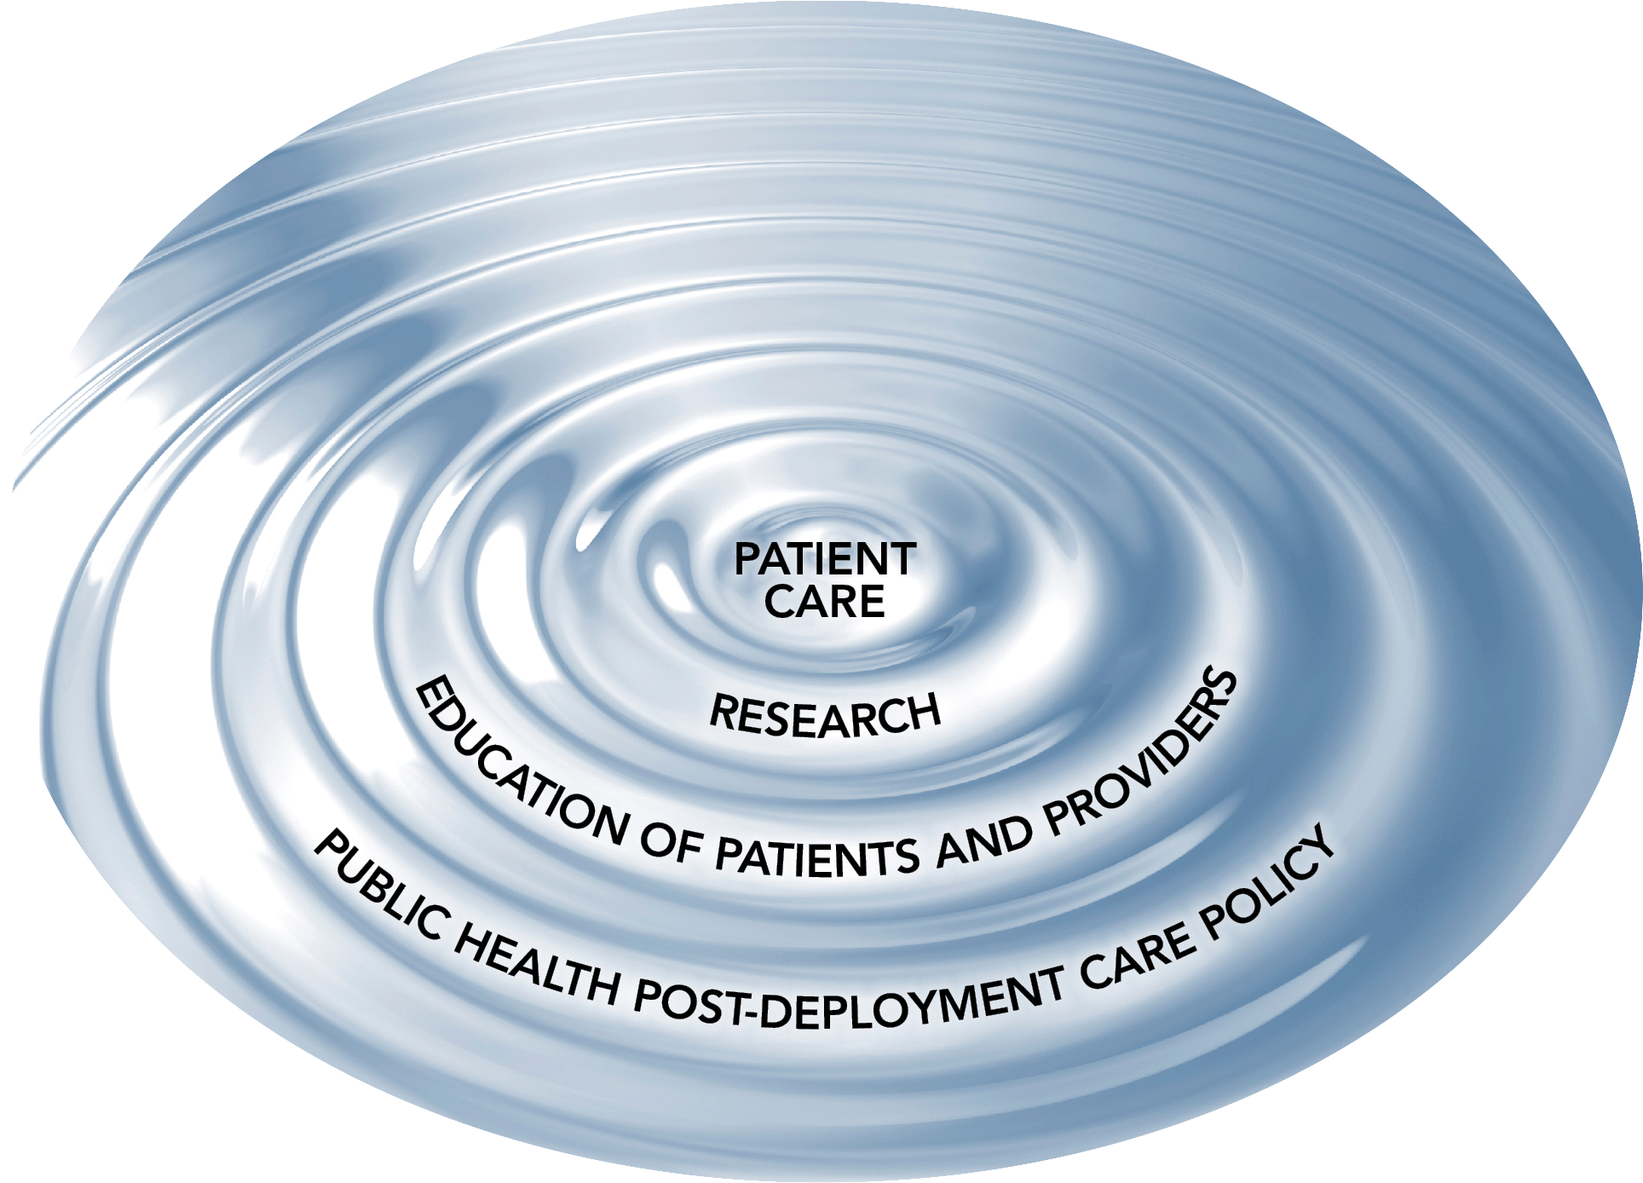
The WRIISC and Post-Deployment Health Care
War Related Illness and Injury Study Center
-VA Office of Public Health and Environmental Hazards
National referral program
A model for Patient Centered Care

Slide 4
Complementary Care within WRIISC at DCVAMC
First response: provide the highest quality traditional western medical care available
Target isolated disease states such as headaches, insomnia or back pain and at times may miss the more complex, multi-system dysfunction
Sometimes results are not completely satisfactory
Residual pain, disability, suffering
Side effects of treatments
Veterans, their families, and their care providers seek additional beneficial therapy

Slide 5
The Birth of Integrative Care within WRIISC
Identified need for coordinated treatment approaches
The emerging literature indicates that complementary integrative medicine (CIM) approaches augment standard medical treatments to enhance positive outcomes for individuals with chronic disease, mental health disorders, and multi-symptom illness (CMI)
Dr. Bonnie Benetato initiated
development of complementary modalities

Slide 6
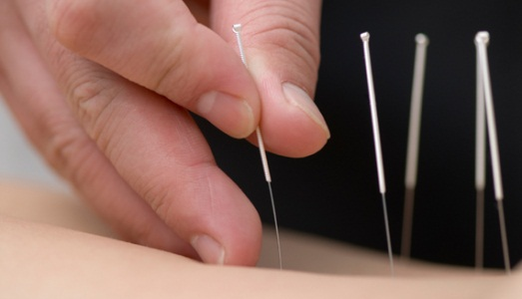
WRIISC Integrative Medicine History
WRIISC-DC has provided complementary and integrative medicine (CIM) treatments to Veterans since 2007.
Acupuncture –
Group and Individual
Yoga Nidra - Group
Health Education Group
Integrative Restoration (iRest®) Yoga Nidra
and acupuncture = broad-spectrum treatments.
Target multiple biological systems simultaneously, and thus, may be well suited for complex chronic illnesses that Veterans of all war eras are facing.

Slide 7
WRIISC Integrative Medicine History
Through “word of mouth” recruitment alone, the WRIISC-DC has successfully attracted Veterans to these CIM treatments:
1,402 total iRest® and acupuncture patient encounters in 2009
2,159 total iRest® and acupuncture patient encounters in 2010
Clinicians have grown accustomed to referring for CIM interventions, particularly for Veterans with chronic, difficult to treat conditions.
Clinics receive ongoing referrals without solicitation from multiple services , including - Pain Clinic, Neurology Service, Mental Health Service, Trauma Services, Social Work, Primary Care, Hematology, Rehab Medicine, Geriatric, and Women’s Clinic
Veterans demonstrate a high level of acceptability for both acupuncture and iRest® Yoga Nidra interventions

Slide 8
Findings
Clinical experience and preliminary findings suggest that Veterans report tremendous benefit from CIM treatments for both physical and mental health disorders and are thoroughly satisfied with the care.
Preliminary satisfaction data (2010)=
Veterans in the acupuncture clinic (n = 130) reported complete or partial improvement in symptoms (96%), good to excellent quality of care (99%), and 99% would recommend acupuncture to another Veteran
Veterans in the iRest® Yoga Nidra clinic (n = 184) reported complete or partial improvement in symptoms (95%), very good to excellent quality of care (96%), and 100% would recommend iRest® Yoga Nidra to another Veteran.
Additionally, demand has steadily increased

Slide 9
Direct Quotes from WRIISC-DC Veterans enrolled in the CIM Program
“I feel more rested after the meditation class than I did after a night of sleeping” “Words can’t describe how much meditation has helped me and continues to help.” “Meditation gives you the opportunity to put some space between you and your circumstances and it feels good.” “The acupuncture program has given me the mental space to help myself get better.” “I finally have less pain. I didn’t believe acupuncture could do that until it happened to me.” “One acupuncture treatment had a profound effect on the pain in my neck – I couldn’t believe it.”

Slide 10
Integrative Healthcare and Wellness (IHW) Program
Building on the WRIISC-DC satisfaction data, clinical experience, and increasing demands for CIM services + the evidence supporting CIM for complex chronic illnesses
WRIISC-DC created a cohesive CIM clinic for Veterans = Integrative Healthcare and Wellness (IHW) Program
IHW Program Services
Individual Acupuncture
Group Auricular Acupuncture
iRest® Yoga Nidra
Health Education Group
Qigong
Chair yoga

Slide 11
Integrative Healthcare and Wellness (IHW) Program
Consult Service
All Veterans must have a consult submitted by a VA provider in order to participate in the IHW Program
Orientation Session
All Veterans attend a 1 hour Orientation Session before participating in offered services (offered 1x/week)
Purpose: provide Veterans with information regarding details of the IHW Program and fill out baseline questionnaires

Slide 12
Integrative Healthcare and Wellness (IHW) Program
Clinical Questionnaires
Filled out at baseline (Orientation Session), 4, 8, 12 weeks from baseline, & 6, 9, 12 months from baseline
Research
For those who consent to research, clinical questionnaires, satisfaction surveys, & electronic medical records are used to assess outcomes of the IHW Program

Slide 13
Research Protocol
Research component
= IRB/R& D approved pilot study
The primary goal = systematically evaluate
patient outcomes and satisfaction for those
in the IHW Program
Secondary goals:
Provide feasibility and health
care utilization data
Use the results to help direct future
research (RCT trials for CIM interventions)
Determine if this program enhances
health service delivery of CIM modalities

Slide 14
Clinical Questionnaires | Baseline (Orientation Session) | Initial Follow-up (4, 8, 12 weeks from baseline) | Longitudinal Follow-up (6, 9, 12 months from baseline)
Demographics
Demographic Questionnaire | √
Physical and Mental Health Functioning
MYMOP-2ª | √ | √ | √
SF-36^{b} | √ | √ | √
PSS ^{c} | √ | √ | √
BDI-II^{d} | √ | √ | √
Pain
Pain Disability Index | √ | √ | √
Defense/Veteran Pain Rating Scales | √ | √ | √
Sleep Disturbance
Insomnia Severity Index | √ | √ | √
Veteran Satisfaction
IHW Program Satisfaction Questionnaire |  | √ | √
ªMeasure Yourself Medical Outcome Profile ^{b}Medical Outcomes Study Short Form-36; ^{c}Perceived Stress Scale, ^{d}Beck Depression Inventory-II

Slide 15
Relevance
Research will help better understand the potential for CIM modalities in treating Veterans with chronic physical and mental health conditions.
Relevance in the following areas:
Clinical Care
Health Service Delivery
Patient-Centered Care
Scientific Knowledge

Slide 16
About 1 year in…
740 Total Consults (including our prior waitlist)
For those that we recorded information on, we are receiving consults from the following places:
Note: Other= Social Work, Polytrauma, Rehab, ENT, Oncology, Ortho, and Walk-In’s
Neurology/Pain Clinic | 187
Psychology | 216
Primary Care | 185
Women’s Clinic/GYN | 37
CBOC | 15
Hematology | 5
Geriatric | 14
Other | 64
Total | 723

Slide 17
About 1 year in…
Of our 66 orientations held over the past year:
328 participants enrolled in the IHW program
226 of those have consented (69% Initial Consent Rate)
Of those:
 | Yoga Nidra | Group Acupuncture | Individual Acupuncture | Health Education Group
Provider Recommendation on Consult | 106 | 98 | 174 | 44
Participants Interest Post Orientation | 186 | 195 | 246 | 120

Slide 18
Sample Characteristics
Brief Demographics:
68% Males, 32% females
Average age = 51.62 years (age range 23-81 years)
Baseline Data (N =226)
Note: On MYMOP-2, 100% of sample reported pain or mental health symptoms as #1 symptom of concern
Questionnaires | Score | %ile/Range
SF-36
Transformed Mental | t = 38.5 | 12th %ile
Transformed Physical | t = 33.9 | 5th %ile
ISI | 18.7 | 0-28
PDQ | 88.26 | 0-150
VA/DoD Pain | 24.8 | 0-40
BDI-II | 25.47 | 0-63
PSS | 22.2 | 0-40

Slide 19
Future Directions
Expand services in the IHW Program
Acupuncture groups (tailored)
Nutritional psychology interventions
Massage
Increase behavioral health interventions
Integrative medicine physician consultation (for both IHW Program and WRIISC National Referral Program)
Use data to formulate an RCT

Slide 20
Barriers to CIM at VA
Clinical barriers
Supply and Demand Issue
Occupational Codes (in the works)
Attaining functional labs
Prescribing supplement protocols
Research Barriers
Formulating RCT’s and research protocols that include controls without taking away the patient-centered quality of CIM modalities

Slide 21
Questions/Comments?

Slide 22
Acknowledgements
List of WRIISC personnel on the study:
Matthew J. Reinhard, Psy.D., Amanda Hull, Ph.D., Jeanette Akhter, M.D., M.Ac., Michael “Cory” Jecmen, M.Ac, L.Ac., Alaine Duncan, M.Ac, L.Ac, Dipl.Ac., Karen Soltes, L.C.S.W., R.Y.T., Kelly McCoy, Psy.D., Katharine Bloeser, L.I.C.S.W, Erika Roberge, B.A., Lauren Roselli, B.A., Nathanial Allen, B.S., Brooke Adams, B.S., Christine Eickhoff, M.S.
Washington DC Veterans Affairs Medical Center
Funding: WRIISC-DC

Slide 23
References
1. Schult, T., Awosika, E., Hodgson, M., Dyrenforth, S. (2011). Disparities in Health Behaviors and Chronic Conditions in Health Care Providers in the Veterans Health Administration. Journal of Occupational & Environmental Medicine, 53(10), 1134-1145.
2. Hammond, M. & Vandenberg, P. (2011) Complementary and Alternative Medicine. Healthcare Analysis and Information Group.
3. Carson JW, Carson, K.M., Jones, K.D., Bennett, R.M., Wright, C.L., & Mist, S.D. (2010). A pilot randomized control trial of the Yoga of Awareness program in the management of fibromyalgia. Pain, 151, 530-539.
4. Zeidan F, Johnson, S.K., Diamond, B.J., David, Z., & Goolkasian, P. (2010). Mindfulness meditation improves cognition: Evidence of brief mental training. Consciousness and Cognition: An International Journal, 19, 597-605.
5. Kwekkeboom KL, Cherwin, C.H., Lee, J.W., & Wanta, B. (2010). Mind-body treatments for the pain-fatigue-sleep disturbance symptom cluster in persons with cancer. Journal of Pain and Symptom Management, 39, 126-38.
6. Grandt, P. (2009). Pain sensitivity and analgesic effects of mindful states in Zen meditators: A cross-sectional study. Psychosomatic Medicine, 71, 106-14.
7. Toneatto T. & Nguyen L. (2007). Does mindfulness meditation improve anxiety and mood symptoms? A review of the controlled research. Canadian Journal of Psychiatry, 52, 260-266.
8. Greeson, J. (2009). Mindfulness research update. Complementary Health Practice Review, 14,10-18.
9. Grossman, P., Niemann, L., Schmidt, S., Walach, H. (2004). Mindfulness-based stress reduction and health benefits: A meta-analysis. J Psychosom Res, 57, 35-43.
10. Gregg, J., Callaghan, G., Hayes, S., Glenn-Lawson, J. (2007). Improving diabetes self-management through acceptance, mindfulness, and values: A randomized controlled trial. Journal of Consulting and Clinical Psychology, 75, 336-343.

Slide 24
References
11. Zhao, C., Stillman, M., & Rozen, T. (2005). Traditional and evidence-based acupuncture in headache management: theory, mechanism, and practice. Headache, 45, 716-30.
12. Lee, C., Wallerstedt, D., Duncan, A., York, A., Hollifield, M., et al. (2011). Design and rational of a comparative effectiveness study to evaluate two acupuncture methods for the treatment of headaches associated with traumatic brain injury. Medical Acupuncture, 23, 124-132.
13. Murray, L. & Kim, H. (2004). A review of select alternative treatment approaches for acquired neurogenic disorders: relaxation therapy and acupuncture. Seminars in Speech and Language, 25(2), 133-149.
14. Acupuncture. (1997). NIH Consensus Statement Online, 15(5):1-34.
15. Bullock, M., Kiresuk, T., & Sherman, R. (2002). A large, randomized placebo controlled study of auricular acupuncture for alcohol dependency. Journal of Substance Abuse Treatment, 22, 71-7.
16. Melchart, D., Linde, K., Fischer, P., White, A., Allais, G. & Vickars, A. (1999). Acupuncture for recurrent headaches: A systematic review of randomized controlled trials. Cephalagia, 19, 779-786.
17. Berman, B., Ezzo, J., Hadhazy, V., & Swyers, J. (1999). Is acupuncture effective in the treatment of fibromyalgia? Journal of Family Practice, 48, 213-8.
18. Wang Z. (2001). Auricular acupuncture: A potential treatment for anxiety. Anesthesia and Analgesia, 92, 48-53.
19. Hollifield, M., Sinclair-Lian, N., Warner, T., & Hammerschlag, R. (2007). Acupuncture for post-traumatic stress disorder. Journal of Nervous and Mental Disease, 195, 504-513.
20. Hull, S., Page, C., Skinner, B., Linville, J., Coeytaux, R. (2006). Exploring outcomes associated with acupuncture. Journal of Alternative and Complementary Medicine, 12, 247-254

