Slide 1
Integrating Post-Combat Care into VA Health Care
Stephen C Hunt MD MPH
Director, Post-Deployment Integrated Care Initiative
WRIISC Conference Washington DC
August 9, 2011

Slide 2
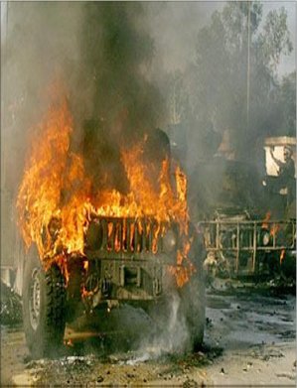
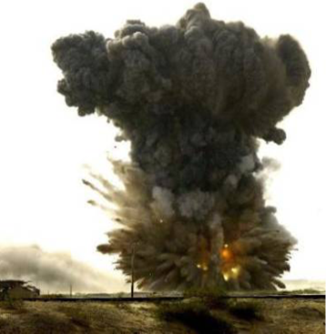
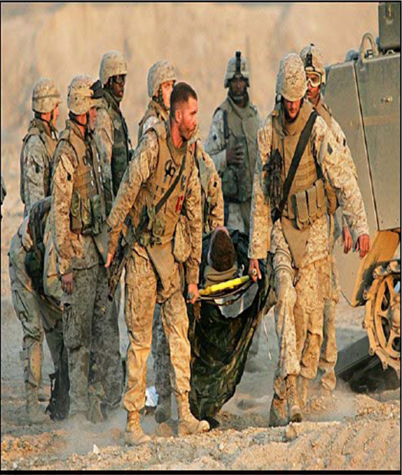
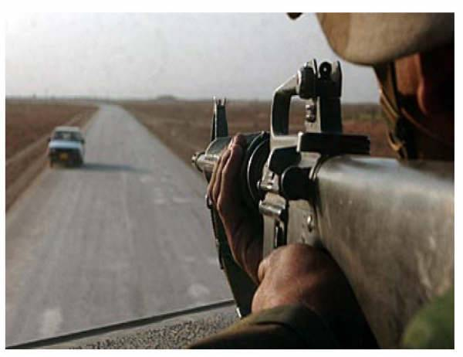
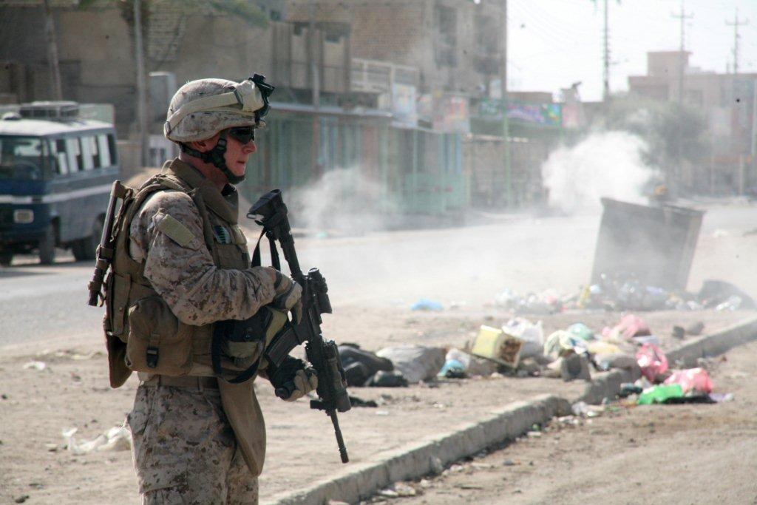
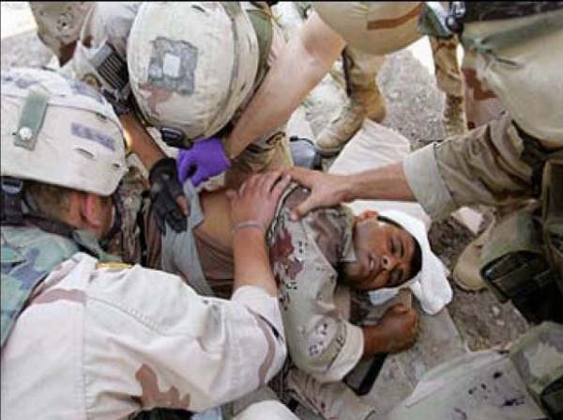
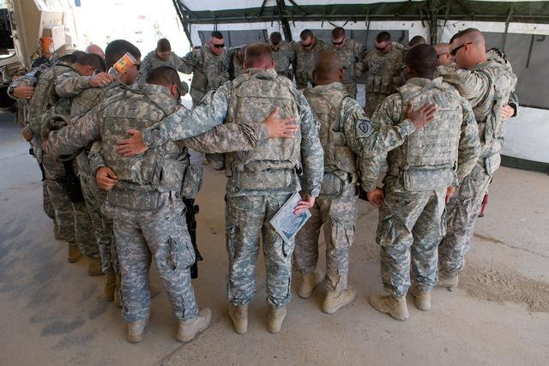
What are the health care needs of our returning combat Veterans?

Slide 3
How does a 26 y/o Combat Veteran differ from a 26 y/o who has not had a combat deployment? How might their health care needs differ?

Slide 4
Health Concerns of Combat Veterans
Some health concerns are consistent after every war while others are unique to each conflict:
Most common conditions for all conflicts:
Musculo-skeletal injuries with pain
Diagnosable mental health conditions
Unexplained symptoms
Dental
Hearing
Unique to conflict
WW I poison gas; trench warfare with artillery blast exposure
WW II Cold injury (European);PUD and GI complaints
Korea: Cold injury
Vietnam: Agent Orange
PGW I: Unexplained Medical Symptoms
OEF/OIF: TBI/Polytrauma

Slide 5
What are the health concerns of OEF/OIF/OND veterans seen in the VA?
1,285,631 of the 2.2 million deployed, are separated and eligible for VA
50 % have been seen in VA between FY02 and April 2010
Musculoskeletal 54.7%
Mental disorders 50.7%
Symptoms/signs 49.2%
Nervous system (hearing) 42.5%
GI (dental) 35.2%
Endocrine/Nutrition 29.7%
Injury/Poisoning 27.5%
Respiratory 24.9%
VHA Office of Public Health and Environmental Hazards
April 2011

Slide 6
Since 2002 approximately 620,000 OEF/OIF/OND Veterans have been seen in VA facilities. A total of 331,514 unique patients have received one or more mental health diagnoses
Disease Category (ICD 9: 290- 319) | Percentage
PTSD | 27.8%
Depressive Disorders | 20.4%
Neurotic Disorders | 17.2%
Affective Psychosis | 12.2%
Alcohol Dependence | 5.7%
Nondependent Abuse of Drugs | 3.9%
Specific Non-psychotic Mental Disorder due to Organic Brain Damage | 3.6%
Special Symptoms, Not Elsewhere Classified | 3.4%
Sexual Deviations and Disorders | 2.9%
Drug Dependence | 2.8%
This data excludes PTSD data from the VA Vet centers, the 90,303 with tobacco use disorder, the 22,156 with alcohol use disorder and the 17,188 with both TOB and ETOH but no other MH disorder.
Cumulative from 1st Quarter FY 2002 through 1st Quarter FY 2011

Slide 7
Co-morbid Concerns in Combat Veterans
Lew, Otis, Tun, Kerns, Clark, & Cifu, 2009 JRR&D
Sample = 340 OEF/OIF outpatients at Boston VA
TBI/Pain
12.6%
TBI
PAIN
10.3%
5.3%
P3 Multi-symptom
Disorder
6.8%
Pain/PTSD
TBI/PTSD
42.1%
16.5%
Overall prevalence:
Pain 81.5%
TBI 68.2%
PTSD 66.8%
PTSD
2. %

Slide 8
Our 26 y/o Combat Veteran is more likely to have:
physical injuries
be taking opioid pain medications
diagnosable mental health conditions
as well as sub-syndromal mental health issues
unexplained symptoms with general health decline
hearing problems
dental problems
psychosocial distress: marital, occupational, financial, social
risk of injury/death from “incidental trauma”
At least a 2-3 fold increased risk of suicide
And he is much less likely to show up for his appointments!

Slide 9
Our 26 y/o Combat Veteran is more likely to need:
Deployment focused care
Pain management intervention
Evidence based MH care
MH support for MH issues not meeting criteria for specific diagnosis
Behavioral health support: health recovery
Expedited dental care (within 6 months of discharge)
ETOH/SUDs intervention
Support for: marital, vocational rehabilitation, securing employment, temporary financial, temporary housing
Expedited compensation claim
Ongoing monitoring for suicide risk

Slide 10
What are the stressors of war?
Physical
injury noise
temperature sleep deprivation
diet austere conditions
toxic agents infectious agents
multiple immunizations blast wave/head injury

Slide 11
What are the stressors of war?
Psychological
anticipation of combat
combat trauma
non-combat trauma
separation from family/home
deprivation

Slide 12
What are the stressors of war?
Psychosocial
Marital/parenting issues
Social functioning
Occupational/financial concerns
Risk of re-deployment
Spiritual / existential

Slide 13
Integrated Post-Combat Care
Physical
Psychological
Veteran
Psychosocial

Slide 14
Integrated Post-Combat Care
PCP
MH
Veteran
SW
OEF/OIF/OND PM
TPA/CM

Slide 15
Rationale for Implementation of
OEF/OIF Programs and PDICI
We recognized unique needs in returning combat Veterans:
High prevalence of physical injury, pain, TBI risk and mental health co-morbidities
Need for integration of medical care, mental health care, polytrauma, SW and pain management support
Need for research, training and consultation (MH, Polytrauma, WRIISCs)
High rates of psychosocial impairments impacting marriages, families, financial and occupational domains
Need for SW involvement and benefits counseling as a standard of care

Slide 16
Rationale for Implementation of
OEF/OIF Programs and PDICI
We recognized unique needs in returning combat Veterans:
High risk of functional decline in early months and years post-deployment; increased suicide risk
Need for more intensive SW case management/care management
Recognition that mainstream primary care not prepared to effectively meet the needs of this population
Need for Clinical Champions/ “points of service”
Need for enhanced training:
PDICI
Discipline specific
Rural Health Initiatives (Post-Deployment modules, MH, pain)
WRIISCs/VHIs
DoD/DCoE trainings

Slide 17
Post Combat Care and the
Patient-Centered Medical Home
Care Coordination & Care Management
Team Function and Culture
Patient Centeredness
Notes:
The available evidence in the literature supports these major domains of the patient-centered medical home. Most of the data that follows is focused on care coordination and care management, especially chronic disease management strategies. However, patient centered medical homes that target their intervention towards one to three of these domains have shown cost, utilization, and satisfaction improvements.

Slide 18
Team members
Clinical Pharmacy Specialist: ± 3 panels
Clinical Pharmacy anticoagulation: ± 5 panels
Social Work: ± 2 panels
Case Manager
Integrated Behavioral Health
Psychologist ± 3 panels
Social Worker ± 5 panels
Care Manager ± 5 panels
Psychiatrist ± 10 panels
PCP
RN Care Manager
Clinical Associate (LPN, MA, or Health Tech)
Clerk
Nutrition: ± 5 panels
Veteran
OEF/OIF/OND Program Manager, TPA/CM
Pain
SUDs
Polytrauma
OEF/OIF/OND PACT
(Patient Aligned Care Team)

Slide 19
PCP
Clinical Associate (LPN, MA, or Health Tech)
Clerk
RN Care Manager
Psychiatrist ± 10 panels
Care Manager ± 5 panels
Social Worker ± 5 panels
Psychologist ± 3 panels
Integrated Behavioral Health
Case Manager
Nutrition: ± 5 panels
Social Work: ± 2 panels
Clinical Pharmacy anticoagulation: ± 5 panels
Clinical Pharmacy Specialist: ± 3 panels
Core
Team members
OEF/OIF/OND
Program staff PM/CM/SW
Veteran
C+P
VBA
PT
PACT for special populations
with support and training.
The PACT expands as needed
to meet the Veteran’s needs .
Ortho
Substance Abuse
Chaplain
WRIISC
Specialty Mental
Health
Pain
Teamlet
Vet Centers
Polytrauma
Neurology
PIDICI Champ
OEF/OIF/OND Consult Team

Slide 20
Directions for the Future
Continuing to formalize the concept of Post-Deployment Care
Developing “point of service” and clinical champions for post-deployment care
Integrating work of Environmental Clinicians/Registry Programs, PACT based post-deployment care, the WRIISCs and C&P
Development of Occupational and Environmental Medicine assets in VA

Slide 21
Directions for the Future
Develop institutional memory in VA and DoD for future deployments
Clinical Research on “War Related Illness and Injury"
Post-Combat Care Wiki
DoD/VA Collaboration with “war time contingencies”
Integrated DoD/V Post-Combat Care implementation at the time of deployment
War time Research Council to coordinate research and clinical implementation (link WRIISCs, DCoEs, etc)
War time Clinical Coordinating Council

Slide 22
“Caring for those who have borne the battle, for their spouses and their children…” Post-Combat Care: The Foundation, Heart and Soul of VA
Stephen C Hunt MD MPH
Director, Post-Deployment Integrated Care Initiative
WRIISC Conference Washington DC
August 9, 2011

