Slide 1
Polytrauma Network Site Services
Presented by:
Esmeralda Madrigal
Stefanie Chin

Slide 2
Our Mission
The PSC offers a unique mission to care for recently injured returning active
duty service members (ADSM) and veterans.
Mission:
The PSC is dedicated to providing rehabilitation services that restore physical, intellectual, communicative, psychosocial and vocational skills, and to facilitating the transfer of those skills from the hospital setting to daily life. Such services include, but are not limited to, inpatient rehabilitation, outpatient rehabilitation, emerging consciousness programs, transitional rehabilitation, day programs, and community re-entry programs.

Slide 3
Definition of Polytrauma
“Polytrauma” is a new medical term that evolved to describe unique, complex patterns of injuries from OEF/OIF:
Complex, multiple injuries occurring as a result of same event
Unpredictable patterns including brain injury, amputation, hearing and vision impairments, spinal cord injuries, psychological trauma, and musculoskeletal wounds
Individuals with polytrauma require extraordinary level of integration and coordination of medical, rehabilitation, and support services
Brain Injury is primary injury that drives care
Higher level of acuity due to severity of injuries
Simultaneous treatment of multiple injuries
Sequence and integrate therapies to meet patient need
Coordinate interdisciplinary team effort with expanded team of consultants

Slide 4
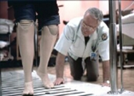
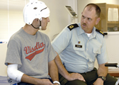
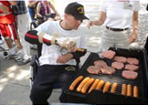
VAPAHCS Rehabilitation Programs
VAPAHCS has four rehabilitation programs under the Polytrauma System of Care.
Polytrauma Rehabilitation Center (PRC)
Inpatient Acute Rehabilitation, Brain Injury
Comprehensive Rehabilitation Center (CRC)
Inpatient Acute Rehabilitation, General Rehabilitation
Polytrauma Transitional Rehabilitation Program (PTRP)
Residential /Outpatient Day Program
Polytrauma Network Site (PNS)
Outpatient Clinic

Slide 5
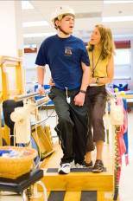
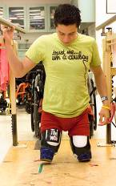
Polytrauma Rehabilitation Center (PRC)
Multidisciplinary preadmission review to develop a customized treatment plan
4 clinical pathways-emerging consciousness, sub-acute, acute and short-stay TBI evaluation
CARF accredited
Provides inpatient acute care for full range of brain injuries and associated injuries
Notes:
Emerging consciousness program Located at 4 Polytrauma Rehabilitation Centers
Provides specialized care for patients with lower levels of responsiveness
Program based on existing evidence and subject matter experts’ input from private sector and VA
Provides interdisciplinary medical, nursing, rehabilitation services to:
Improve responsiveness/ return to consciousness
Optimize long term functional outcomes after severe brain injury
Facilitate advancement to next phase of rehabilitation
Individualized stimulation program, intensive social work and case management, active therapy involvement of family
Research and evaluate outcomes
18 beds
12-PRC and 6 CRC:
FY09 highlights from our outcome indicators
92% patient satisfaction
100% minimally conscious patients achieving functional communication
93% staff retention
Total Average Functional Independence Measure (FIM) score 3 months after discharge 109.9 (VA National Average 108.3)
TBI/Vision program continues to be regarded as one of the lead VA centers in the nation.
Developed an interdisciplinary pathway for minimally conscious patients
Our program participated in collaborative efforts with the other Polytrauma centers to establish a partnership with TBI Model Systems.
In partnership with our Office of Information Technology, we implemented an electronic scheduling board.
Staff acknowledgements : Dr. Sandy Lai and Renee Magana nominated for the Olin Teague Award, Laura Howe recipient of the Early Career Award by the National Academy of Neuropsychology

Slide 6
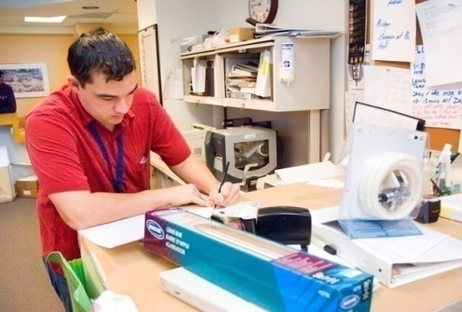
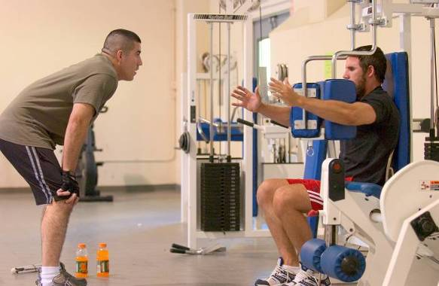
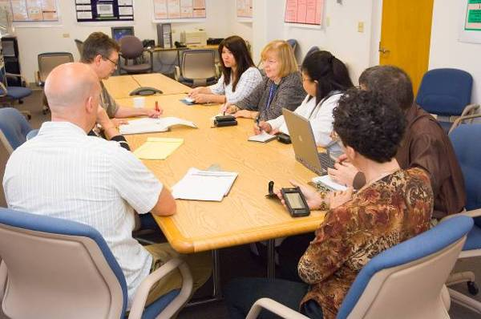
Polytrauma Transitional Rehabilitation Program (PTRP)
Post-acute day treatment program for individuals with moderate to severe TBI
CARF Accredited
Hybrid residential/outpatient program
12 Residential Beds
Off-site apartments (Moffett Field)
Notes:
Located at 4 Polytrauma Rehabilitation Centers
Provides interdisciplinary rehabilitation for patients in a 10-bed home-like unit for individuals requiring
FY09 highlights from our outcome indicators
80% of residents have transitioned to independent community living
100% of residents have successfully completed coursework or volunteer position before discharge
100% patient satisfaction
We have 12 bed-capacity, including 2 private rooms
Goal is to maximize independent living and return to meaningful activity
Need for a continuum of services that would extend beyond acute care
Programming includes Physical Health/Wellness, Cognitive Rehabilitation, Psychosocial Adjustment, Independent Living Skills, and Therapeutic Leisure Activity
Program uses a Phase Model to accommodate individuals at different functional levels and provides structure for progression into independent living
Return to School and Return to Work Programs are built into Phase Model
All residents have the opportunity to attend school or complete a volunteer/work rotation prior to discharge

Slide 7
Polytrauma Network Site (PNS)
Outpatient blast injury/TBI evaluative clinic
At Palo Alto, we evaluate anyone with a positive TBI screen
Manage stable Polytrauma sequelae
Proactive follow-up ensuring comprehensive outpatient Polytrauma care in VISN 21
Facilitates Polytrauma education in VISN 21
Provides family support

Slide 8
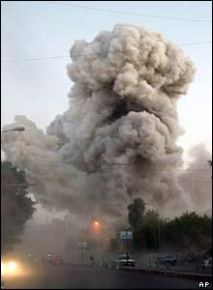
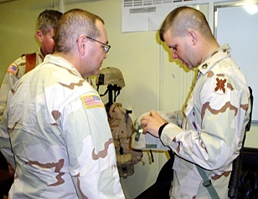
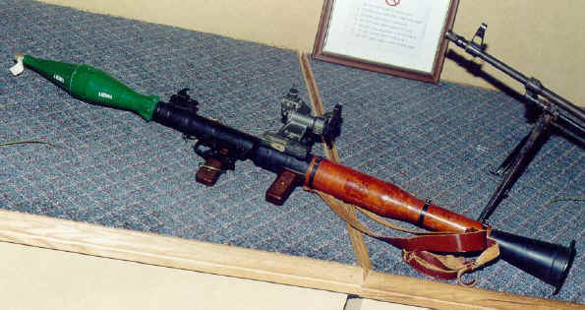
Nature of Injuries
Improvised Explosive Devices (IED)
Rocket-propelled Grenades (RPG)
Landmines
Mortars
Hand Grenades
Snipers
MVA
Assaults
Falls
Any other blows to the head

Slide 9
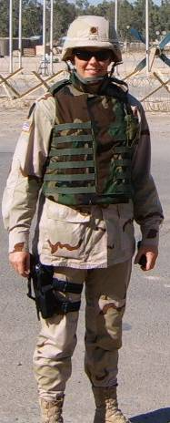
Many issues following deployment are not visible
Ringing in ears- Audiology
Blurred vision/light sensitivity-
Eye Clinic
Poor memory/concentration-
Neuropsychology/Speech
Depression/PTSD-
Trauma Services
Back Pain, Headaches-
Primary Care, Neurology
and PM&R
OIF/OEF Normal Appearance Team Approach

Slide 10
American Congress of Rehabilitation Medicine Criteria for Mild TBI
Traumatically induce physiologic disruption of brain function as indicated by at least one of the following:
Any period of loss of consciousness
Any loss of memory for events immediately before or after the accident
Any alteration in mental state at the time of the accident
Focal neurologic deficits that may or may not be transient
Severity of the injury does not exceed:
Loss of consciousness of 30 min
GCS score of 13-15 after 30 min
Posttraumatic amnesia of 24 hr
*Kay, T., Harrington, D.E., et. al. (1993)

Slide 11
Criteria for Severity of TBI
Mild | Moderate | Severe
Altered or LOC < 30 min* with normal CT &/or MRI | LOC < 6 hours with abnormal CT &/or MRI | LOC > 6 hours with abnormal CT &/or MRI
GCS 13-15 | GCS 9-12 | GCS < 9
PTA < 24hr | PTA < 7days | PTA > 7days
* Without this the Veteran did NOT sustain a TBI

Slide 12
PNS Scope of Clinical Services
Provide specialized interdisciplinary post-acute rehabilitation services; inpatient and outpatient
Continued management of existing and emerging sequelae
Manage rehabilitation plan developed at PRC
Manage new polytrauma patients in consultation with PRC
Identify resources for VA and non-VA care across the VISN
Provide proactive clinical and psychosocial case management; continued support for families
Provide regular follow-up care, check-ups
Coordinate services between VHA, VBA, DOD, private sector (fee-basis)

Slide 13
PNS Patient Demographics
VAPAHCS has evaluated approx 1,300 patients for mTBI
Consult driven referral system
Mostly male, aged 21-38 years old
Active duty service members and veterans
FY 08 to present:
TBI dx: 75%
PTSD/Mental Health dx: 64.2%
MSK/pain dx: 31.3%
Variety of psychosocial factors impact functioning
Social Isolation
Substance Use and/or abuse

Slide 14
Who is Appropriate for Referral to Polytrauma Outpatient Clinic?
OEF/OIF patients who have positive TBI screen: refer for TBI second level evaluation which is a 2 hr appointment
Patients with history of TBI and current functional impairments: refer for PNS MD "followup" which is a 1 hr appointment slot
Unlike some PNS across the country, VAPAHCS PNS also evaluates non-OEF/OIF patients who have known or suspected TBI
PNS MD determines if history is consistent with TBI, and determines if pt has functional impairments that would benefit from PNS interdisciplinary services
Only PNS MDs may refer to PNS disciplines (PT, OT, SLP, RT, Neuropsychology, case management)

Slide 15
PNS Referral Process
Referrals and transfers are coordinated by the Social Work case managers and/or nurse case manager
In consultation with the PNS physiatrist as needed
Referrals can be made by telephone contact if outside the VA or by consultation within the VA
The SW will facilitate the enrollment process if needed
Tricare authorization needed prior for active duty service members
Medical records requested, if available

Slide 16
Specialized Rehabilitation Team
PNS teams include: Physiatry, Nursing, Occupational/Physical/Recreational therapy, Speech Language Pathology, Optometry, Social Work and Neuropsychology
Interdisciplinary team approach to care
Patient/family focused care
CARF Accreditation since 2010
Tele Rehabilitation PNS evaluations conducted using V-tel technology

Slide 17
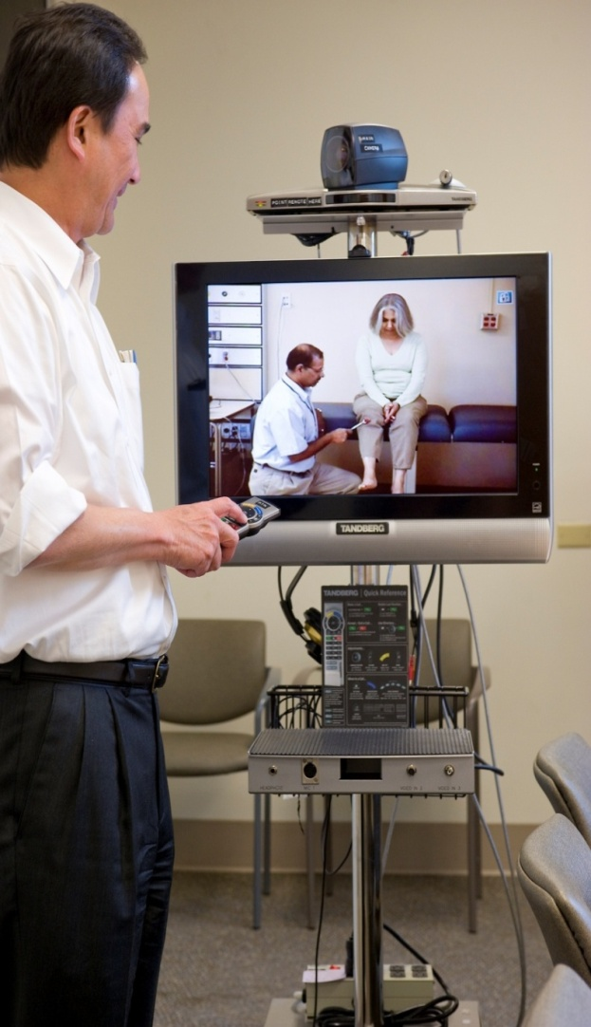
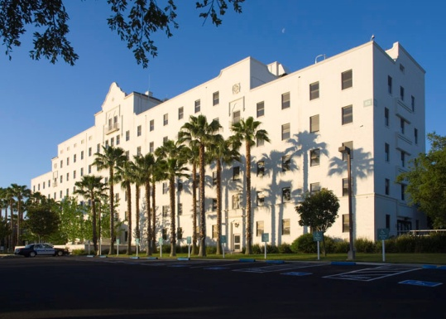
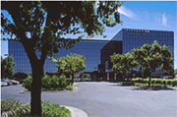
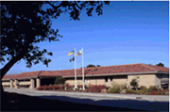
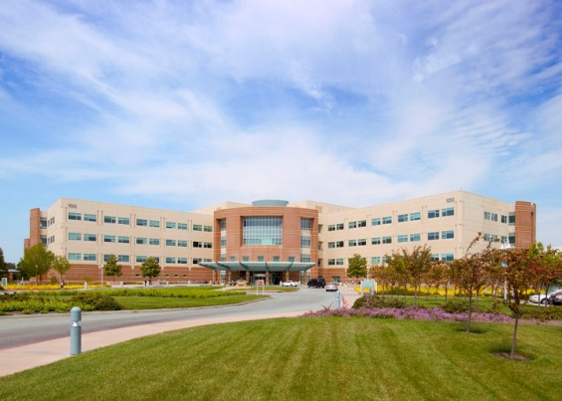
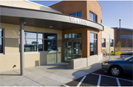
Telehealth Initiative
Polytrauma Telehealth TBI Second Level Evaluation and Follow-up Program
Provider / Distant Site
TBI Specialty Physiatrist Locations:
Patient / Originating Site
Patient and Telepresenter Locations
Community Based Outpatient Clinics'
Livermore
Modesto
Monterey
Palo Alto
Stockton
Notes:
Will link PRC and PNS within and across regions
Provide videoconferencing capabilities
Facilitate discharge planning and coordination of care
Remote provider-to-provider consultation
Remote evaluation for specialized services
Education for providers and families

Slide 18
Community Re-integration
Common goals of veterans/SMs:
School
Employment
PNS team members assist with community re-integration
Collaborate with local schools
Provide resources for education and employment

Slide 19
Advanced Technology Applications
Rapidly evolving devices and technology have great potential for rehabilitation, and are well-received by Veterans
Establishing Assistive Technology Labs at 4 Polytrauma Rehabilitation Centers
Labs will serve as resource for VA Health Care and provide access to most advanced technology for:
Cognitive impairment
Sensory impairment (hearing, vision, speech)
Computer access
Communication devices
Wheeled mobility / Seating / Lift systems
Home / Vehicle Modification
Self care
Home Telehealth
Notes:
Remember the “big black memory book” that was screaming “impairment.”
This is important because people with cognitive impairments are kept out of technology for a lot of reasons – we need to make sure that these disabilities do not keep them out.

Slide 20
PNS Contacts
Julianna Brooks, Program Director
Julianna.brooks@va.gov
650 493-5000, ext. 65053
650 444-8029 cell
Rose Salerno, RN, CBIST
650 493-5000, ext. 66150
650 380-8223
Esmeralda Madrigal, LMSW, CBIS
650 493-5000, ext. 62768
650 444-8252 cell
Stefanie Chin, LMSW
650 493-5000, ext. 69226
650 814-0583 cell

Slide 21
OEF/OIF Contacts
Laura Gomez, LCSW – Program Manager
650 493-5000, ext. 60007
Amy Alderman, LMSW
650 493-5000, ext. 66870
Pamela Calimlim, LCSW
650 493-5000, ext. 67203
Raquel Morales, LMSW
650 493-5000, ext. 77629

Slide 22
Thank You!
Questions?

