Slide 1
"Military Culture: What You Should Know"
Presented by
COL David Rabb LICSW, ACSW
SGT Anh K. Ban, BS
Director of Psychological Health Office
63D Regional Support Command

Slide 2
Purpose
To increase your knowledge of military culture and to explore the challenges that OIF/OEF Service Members, Veterans, and Families face during transitions and readjustment.
Notes:
Develop skills to provide more effective clinical care through improved abilities to understand, communicate and interact with service members and their families.

Slide 3
Outline
Discuss the importance of understanding military culture and identity.
Review assumptions related to OIF/OEF veterans.
Examine readjustment and transition challenges and offer recommendations.

Slide 4
VA/DoD Common Ground
Congressionally mandated
Important missions
Public trust
Large systems
Enormous challenges
In midst of transformation
Similar vulnerabilities
Dependent on everyone doing their job
Acronym challenged
Notes:
The VA and DoD have a lot in common from being congressionally mandated to being acronym challenged. What we like to highlight here is our distinct but essential missions and the public trust that are bestowed to us in protecting our country’s way of life. “Trust” and “mission” are two themes that will be carried across today’s talk.
4

Slide 5
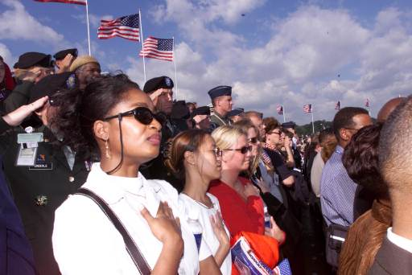

Slide 6
Cultural Competence
Culture is the way of life for a society. As such, it includes codes of manners, dress, language, religion, rituals, norms of behavior such as law and morality, and systems of belief as well as the arts and gastronomy.
Cultural competence is comprised of four components:
  Awareness of one's own cultural worldview
  Attitude towards cultural differences
  Knowledge of different cultural practices and worldviews
  Development of cross-cultural skills
Developing cultural competence results in an ability to understand, communicate with, and effectively interact with people across cultures.
- Scott R. Swaim, Veterans Services, Auburn, WA

Slide 7
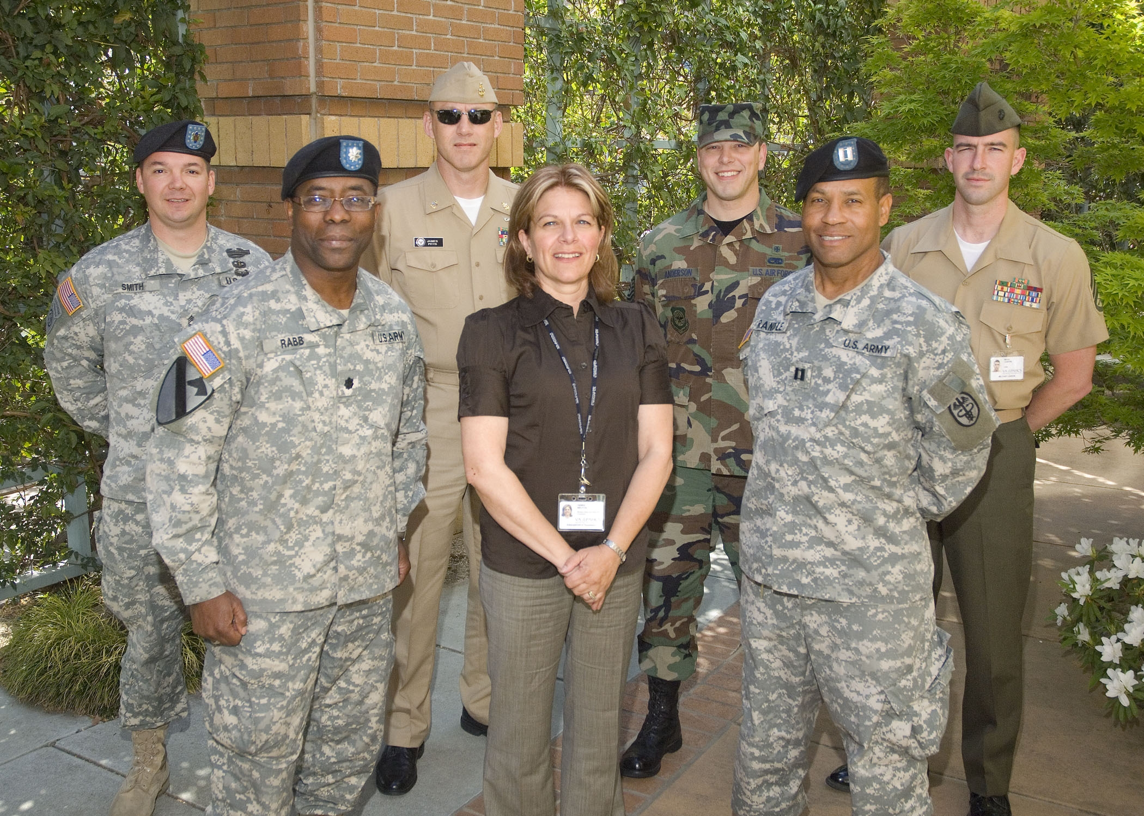
Notes:
7

Slide 8
Why is Culture Important?
The DNA for healing is intrinsically found in culture.
PTS is more related to an identity disorder than a stress or anxiety disorder.
We can use culture to change culture/behaviors.
Notes:
The DNA for healing is intrinsically found in culture, especially when considering behavioral health. The best medicine and treatment is indigenous to the people based on their beliefs, customs, and faith.
PTS is more related to an identity disorder than a stress or anxiety disorder. It is a disruption to the spirit. Identity and culture go hand in hand.
We can use culture to change culture – By having a good understanding of a culture, we can use it to increase awareness pertaining to a specific issue or concern. We are able to enter into the world of our patients and influence change.

Slide 9
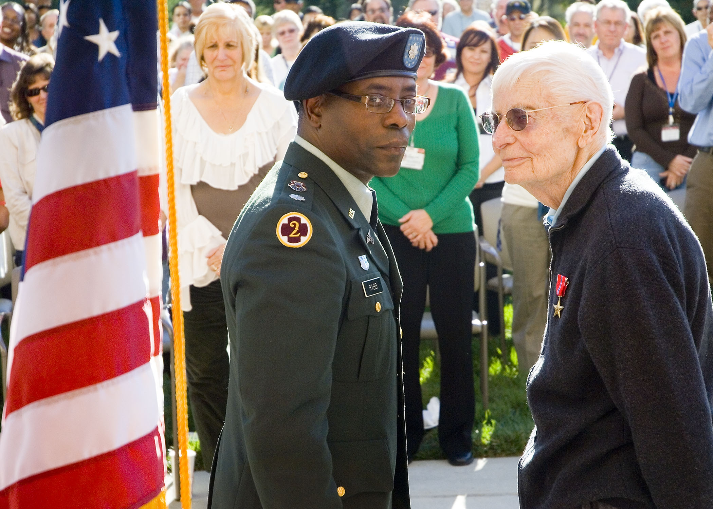
Notes:
9

Slide 10
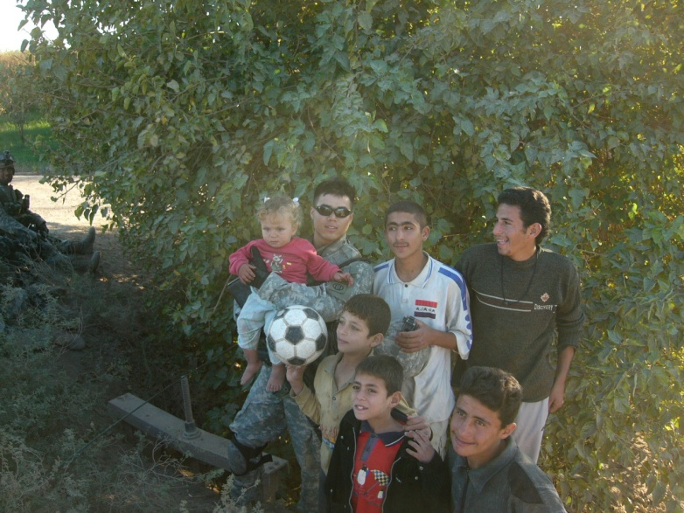
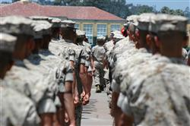
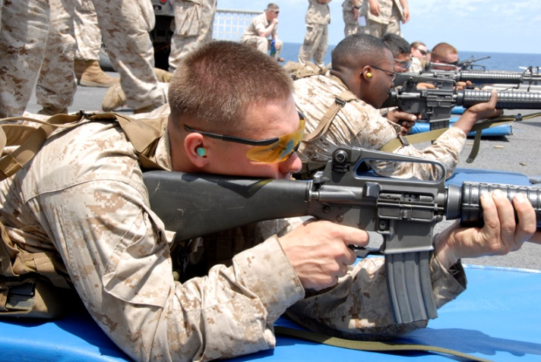
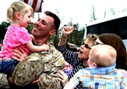
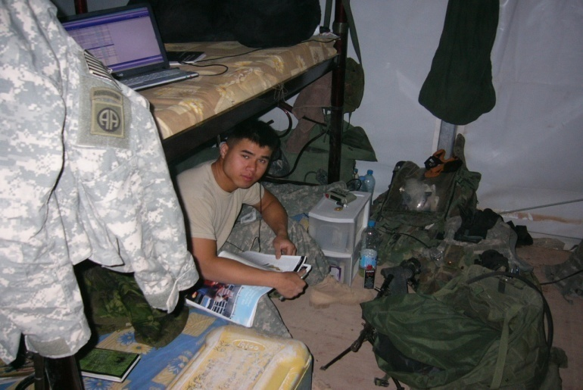
Military Life
Notes:
10

Slide 11
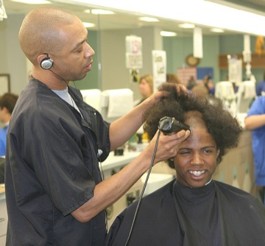
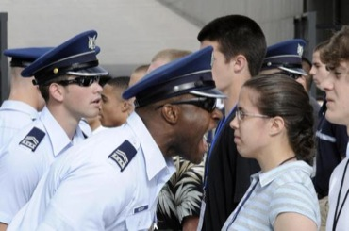
Purpose of Boot Camp
Transform civilians in to service members
To create an artificial stress environment
To screen out recruits that would not be successful in adapting to military life
Notes:
Boot Camp is the sentinel event that all Service Members go through in their military career. It is the crucible (test) of whether a recruit has the right stuff to enter the military.
Boot camp has three main purpose:
Transform civilians in to service members
To create an artificial stress environment
To screen out recruits that would not be successful in adapting to military life

Slide 12
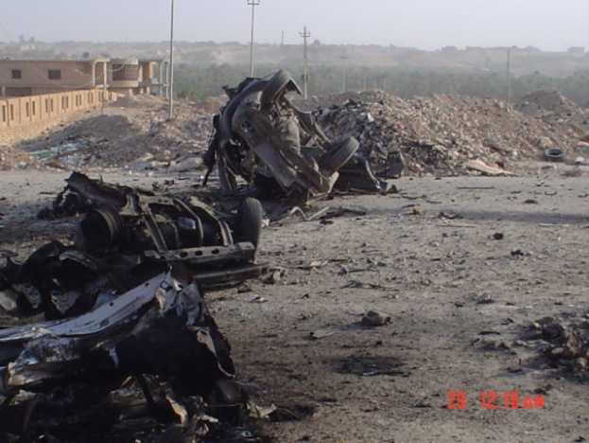
Military Stressors
High risk occupation
Mobility
Authoritative work environment
Impact of separation
High degree of living with uncertainty
Notes:
12

Slide 13
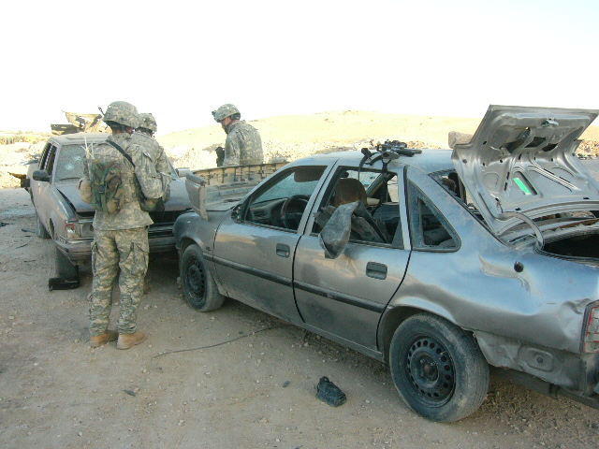
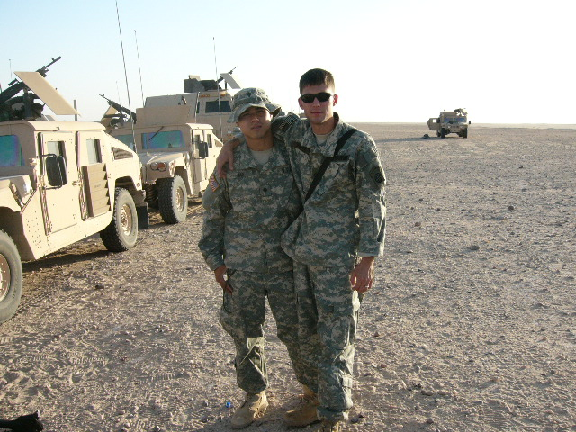
Conditions on the Battlefield
Hostile
Deadly
Multiple threats
Asymmetrical
Guerilla war – friends/foe
Notes:
13

Slide 14
Stressors In War
Having to survive in an adverse and hostile environment
Finding safe routes to travel “outside the wire”
Coping with the uncertainty inherent in the “fog of war”
Enduring lengthy deployment or being redeployed multiple times
Managing peer/leaders relationship conflicts
Experiencing family separation/home front worries
Struggling to find time for self-care
Notes:
14

Slide 15
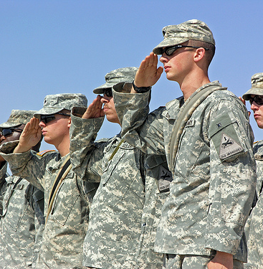
The Soldiers Creed
  I am an American Soldier.
  I am a Warrior and a member of a team. I serve the people of the United States, and live the Army Values.
  I will always place the mission first.
  I will never accept defeat.
  I will never quit.
  I will never leave a fallen comrade.
  I am disciplined, physically and mentally tough, trained and proficient in my warrior tasks and drills.
  I always maintain my arms, my equipment and myself.
  I am an expert and I am a professional.
  I stand ready to deploy, engage, and destroy, the enemies of the United States of America in close combat.
  I am a guardian of freedom and the American way of life.
  I am an American Soldier.
Notes:
Once in the military, Service Members are held to a very high standard. It is this high standard that differentiates warriors from civilians – military life from civilian life.
The military is a “mission driven” enterprise. We don’t accept defeat. Not excepting defeat is drilled into us from boot camp. This belief works for us during difficult times and at war. This belief can have the opposite effect when the Service Member needs to seek help. We train as we fight, and fight as we train.
Today, combat stigma and encouraging service members and veterans to seek help is on our major battles.
Once in the military Service Members are held to a high standard. It is this high standard that differentiates warriors and civilians, military life and civilian life.
The military is a “mission driven” enterprise. We don’t accept defeat. This belief is drilled into us; never, ever accept defeat. This belief can work for us during war time, but can have the opposite effect when it comes to seeking help. Today, Combating stigma in one our major battles.
The Soldiers Creed speaks to the role of a Warrior. It places the will of the unit/team before the will of the individual.
It sets a high bar and high standards.
The Creed differentiates civilians and warriors.
The Creed can work for Soldiers especially during difficult and stressful time as going to war. However it can work against them in reaching out and seeking care.
15

Slide 16
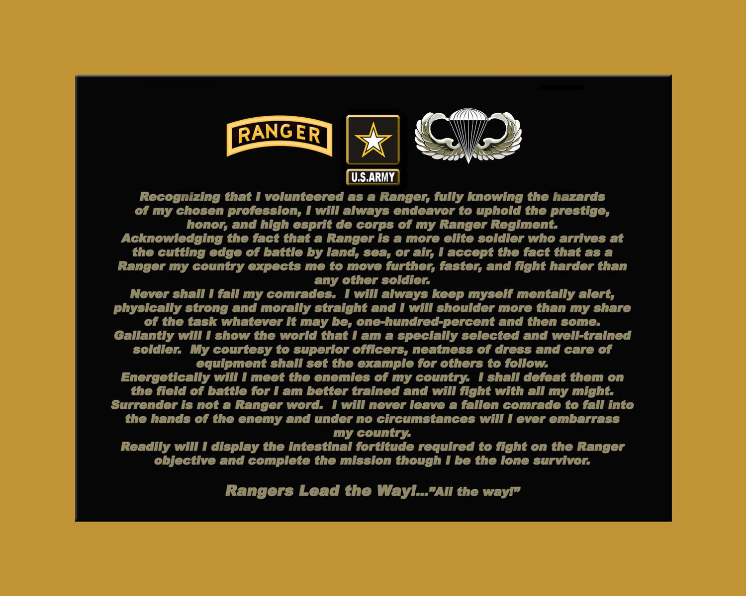
Notes:
16

Slide 17
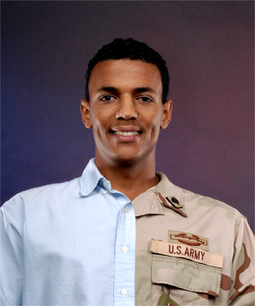
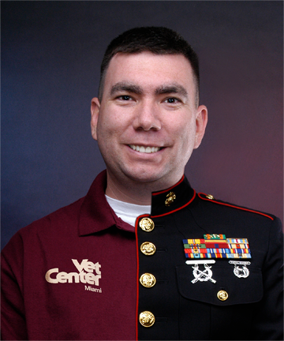
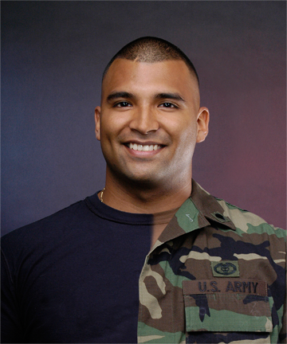
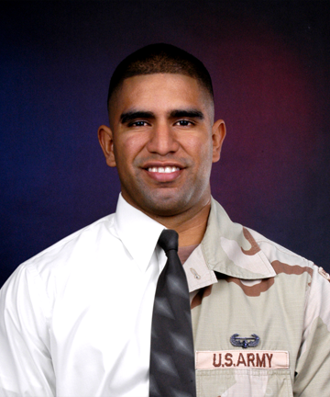
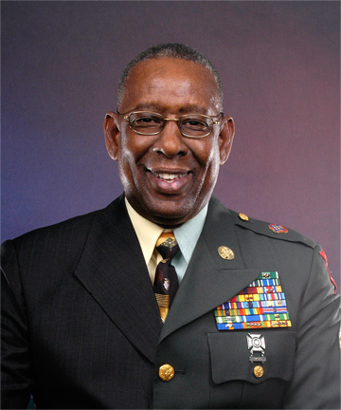
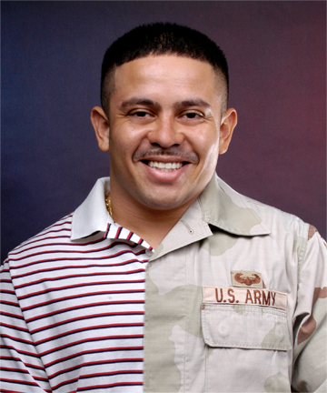
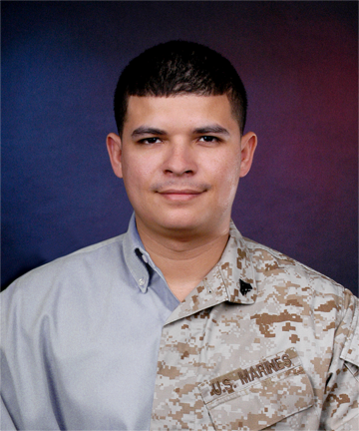
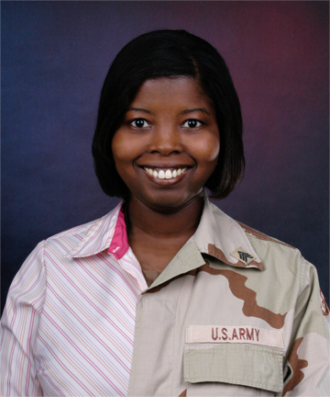
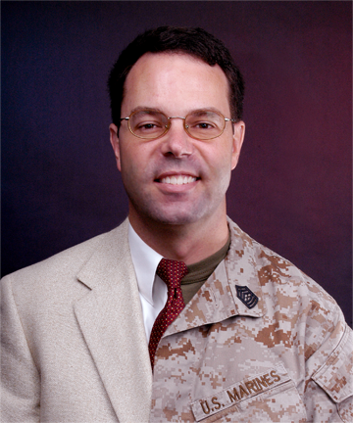
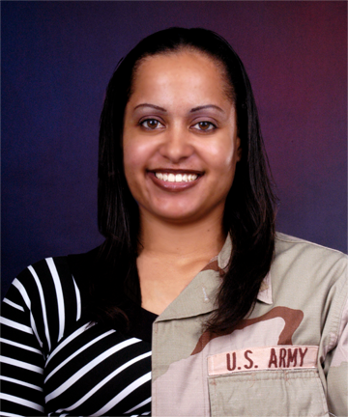
You Can Remove the Warrior From the War, but Not the War From the Warrior

Slide 18
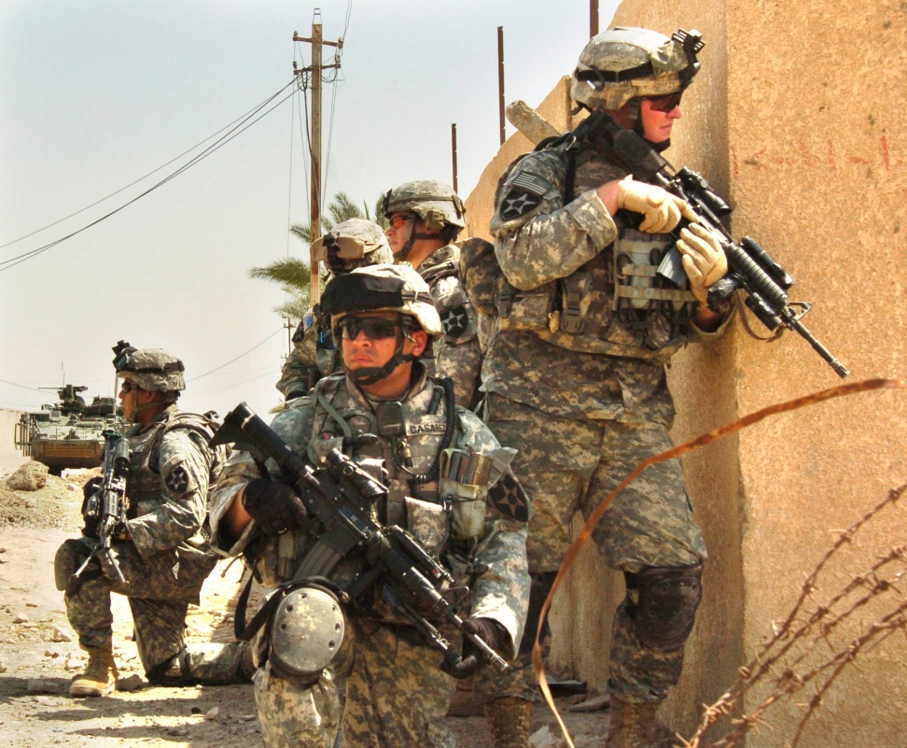
Psychological Concepts/
Reactions To Trauma
Safety
Trust
Esteem
Control
Power
Frame of reference
Exposure to risk
Notes:
This slide highlights cognitive schemas that come into questions when a Service Member in place in a combat zone.
Because of the shifts in the cognitive schemas, a Service Members attitude, belief system, and coping mechanisms change.
18

Slide 19
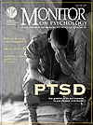
Readjustment Challenges
“The Three D’s”
Disjointed
Disconnected
Dead
Notes:
If a Veteran is not able to reconcile her wartime and civilian experiences several things can occur:
The Service Member may feel disjointed – interpersonally he may feel off centered or not themselves.
Disconnected – The Service Member may feel that they can relate to others/ No one understands what they have been through. May become isolated.
Dead – The Service Member may is so much psycho spiritual pain that he may feel dead. “The walking dead”. They may have a don’t care attitude and become comfortable with the thought of taking themselves out.
19

Slide 20
“They say war is hell, but I say it’s the foyer to hell…I say coming home is hell, and hell ain’t got no coordinates. You can’t find it on the charts, because there are no charts.”
-Tyler E. Boudreau,
CPT US Marine Corps (Retired)
from Packing Inferno
Notes:
This quote by Tyler Boudreau in his book Packing Inferno speaks to the anguish that some veterans experience in returning from war and feeling lost.
There are no good maps or grid coordinates in returning from war because everything and everybody has change.
The key to supporting veterans will be in helping them find their way and helping them grow through there experiences by making sense of where they been and where they are going.

Slide 21

Breathing slide

Slide 22
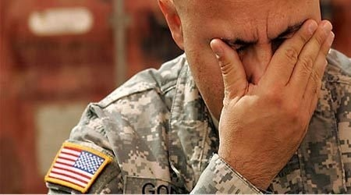
Notes:
The danger in being in uncharted waters is that you can drown.

Slide 23
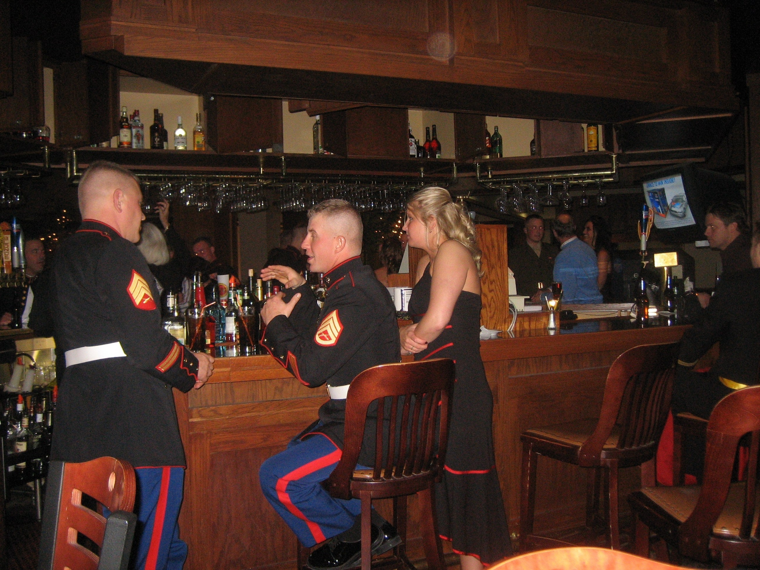

Slide 24
Assumptions
It takes approximately three months for OIF/OEF Veterans to readjust to civilian life
OIF/OEF Veterans are bitter about having served in an unpopular war(s).
Only the uneducated/unskilled go into the military
Female OIF/OEF Veterans do not play a major role in the war
Notes:
These are all false assumptions.
Readjustment takes time. There is not time clock that fits everyone. Everyone in theater is different and they have common and unique experiences. For some Service Members it may take less than 60 days to fully adjust to civilian life, for others it may take six months to a year. For others it may take a life-time based on what they went through at war.
Many OIF/OEF Veterans are very proud of their role, contributions, and sacrifices in serving our Country. This is similar to many Vietnam Era Veterans that honorable served their country despite the political aspects of the war.
Currently, we have an all volunteer force. Despite the notion that some people may have that only the bottom of the barrel of people enlist in the military.
By the time that a Service Member gets through boot camp, advance training or specialty schools, they have a competitive edge over most of their peers.
The last bullet is demeaning, if not hurtful because a Soldier is a Soldier. A Marine is a Marine, A Airmen is Airmen, and a Sailor is a Sailor. The threats in this war doesn't discriminate their targets. We have had more female die in this war than in all the wars/conflicts since WWII combined. Everyone that goes to war is at risk.

Slide 25
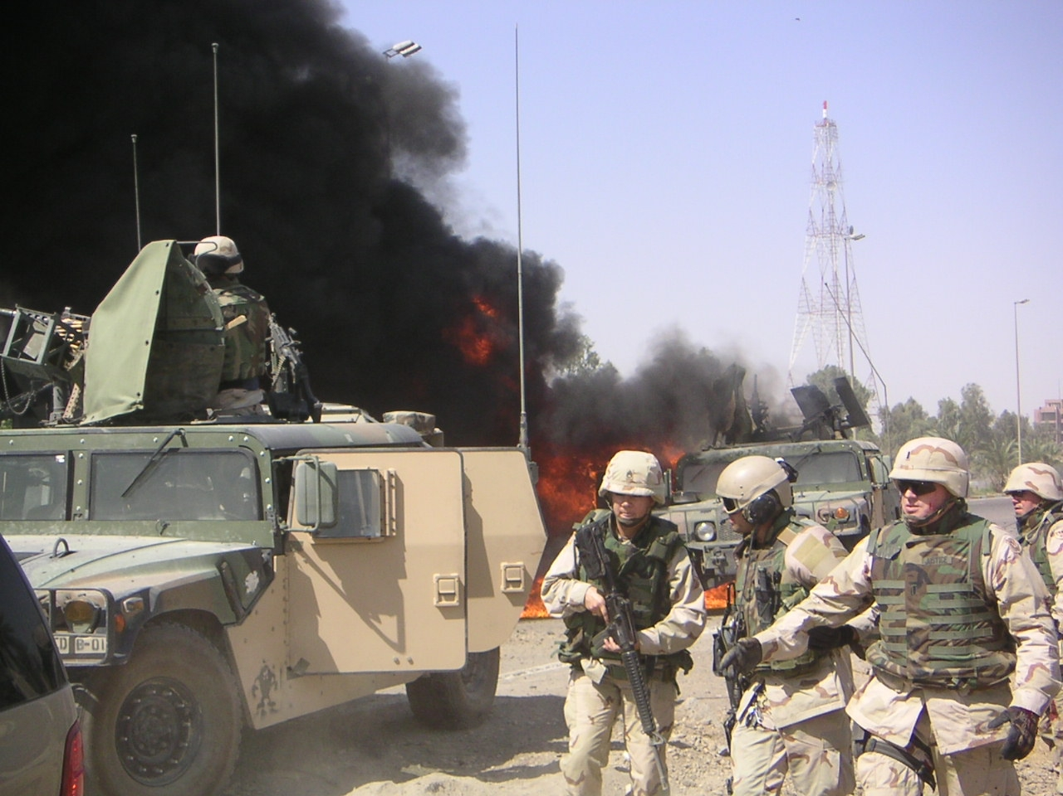
Notes:
The Soldier with the M-16 Rifle at the ready position is one of my Behavioral Health NCOs responding to an attack on the convoy. She was coming from Camp Victory to the Green Zone. That day she was coming to pick up a lap top computers. Because she is a Soldier and relied on her training as a Soldier she was able to respond appropriately to the this treat and help save several lives. War is War for all those that are in the combat zones.
25

Slide 26
Assumptions
OIF/OEF Veterans that do not present with psychosocial problems are adjusting well
“It’s 2010, Sexism, Racism, Ageism does not exist or occur in the military or the VA”
OIF/OEF Veterans miss their appointments because they don’t care about their health care or irresponsible
OIF/OEF Veterans are eager and capable of taking advantage of their GI Bill
Notes:
Again here are more assumptions that need to be corrected.
There are many chambers to a veteran’s soul and how many doors that she or he allows open is depending on several factors that includes trust, time, and safety. Not everyone who appears well are well and we need to be open to that fact. Suicide and domestic abuse are increasing as the length of the war goes on. It’s important for us to acknowledge that having resources in place to support OIF/OEF Veterans/Families is half the battle. The other half is convincing them to take advantage or make us of the services. That takes time and persuasion, for what we are going up against is the Soldier’s pride and feeling less then because they are in need of help.
Despite the progress that have been made in our military and society, the “ism’s” are still alive and well. We still have some way to go to create an equal and fair playing field.
One of the biggest misnomers is that OIF/OEF veterans miss their appointments they are not interested in their care or the are irresponsible. The fact is that when the veteran return from war and are in the midst of transition, their focus is on trying to stay afloat with family responsibilities, finding and keeping employment, starting or attending school or colleges – they are trying to jump start their lives. What I’m hearing is that going to the VA can be like drinking through a water hose…first you wait, wait, and wait to get the care and then once you are in the system, the system kicks end and there are all these appointments at once, which sometime conflict with what the veteran is doing to make the transition or adjustments. VA needs to be more accommodating to family, work, school schedules.
Not all OIF/OEF Veterans are eager or capable of taking advantage of their GI Bill. The New GI Bill is great and very much needed and appreciated. However, because of their mental, emotional, spiritual, social, psychological concerns, some veterans are holding up in starting college. I will tell a Soldier with PTS not start attending college until they first get help, enrolled in a trauma recovery program. Right now one of the major challenges for educators and counselors at secondary higher learning institutions is managing the mental health needs of veterans coming to their campuses, with limited resources.

Slide 27
Connecting with Veterans
Engage Veterans in their story: (Examples)
  Ask about their branch of service
  What is/was their rank?
  Ask about the motives for going into the service
  Ask them about their boot camp experience
  Ask about their military occupation specialty (MOS)
  Where is/was the Veteran stationed/deployed?
  What role do/did the Veteran play in their unit?
  What is/was the Veteran biggest personal/personnel achievement?
Notes:
Questions (discussion points) to engage Veterans in telling their stories and to begin the relationship.

Slide 28
Change and Transition
What can I do to make you feel more comfortable?
What is it like being back?
What is it like being a civilian or having to be around civilian?
How are you sleeping?
How has life changed since you have been back?
What have you gain/lost since coming back?
What did you like/dislike most about being in the service?
What did you like/dislike most about being deployed?
What is family life like since being back?
What is the most difficult part of your transition?
What are your hopes/goals?
What do I need to know to help you move forward?
Are you running into any system problems with the VA?
Notes:
Additional questions to explore with veterans.

Slide 29
Peeling the Onion
A Veteran is more than…
  Their age
  Their race
  Their religion
  Their education
  Their abilities or disabilities
  Their occupation
  Their past
  Their future
  Their sexual orientation
  Their social class
  Their war experience
  Their hopes or hopelessness
  Their political or social affiliation
  Their income
  Their neighborhood or the cost of their home or car
Notes:
The Commandant (General James Conway) and SGM (SGM Carlton Kent) of the of the Marine Corps demonstrated the importance of REACH when they came to the Palo Alto VA Medical Center for a Town Hall Meeting with veterans, family, and staff. They discussed openly the challenges facing the Marine Corps in addressing PTS and TBI. SGM Kent said that “they get it” as to how the war is impacting their Marines and Families. They appealed to the VA for support in helping care for their Marines. VA has a big mission!
29

Slide 30
From War Zone to Home Zone
BATTTLEMIND skills helped you survive in combat, but may cause you problems if not adapted when you get home.
Buddies (cohesion) vs. Withdrawal
Accountability vs. Controlling
Targeted Aggression vs. Inappropriate Aggression
Tactical Awareness vs. Hypervigilance
Lethally Armed vs. “Locked and Loaded” at Home
Emotional Control vs. Anger/Detachment
Mission Operational Security (OPSEC) vs. Secretiveness
Individual Responsibility vs. Guilt
Non-Defensive (combat) Driving vs. Aggressive Driving
Discipline and Ordering vs. Conflict
Notes:
We have taken the word Battlemind, and have used each letter to denote a combat skill that has to be modified to facilitate your transition home. This list only comprises a subset of your combat skills. However, this is the subset of skills that we will focus on today. [Note to Speaker: Do NOT go through each of these skills, this is only intended to be an Introduction.]
We are going to focus on your strengths. However, we want to make sure that we don’t let your proven strengths become a weakness.
The key point is that if you used the same BATTTLEMIND-set that you had in combat when you get home you may have experienced some problems.
Soldiers frequently let how they were thinking and reacting in combat affect how they are thinking and reacting back home. If you do, then negative things can happen. And if you are still thinking and behaving, now that you are home, the same way you thought and behaved in combat, then these are indicators that you might need some help.
I am also going to ask you throughout this presentation to share your own deployment and transition experiences. The idea is that you all can learn from each other as well, and help each other as you continue your transition home.

Slide 31
Transition and Readjustment Assessment: “The Three P’s”
Pain
Purpose
Passion
Notes:
Good history and physical exams and psychosocial assessments need to take in consideration the following areas:
Pain – Assessments of pain is vital to helping a veteran in their readjustment. The assessment should include pain that that accounts for the physical, psychological, spiritual, emotional, and relational aspect of daily living.
Purpose – Service Members and Veterans may present, along with their medical issues, existential issues as it relates to who they are know that they have returned from war. Helping veterans find their purpose is key for them to take the next steps in their journey of discovery.
What now drives them to wake up and take on the world is critical in finding or maintain their passion. At war, they survived, because of their passion for their missions and their buddies. Know that that’s over the need to find a similar experience or routines that make them feel alive. Their “why’s ” for living needs to be so strong and passionate that it “cries”. A life with out passion can be a sorry dreadful life.
31

Slide 32
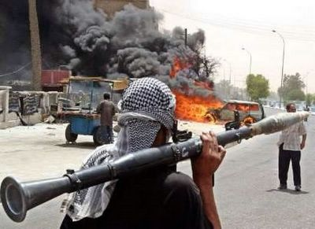
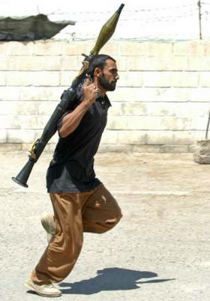

Cultural Competency Test

Slide 33
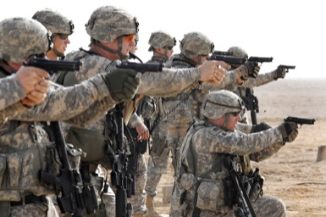
Cultural Competency
Notes:
Having an appreciation for military culture and knowledge of what is going in the war can go a long way in connecting with veterans in your practice.
What type of weapon is being used in the left photo?
What weapons are being used in the right photo.
Tell the story about Lonnie Moore going into a VA Clinic and seeing Primary Care doctor the first time.
Cultural Competency is important because you can use knowledge in a specific culture to change culture.
Explain “BRASS”

Slide 34
REACH for Diversity
Respect
Education
Awareness
Collaboration
Honesty
Notes:
The foundation of having an appreciation for military culture is having a deep appreciation for diversity. The military culture is distinct with it manners, dress language, rituals, norms of behavior and law (uniform code of military justice). To understand a different culture we have to REACH for diversity.
REACH is a strategic aim that comes out of the VA Under Secretary for Health Diversity Advisory Board to keep the importance of diversity in front of VA employees to meet VA Strategic Goals.
Understanding diversity begins and ends with respect. VA employees need to continue to respect the differences that OIF/OEF bring with them. And there are many differences from the ways they like to communicate using today’s technology to preference for being seen in evening and weekend clinics.
Education refers to taking an active role in learning about the new culture to increase your knowledge and effectiveness. Education is a continuous process that unlocks potential and possibilities.
Awareness – Is about keeping abreast to what’s going around you and what’s issues are going on in the veterans community. It’s also meaning taking your own pulse at times to see how you are coming across in your interaction with your patients. Being aware of the cultural climate of your work environment is key to Veterans and Families feeling welcomed and safe.
Collaboration – is about working as a team. Veterans feel more confident about getting their care at the VA, if they know and see teamwork occurring on their behalf.
Honesty in REACH stands for being realistic and true to the mission of caring for veterans. We need to be honesty on an individual level as to what we are doing well and what needs to improve. On an organizational level there needs to be appropriate performance measures and monitors that reflect how the organization is doing and areas of opportunities and needed growth.

Slide 35
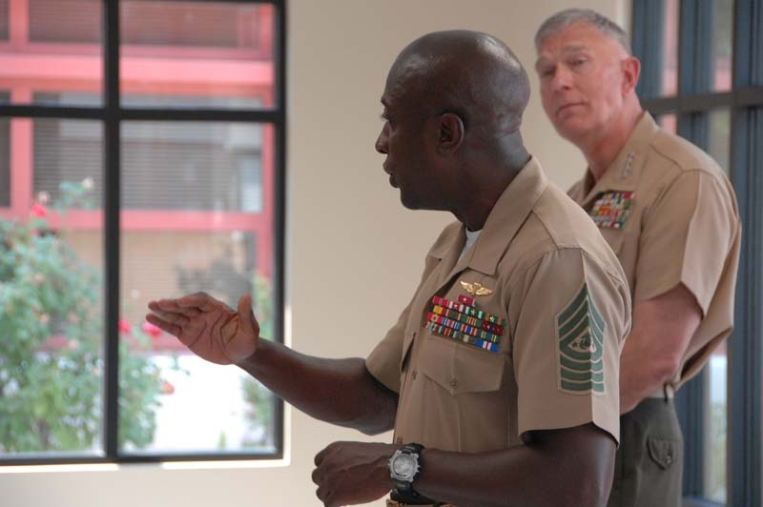

Slide 36
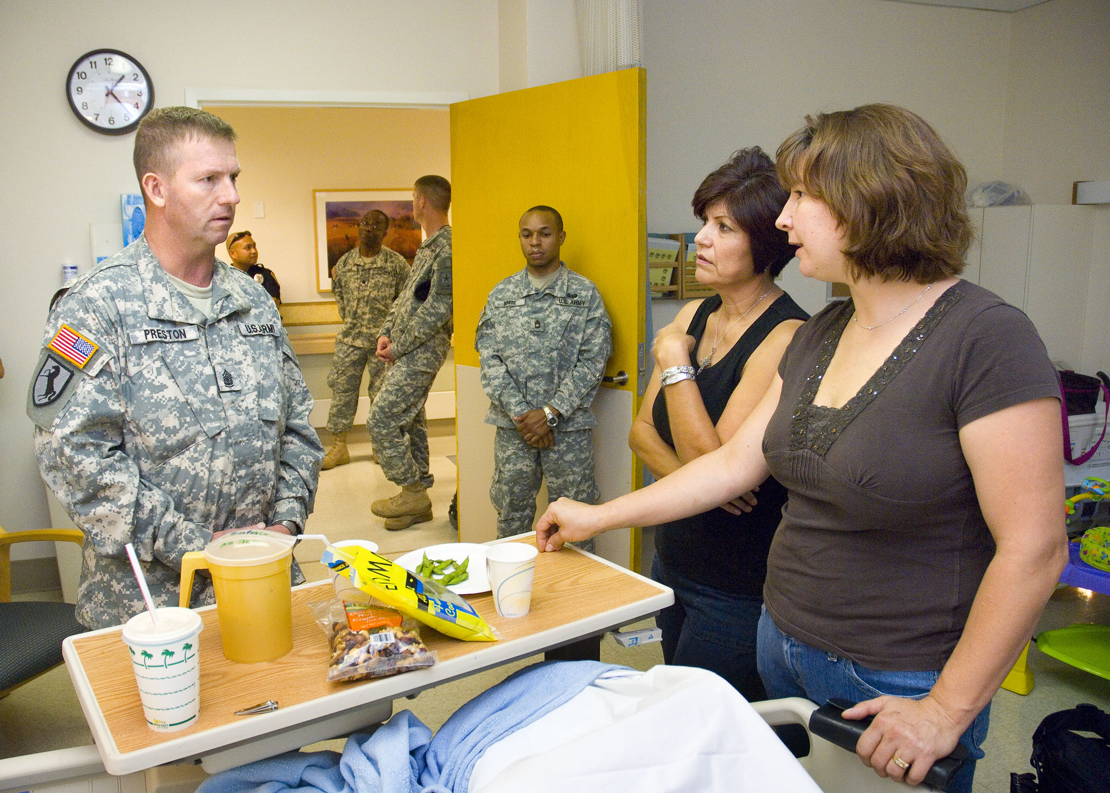

Slide 37
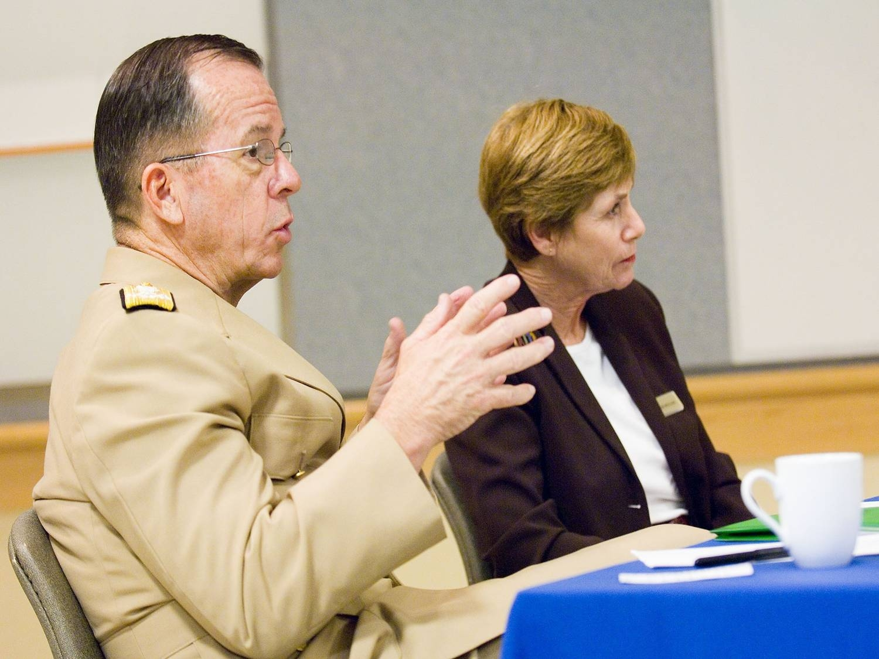
Notes:
Admiral Mike Mullen, Joint Chiefs of Staff and his wife Ms. Deborah Mullen also paid a visit at the VA Palo Alto Medical Center. They too expressed their gratitude for what the VA is doing to ensure that Service Members, Veterans, and their Families are cared for. The military community has a vested interests in VA continuing to change and adapt to fulfill it’s mission.

Slide 38
Recommendations to the VA from the Joint Chief of Staff
Promote resiliency
Focus on the strength and skills that Warriors/Veterans bring with them
View Warriors/Veterans as part of the solution
Consider dropping the “D” when referring to PTSD
Consider indigenous and alternative approaches to treatment
Notes:
Here are recommendations from Admiral Mullen to the VA.
38

Slide 39
Conclusion
Having an understanding and appreciation for military culture is the first step in becoming cultural competent. Developing a strength-based approach in supporting Veterans will provide the foundation for dynamic engagement, change, and transformation.
Notes:
39

Slide 40
QUESTIONS?
Notes:
Subject to questions, that concludes our presentation.

