Slide 1
Introducing
The War Related Illness and Injury Study Center
J. Wesson Ashford, MD, PhD
Sandra Scaling, RN
Louise Mahoney, MS
US Department of Veterans Affairs
VA Palo Alto Healthcare System
Office of Public Health and Environmental Hazards
Notes:
Dr. Ashford

Slide 2
Outline
Background
Clinical Programs
Research Projects
Education and Outreach Initiatives
Questions and Answers
Notes:
Dr. Ashford

Slide 3
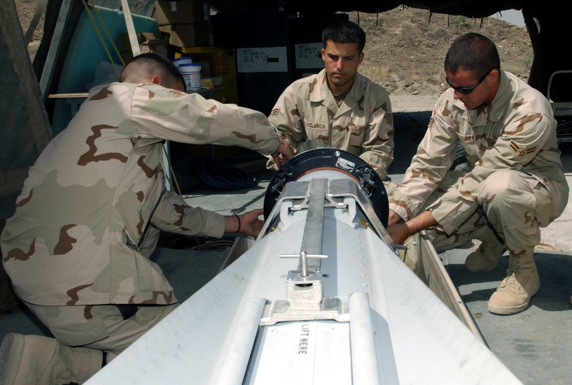
The War Related Illness and Injury Study Center (WRIISC)
A national program in the Department of Veterans Affairs (VA), initially established in 2001 to address post-deployment health issues from the First Gulf War.
Notes:
Dr. Ashford

Slide 4
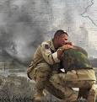

ABOUT THE WRIISC
Deployed Veterans have unique healthcare issues and concerns.
We develop and provide expertise for Veterans and their health care providers through clinical evaluation, research, education, and risk communication.
The WRIISC now serves Veterans from any era or conflict with war related illnesses and injuries.
Notes:
Dr. Ashford

Slide 5
WHERE WE ARE
Three National Locations
Covering Three Regions
East Orange, New Jersey (established 2001)
Washington, DC (established 2001)
Palo Alto, California (established 2007)
Notes:
Dr. Ashford

Slide 6
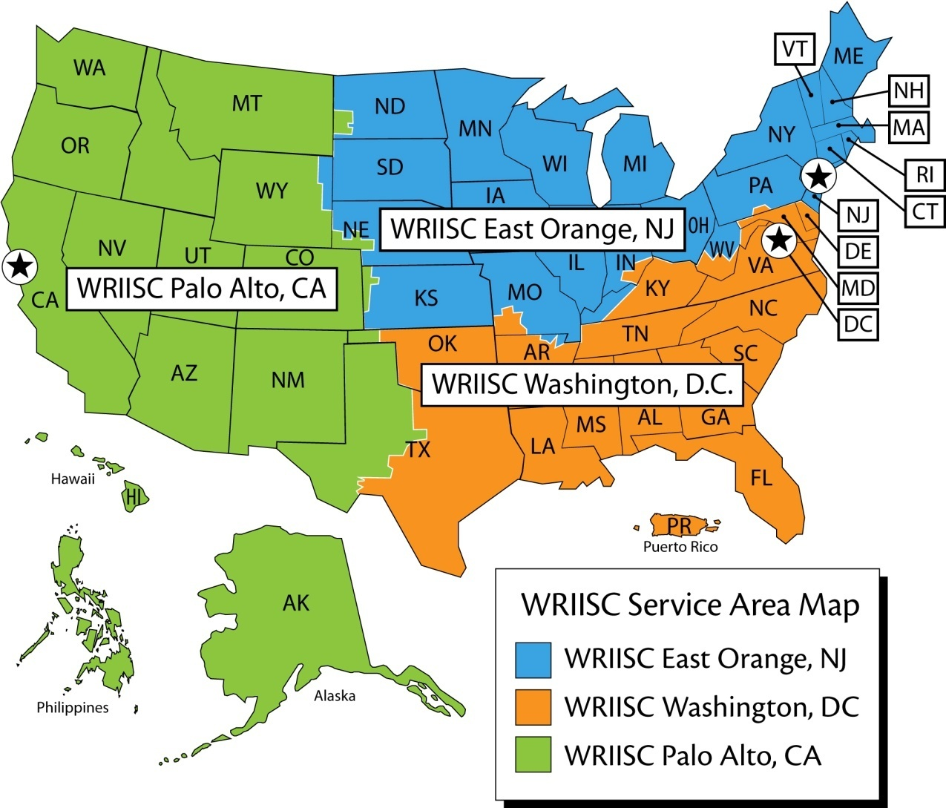
WRIISC REGIONAL MAP
Notes:
Dr. Ashford

Slide 7
WRIISC Clinical Activities
We serve as a 2nd opinion resource for addressing the post deployment health needs of Operation Enduring Freedom/Operation Iraqi Freedom veterans and veterans of prior conflicts.
Our team of health professionals consists of physicians, nurses, specialists in exposure, psychologists, social workers, chaplains, and health education specialists.
Notes:
Dr. Ashford

Slide 8
VAPAHCS WRIISC Team
Jerome Yesavage, MD - ACOS for Mental Health
J. Wesson Ashford, MD, PhD - WRIISC Director
Joseph Cheng, MD, PhD - Neuroscience
Steven Chao, MD, PhD - Neuroscience
Louise Mahoney, MS - Education & Risk Communication
Sandra Scaling, RN, MSN - Clinical Coordinator
Stacy Moeder, MHA, MBA - Administrative Officer
Maheen Adamson, PhD - Data Manager
Lisa Kinoshita, PhD - Neuropsychology
Trisha Suppes, MD, PhD - Bipolar Disorders
Mylea Charvat, MS - PTSD
Ansgar Furst, PhD - Neuroimaging
Richard Brandt, M Div - Spiritual Assessment
Notes:
Dr. Ashford

Slide 9
WRIISC Focus
We are a program of the VA Office of Public Health and Environmental Hazards that has been tasked with studying war-related problems such as:
  Anxiety
  Depression
  Gastrointestinal Disorders
  Pain
  Fatigue
  Chronic headache
  Substance dependence
  Post Traumatic Stress Disorder
Notes:
Dr. Ashford

Slide 10
RESEARCH
Environmental Exposures
Medically Unexplained Symptoms
Traumatic Brain Injury (TBI)
Advanced Diagnostics (brain imaging methods: DTI, PET/CT, fMRI, physiological measures)
Post-Traumatic Stress Disorder (PTSD)
Complementary and Alternative Medicine
Symptom Prevalence & Relief (insomnia, pain)
Notes:
Dr. Ashford

Slide 11
Markers for the Identification, Norming & Differentiation (MIND) of TBI and PTSD Study
Phase I: To estimate the prevalence of TBI and PTSD in OEF/OIF veterans (n=800).
Phase II: To determine if OEF/OIF veterans diagnosed with TBI (VHA definition) and/or PTSD exhibit impairments in selected advanced neuroimaging, sensorimotor and cognitive measures that differ from control groups.
Phase III: To determine if OEF/OIF veterans diagnosed with TBI and/or PTSD exhibit impairments in selected neuroendocrine, sleep and genetic measures that differ from control groups.
Notes:
Dr. Ashford

Slide 12
CLINICAL EVALUATIONS
Comprehensive Interdisciplinary Evaluation
  Focus is on symptoms and improving function.
  Comprehensive environmental exposure consults available for Veterans of any conflict - No referral necessary and phone consults available.
Duration of Exam
  One to two-day or three to five-day evaluation as pre-determined by WRIISC clinical team
  Based on complexity of case and the individual Veteran’s needs.
Notes:
Sandy

Slide 13
Clinical Services
Comprehensive Multidisciplinary Evaluation
History and Physical
Psychological Evaluation
Neuropsychological Testing
Exposure Assessment
Spiritual Assessment
Education Session
Labs, X-Rays, EKGs, PFTs
Notes:
Sandy

Slide 14
Care Model
Veteran
WRIISC
Team
Home VA Primary Care Team
Home
VA
VA
Palo Alto HCS
Notes:
Sandy

Slide 15
Clinical Services
Resource to Primary Care Physicians
Assess returning Veterans to identify new issues and concerns
Develop tools and techniques for all VA
Pilot programs in Complementary and Alternative Medicine
  Mat and chair yoga classes for Veterans with PTSD, pain, and fatigue
Notes:
Sandy

Slide 16


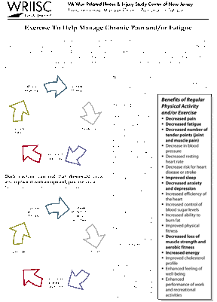
WRIISC Education & Risk Communication
Training programs for health care professionals such as conferences, seminars, risk communication, and fellowships
Print-based educational materials
  Newsletters
  Fact Sheets
  Brochures
Notes:
Louise

Slide 17
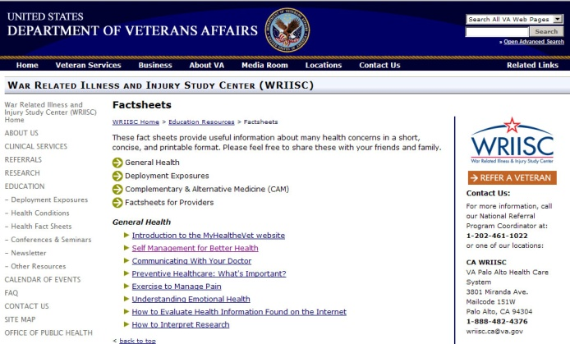
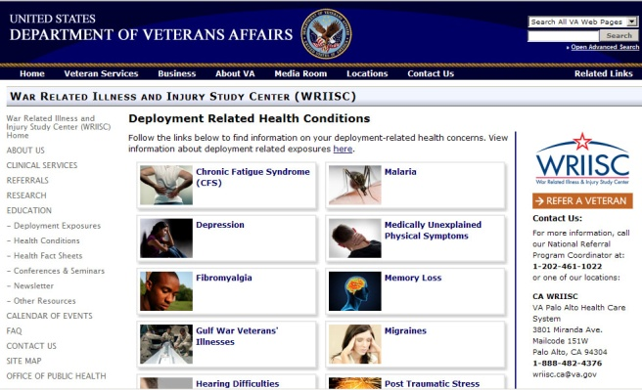
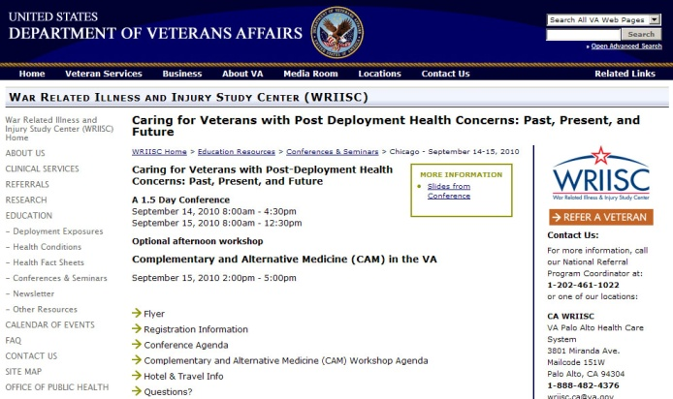
WRIISC Education & Risk Communication
Web-based educational materials @
www.warrelatedillness.va.gov
Deployment health information
Exposure information
Slides and video lectures from conferences
Notes:
Louise

Slide 18


WRIISC Education & Risk Communication
Veteran education sessions on self management:
  Techniques for managing stress
  Information on mind/body
  exercises, chair yoga
Speakers bureau
Notes:
Louise

Slide 19
WRIISC Referrals
Primary Care Physicians complete a consult request in our computerized record system or contact us at 1-888-482-4376
More information @ www.warrelatedillness.va.gov
WRIISC Washington, DC
wriisc.dc@va.gov
1-800-722-8340
WRIISC East Orange, NJ
wriisc.nj@va.gov
1-800-248-8005
WRIISC Palo Alto, CA
wriisc.ca@va.gov
1-888-482-4376
Notes:
Louise

