Slide 1
Diagnostic and Treatment Approaches for Social Cognition
Kelly K. McCoy, Psy.D.
Neuropsychologist
War Related Illness and Injury Study Center
Washington, DC VA Medical Center

Slide 3
“Historically, it is often the physical manifestations of a brain disorder that are the first to be described in the scientific literature and to be clinically treated. Some decades later, the cognitive impairments are recognized. Yet, it is the emotional and behavioral changes that are the most significant barriers to effective functioning in family, in work, in school and in other settings.” (Judd, 1999)

Slide 4
What is social cognition?
Brain-behavior factors involved in processing social information
Includes encoding, storage, retrieval, and organization of socially-salient information
Emphasizes emotional factors rather than “cold cognition”

Slide 5
Brain Structures
Brain structures involved in social processes include:
Higher-order sensory cortices
Limbic areas: amygdala, striatum
Higher cortical regions: medial prefrontal cortex, orbitofrontal cortex, anterior cingulate

Slide 6
The Social Brain
From Blakemore, S. J. (2008). The social brain in adolescence. Nature Reviews Neuroscience, 9, 267-277.

Slide 7
Social Cognition - Perception
Face perception
Face identification
Facial expression
Eye gaze
Prosody
Biological motion
Dynamic emotion

Slide 8
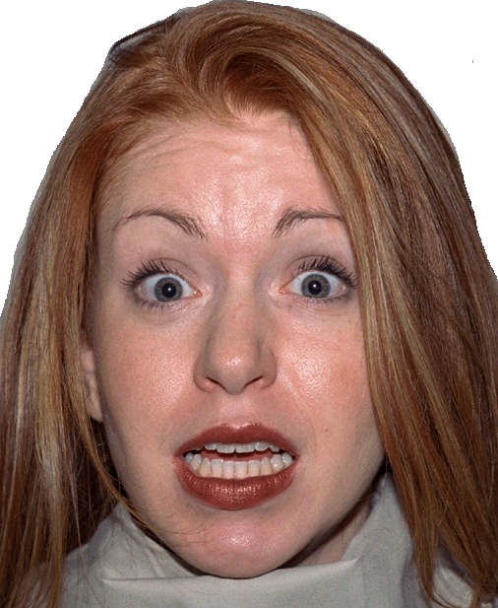
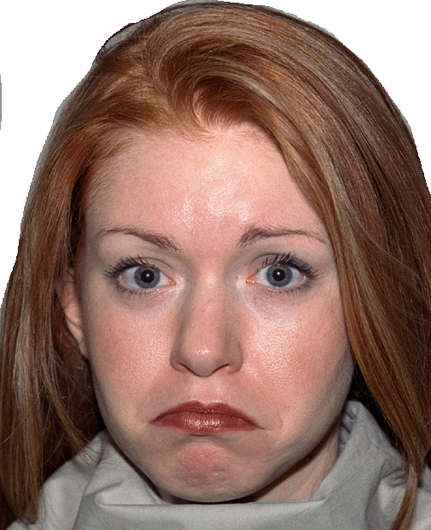
From Tottenham, N., Tanaka, J., Leon, A., McCarry, T., Nurse, M., Hare, T., Marcus, D., Westerlund, A., Casey, B., & Nelson, C. (2009). The NimStim set of facial expressions: Judgments from untrained research participants Psychiatry Research, 168, 242-249.

Slide 9
Post-Perceptual Processing
After perceiving social cues, the brain makes associations and inferences
“Automaticity” of emotional processing
Associations and inferences assigned to the stimuli influence other cognitive processes:
Memory
Attention
Decision making

Slide 10
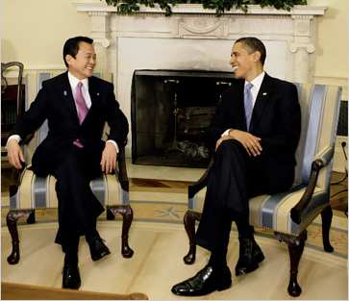

Slide 11
Higher Level Processing
Theory of mind
What is the other person thinking?
Metacognition
Am I thinking about this in an effective way?
Social reasoning
Is he being deceptive?
Is this a good bet?
Should I cooperate with these people?

Slide 12
Social Responses to Stress
Fight-or-flight
Sympathetic nervous system
Hypothalamic-pituitary-adrenocortical axis
“Tend and Befriend”
Appetitive social-approach behavior
Affiliation under stress
Oxytocin and opioids
Relationship distress (elevated oxytocin)
Reduced stress response (elevated oxytocin)
Taylor, S. (2006). Tend and befriend: Biobehavioral bases of affiliation under stress. Current Directions in Psychological Science, 15, 273-277.

Slide 13
“Social Pain”
Theoretical model of social rejection
Consistent with “embodied mind” theory
Brain bases similar to physical pain
Dorsal ACC – physical pain distress and social exclusion
RVPFC – regulation of physical pain distress, diminished distress after social exclusion
Neurochemical and social support interventions affect physical pain and social pain similarly
Eisenberger, Ni. I., & Lieberman, M. D. (2004). Why rejection hurts: A common neural alarm system for physical and social pain. Trends in Cognitive Sciences, 8, 294-300.

Slide 14
Assessment
Interview
Ask patient and family members/caregivers
Insight into impairments may be an issue
Ask about social difficulties and strengths
Understanding what others mean
Frequent misunderstandings
Small talk
Getting needs met in social situations
Social avoidance and social failure behaviors
Behavioral observations
Wonder, how is this behavior related to brain function?

Slide 15
Assessment
Neuropsychological tests
Weschler Adult Intelligence Scale – 4th Ed. (WAIS-IV)
The Awareness of Social Inference Test (TASIT)
Experimental paradigms
facial affect recognition test, Bell-Lysaker Emotion Recognition Task, mind in the eyes test, faux pas test, point-light displays, hotel task, multiple errands test, Iowa Gambling Task
Need for improved assessment methods
Treatment limited by insufficient assessment

Slide 16
Research Findings: TBI
Long-term adjustment and rehabilitation following TBI are better predicted by psychosocial competence than by cognitive or physical sequelae (Bornhofen & McDonald, 2008).
Social deficits following TBI are thought to reflect cognitive deficits.

Slide 17
Research Findings: TBI
Social functioning
Loss of employment, social networks, intimate relationships
Social cognition
Facial expression, body language, tone of voice, theory of mind, sarcasm detection, empathy
Deficits both early after injury and at one-year follow up - persistent and “direct effect of brain injury” (Ietswaart, Milders, Crawford, Currie & Scott, 2008)

Slide 18
Deployment TBI
Age at injury
Adolescent brain and social cognition
Psychopathology and social cognition
PTSD, depression, anxiety
Insult related risk and resilience factors
Type of insult, pathophysiology of insult, post-insult environment
Non-insult related risk and resilience factors
Pre-morbid cognitive and psychological functioning, SES, sociocultural context, legal issues, family functioning

Slide 19
Research Findings: PTSD
Social Functioning
Establishing, reestablishing and maintaining relationships
Avoidance and social withdrawal
Marital discord, divorce, and parenting problems (e.g., Kulka, Schlenger, & Fairbank, 1990)
Social Cognition
Facial affect recognition, especially fear (Sta. Maria, 2002)
Alexithymia (e.g., Frewen, Pain, Dozois, & Lanius, 2006)
Attentional bias for emotional information (Vasterling & Brewin, 2005)
Positive emotional processing and emotional numbness (Jatzko, Schmitt, Demirakca, Weimer, & Braus, 2006)

Slide 20
Research Findings: Psychopathology
Schizophrenia
Autism
Depression
Anxiety
Antisocial Personality Disorder
Bipolar

Slide 21
What could possibly go wrong?

Slide 22
Group Members
TBI/PTSD diagnosis
Difficulty reading social cues, understanding other people’s intentions, making sense of conflicting social cues, and managing emotions in social situations.
Social cognition complaints run the gamut from difficulty connecting emotionally with one’s spouse to trouble accomplishing basic goals in formalized social settings.

Slide 23
Social Cognition Rehabilitation
Weekly, 60-90 minutes, 2-6 Veterans, co-facilitated by neuropsychology and speech
Heterogeneous groups
Divided by expressive language abilities
Neuropsychotherapy approach
Combined psychotherapy and cognitive rehabilitation
Structured sessions
Review homework, new topic, role play, assign homework

Slide 24
Group Modules
Emotion Perception and Expression
Identity and Readjustment
Social Problem Solving

Slide 25
Emotion Perception and Expression
Defining emotions
Static emotion perception
Dynamic emotion perception
Matching tone of voice to content
Reading and conveying body language
Emotional mimicry
Reading social inferences: Sarcasm, humor, sincerity and theory of mind
Social self-awareness
Emotional self-awareness
Distress tolerance
Gathering additional social information

Slide 26
Techniques
Psychoeducational handouts
Videotaping and mirrors
Role plays
Real life examples
Inclusion of friends and family
Homework activities
Social outings

Slide 27
Social Skills Rating Form

Slide 28
Identity and Readjustment
Understanding your injury
Changing roles following injury
Rediscovering role functioning
Ability and disability
Social anxiety
Advocating for yourself
How to convey respect
Parenting
Effective vs. offensive behaviors
Significant other relationships
New psychosocial goals
Identifying social norms
Establishing safety
Circles of care

Slide 29
Social Problem Solving
Understanding the social context
Give and take in conversations
Asking for and accepting help
Active listening
Assertiveness
Topic maintenance
Strategies for self-calming
Explaining your injuries to other people
Dealing with unexpected outcomes
Managing stigma and misperceptions

Slide 30
Issues of Special Importance
Vulnerability to exploitation
Small talk
Self-disclosure
Hopelessness
Socializing without alcohol

Slide 31
Additional Factors that Affect Cognition
Insufficient sleep
Chronic pain
Fatigue
Medications
Hormone and vitamin levels
Dissociative symptoms

Slide 32
Take Home Points
Social functioning is critical to recovery and adjustment following TBI
Assess for cognitive deficits, including social cognition
Do not underestimate the importance of including friends, family, and caregivers in treatment
Anchor treatment in goals that are important to the patient

Slide 33
Take Home Points
Consider social cognition when communicating with a patient:
Be patient – remember that an expressed emotion may be unintended or based on inaccurate appraisal of the situation
Clarify – “Can you repeat back what I am trying to convey?” “Is there something I missed?”
Address nonverbal communication verbally – “How do you feel today?”

Slide 34
Take Home Points
Communicate respect
Try to understand specific deficits and strengths
Design a treatment plan that remediates and/or compensates for deficits and plays to strengths

Slide 35
Take Home Points
In addition to TBI, co-morbid psychopathology may contribute to cognitive difficulties and difficulties in social functioning
Take a team approach and refer to appropriate providers:
Primary care, neurology, physical medicine and rehabilitation, neuropsychology, speech language therapy, occupational therapy, sleep medicine, recreation therapy, social work, driver’s rehabilitation, audiology, vision, individual and family therapy, legal advocacy, supported employment , substance abuse treatment, complimentary and alternative medicine

Slide 36
And remember…

Slide 37
Contact Information
We are currently developing a social cognition rehabilitation workbook. If you would like to receive updates when materials become available, please email: Kelly.McCoy2@va.gov
Thanks!

