Slide 1
Exposures of Concern to Veterans and How to Conduct an
Environmental Exposure Assessment for Veterans
Caring for Veterans with Post Deployment Health Concerns:
Past, Present and Future
March 30-31, 2011
Ron Teichman, MD, MPH, FACP, FACOEM

Slide 2
Ron Teichman, MD, MPH, FACP, FACOEM
Associate Director – Clinical, Education and Risk Communication
War Related Illness and Injury Study Center (WRIISC)
VA New Jersey Health Care System – East Orange, NJ
With the NJ WRIISC for 8 years
Board certified in Internal Medicine and in Occupational and Environmental Medicine

Slide 3
Disclaimer
The views expressed in this presentation are those of the author and do not necessarily represent the position of the Department of Veterans Affairs or the United States Government
I have no known conflicts of interest other than that I work for the Department of Veterans Affairs

Slide 4
What do we know about some of the more common exposures of concern to OEF/OIF Veterans?
How do you conduct environmental exposure assessment with Veterans?

Slide 5
Categorization of Exposures
Weapons Concerns:
Missile warfare
Nerve agents
Depleted Uranium
Environmental Exposures:
Oil well fire soot
Smoke from burning trash and feces
Poor ambient air quality
Local food
Insect bites
Harsh weather
Contaminated water

Slide 6
Categorization of Exposures – cont’d
Disease Prophylaxis and Treatment Concerns:
Pesticides
Pyridostigmine Bromide
Vaccinations
Protective gear
Not all inclusive
Occupational Exposure Concerns:
Diesel, kerosene, and gasoline
Jet fuels and hydraulic fluids
Paints
Solvents
May fall into >1 category

Slide 7
Depleted Uranium
What is this substance?
A by-product of the uranium enrichment process.
About 50% of the radioactivity of natural uranium
Used commercially in medicine for radiation shields, in aviation as counterweights, in petroleum exploration as drilling equipment, and in space as satellite ballast
The U.S. Military, and those of other countries, use DU in both armor–piercing projectiles and in armor

Slide 8
Depleted Uranium - 2
Natural and depleted uranium are primarily alpha emitters
Alpha particles travel only 30 micrometers in skin and cannot penetrate glass, dead skin or paper
DU is classified as a low level radioactive material
Heavy metal similar to tungsten, lead and mercury
Chemical properties and specifically heavy metal toxicity are the primary causes of concern regarding possible health effects from DU exposure

Slide 9
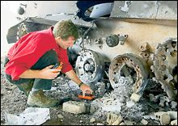
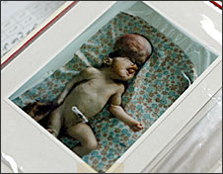
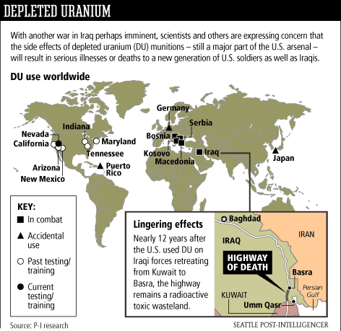
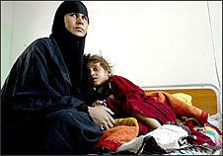
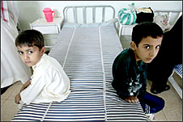

Public Perception - Toxic Effects of DU
Remains of toxic bullets litter Iraq
Horror Of US Depleted
Uranium In Iraq Threatens World
Iraqi cancers, birth defects
blamed on U.S. depleted uranium
Iraq Military Vets "are on DU death row, waiting to die"

Slide 10
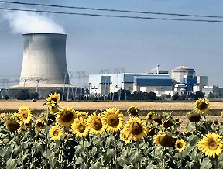

Civilian Uses of Natural Uranium
Primarily used as fuel for nuclear power plants
Smaller amounts used in manufacturing
  Ceramic & pottery glazes
  Yellow glass
  Light bulbs & filaments
  Photographic chemicals
  Dentures
  Leather & wood stains/dyes

Slide 11
Depleted Uranium - 3
How might a Veteran have been exposed?
When a vehicle is hit and penetrated by a DU projectile, it splits into small shards and bursts into flames. The vehicle may fill with flying metal fragments, particles, and dust. Soldiers inside may inhale or swallow airborne particles, be injured by fragments, or have wounds contaminated by DU fragments, particles, and dust.
Soldiers can have retained shrapnel imbedded in soft tissue and muscle. Some shrapnel particles are too small to be safely removed without doing damage to the surrounding tissue.

Slide 12
Depleted Uranium - 4
Rescuers who enter vehicles damaged by DU projectiles may also be exposed to dust and airborne particles. Others may be exposed to DU dust and particles during salvage, cleaning, and reclamation operations.
The main routes of uranium uptake by the service members are inhalation, ingestion, and embedded metal fragments slowly dissolving in the body. In the general population, the major portion of the natural body burden of uranium is derived from ingestion and inhalation of the naturally occurring uranium in the air, food, and water.

Slide 13
Depleted Uranium - 5
What are the known health effects?
Radiation and heavy metal toxicity.
External radiation from DU does not penetrate very far through skin, thus is not much of a health risk.
Ingested and inhaled DU particles are largely expelled through the digestive system and though exhalation.
The first organs of concern with regards to heavy metal toxicity are the kidneys. The VA is following a group of US Veterans from the Gulf War that have DU exposure. As of the time of this writing (2010) no significant health effect has been identified.

Slide 14
Depleted Uranium - 6
Is there a way to test to confirm exposure?
A 24 hour urine collection for uranium may be conducted on any Gulf War Veteran that so requests. If the total count is elevated, a fractionation may be performed to identify how much, if any, of the uranium is DU. Being coordinated through the Baltimore, MD VAMC.
Is there a way to test for health effects?
Urinalysis for proteinuria and blood tests for BUN and creatinine are very helpful in determining the presence of renal pathology. However, there are no tests that will specifically identify DU related renal insufficiency.

Slide 15
Depleted Uranium - 7
Are there specific treatments for the health effects secondary to exposure?
At this time there are no recognized adverse health outcomes of exposure to DU. However, Veterans who have exposure concerns are periodically monitored for adverse health effects through the DU follow-up program at the Baltimore VAMC.
Additional diagnostic resources
Veterans that still have concerns about this exposure may be referred to the VA’s War Related Illness and Injury Study Center (WRIISC).

Slide 16
Sandstorms
What is this substance?
Extremely fine sand, comparable to our dust. Wind blowing across large areas of flat terrain picks up the sand and creates sandstorms.
Microscopically this is a matrix that can carry a variety of chemicals, bacteria, viruses, fungi, etc. NEW INFO
How might a Veteran have been exposed?
Anyone that has been through a sandstorm will know it. The sky typically darkens, the dust in the air becomes thick, visibility drops significantly and every mucous membrane may become irritated.

Slide 17
Sandstorms - 2

Slide 18
Sandstorms - 3
What are the known health effects?
Very limited data regarding direct health effects.
Reasonably good evidence that individuals with chronic pulmonary and/or cardiac disease are at increased risk of exacerbation during or shortly after exposure to sandstorms.
There is anecdotal evidence of the development of reactive airway disease following exposure to sandstorms, with a variable time to onset. Additional investigations are continuing. (to be further discussed with burn pits)

Slide 19
Sandstorms - 4
Is there a way to test to confirm exposure?
No, there are no tests available that will specifically test for previous (18 years ago) exposure to sandstorms.
Is there a way to test for health effects?
All Veterans with pulmonary symptoms, including SOB at rest or with exertion, or with decreased exercise tolerance in the absence of other known causes, should have a base line PFT, with testing both pre- and post-bronchodilator and a baseline CXR. The exact periodicity with which these tests should be repeated is unclear, and should be based on clinical evaluation of the patient’s condition.

Slide 20
Sandstorms - 5
Are there specific treatments for the health effects secondary to exposure?
No. Pulmonary problems secondary to this exposure are treated the same way that the same symptoms or disorders are treated when from other causes or when idiopathic.
Additional diagnostic resources
Veterans that still have concerns about this exposure may be referred to the VA’s War Related Illness and Injury Study Center (WRIISC).

Slide 21
Multiple Vaccinations
What is this substance?
A vaccination is a preparation of killed microorganisms, living weakened organisms, noninfectious particles of organisms, etc. introduced into the body to produce immunity by causing the formation of antibodies .
How might a Veteran have been exposed?
Before and during deployment s all troops are given the inoculations against infectious diseases that would be given to any US citizen traveling to that part of the world. In addition, Anthrax and botulinum toxoid was given to many Service Members.

Slide 22
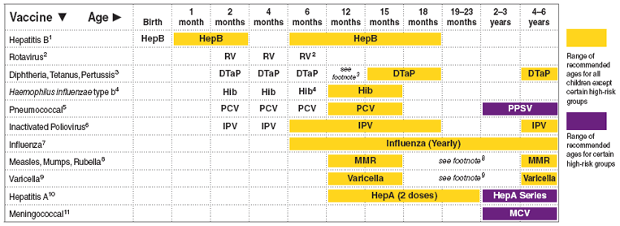
Advisory Committee on Immunization Practice (ACIP)
Recommended immunization schedule for persons aged 0 through 6 years --- United States, 2010
Recommended immunization schedule for persons aged 0 through 6 years --- United States, 2010

Slide 23
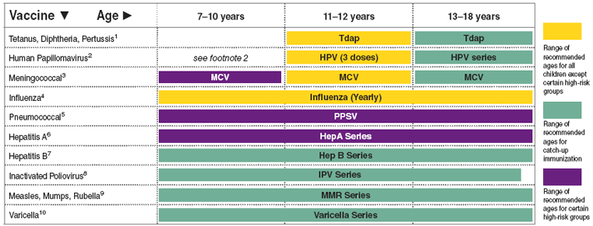
Advisory Committee on Immunization Practice (ACIP)
Recommended immunization schedule for persons aged 7 through 18 years --- United States, 2010
Recommended immunization schedule for persons aged 7 through 18 years --- United States, 2010

Slide 24
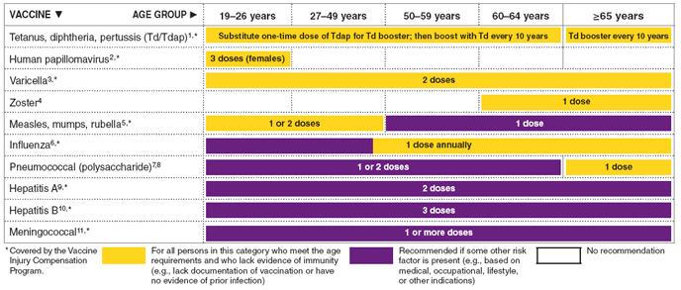
Advisory Committee on Immunization Practice (ACIP)
Recommended adult immunization schedule, by vaccine and age group - United States, 2010
Recommended adult immunization schedule, by vaccine and age group - United States, 2010

Slide 25
Vaccines Routinely Administered to All Military Recruits (PGW Era)
Vaccine | Schedule
Adenovirus | 1 oral dose
Influenza | Annual shot
Measles | 1 shot
Meningococcal | 1st shot & booster every 3-5 years
Polio | 1 oral dose
Tetanus-Diphtheria | Booster every 10 years
Rubella | I shot
Small pox (through the late 1980s) | 1 dose

Slide 26
Vaccines Administered to Special Military Occupations (PGW Era)
Vaccine | Personnel | Schedule
Plague | Marines, Navy, Army, Special forces, at-risk occupations or deployment to at risk areas | 5 shots over 12 months then booster every 1-2 years
Smallpox | Vaccine or booster to new recruits through the late 1980’s | 1 dose
Typhoid | Army & Air Force alert forces for deployment to high risk areas | 2 doses in 2 months, then booster every 3 years
Yellow Fever | Navy, Marines, Army and Air Force alert forces and for deployment to high risk areas | 1st shot, then booster every 10 years

Slide 27
Multiple Vaccinations - 2
What are the known health effects?
A common reaction is local erythema, swelling and tenderness, malaise and a “viral illness” like syndrome. Typically onset within 12-24 hours and tend to resolve within 48-72 hours of onset. Same with Anthrax vaccine.
Studies show rare delayed onset of side effects to any of the common vaccinations. There is a small number of individuals that will have a serious reaction following administration of any immunization, but this number is not significantly larger for Anthrax vaccine.
Multiple vaccinations on the same day common practice.
Unproven theory.

Slide 28
Multiple Vaccinations - 3
Is there a way to test to confirm exposure?
Blood tests may indicate prior vaccination or exposures to the native infection. However, there are no tests available that will specifically test for multiple vaccination related immune dysregulation.
Is there a way to test for health effects?
Blood tests can assess different components of the immune system, both in terms of quantity and function. However, since there is still no objective evidence of a specific type of immune dysregulation related to multiple vaccinations there are no tests currently recommended.

Slide 29
Multiple Vaccinations - 4
Are there specific treatments for the health effects secondary to exposure?
No, there are no specific treatments because there are no known clinical entities connected to this exposure.
Additional diagnostic resources
Veterans that still have concerns about this exposure may be referred to the VA’s War Related Illness and Injury Study Center (WRIISC).

Slide 30
Hexavalent Chromium –
Qarmat Ali
What is this Substance?
Water treatment facility near Basra, Iraq. Sodium Dichromate used as an anticorrosive agent in pipes. Chromium is a known human carcinogen.
How might a Veteran have been exposed?
During looting large bags were vandalized and the chemical spread over the site. From April to September 2003, probability of some (unknown level) exposure to NG troops, 700, from IN, OR, WV and SC.
Airborne, Dermal, Ingestion, Direct Inhalation?

Slide 31
Qarmat Ali - 2
What are the known health effects?
Nose irritations, nose bleeds, chrome holes
Allergic reactions, including skin rashes, chrome ulcers
Respiratory problems such as asthma, cough, shortness of breath, wheezing
Lung cancer

Slide 32
Qarmat Ali - 3
Is there a way to test to confirm exposure?
Blood and urine tests not helpful 7 years later.
Is there a way to test for health effects?
Presence of chrome holes and/or ulcers with no other source of exposure.
Current recommendation is for CXR, PFT and directed PE.

Slide 33
Qarmat Ali - 4
Are there specific treatments for the health effects secondary to exposure?
No, clinical conditions secondary to chrome exposure are treated based on the condition regardless of causation. The exception is to ensure no further exposure and no aggravating conditions or behaviors.
Additional diagnostic resources
Veterans identified as having worked at the site during the time in question (now in 32 states) have been directly contacted to have a PGW Registry exam. Questions, tests and exam components have been added and they will be followed-up in one year. Precedent setting!

Slide 34
Burn Pits
What is this Substance?
Military burns all waste, including paper, wood, metal, chemical, vegetable, human, etc. many burn pits operated 24/7. As large as 100 acres.
Sampling reveals multiple contaminants in very low levels*.
How might a Veteran have been exposed?
Working or being billeted downwind
Most actual operators were/are contractors
Regulations about what should not be burned, but…

Slide 35
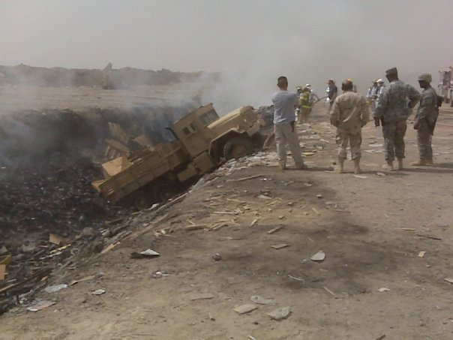
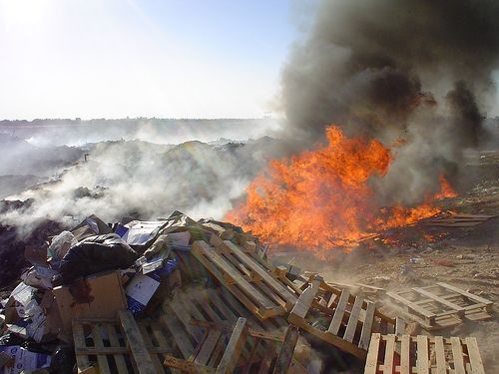
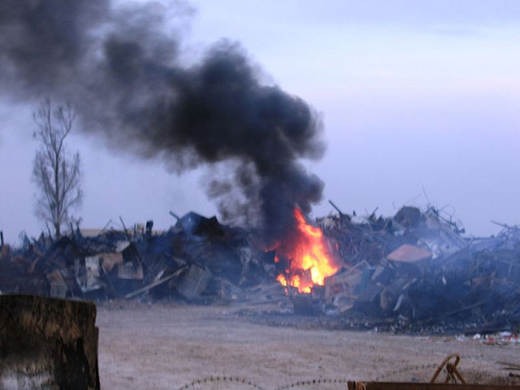
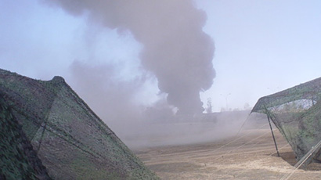

Slide 36
Burn Pits - 2
What are the known health effects?
Not sure, believe asthma and sinusitis.
Unproven what else, many studies are ongoing.
Possible small airway condition, resulting in reduced exercise tolerance?
Is there a way to test to confirm exposure?
No
Is there a way to test for health effects?
No. Recommendations being written for probable CXR, PFT with BD, possible CT, EST, Prone CT, etc.

Slide 37
Burn Pits - 3
Are there specific treatments for the health effects secondary to exposure?
No, clinical conditions are treated based on the condition regardless of causation. The exception is to ensure no further exposure and no aggravating conditions or behaviors.
Additional diagnostic resources
Veterans that still have concerns about this exposure may be referred to the VA’s War Related Illness and Injury Study Center (WRIISC). Although most answers not yet known.

Slide 38
How to conduct an environmental exposure assessment for veterans
Why?
  ¼ Million Service Members with concerns (at least)
  50% not receiving care from the VA
  Prevention

Slide 39
Environmental Exposure Assessment
Step by Step “How To”
Introduction - Display empathy and care for the veteran to establish trust and credibility. Tell the veteran upfront that you will be honest - explaining what you do and don't know. Listen actively and patiently. Most veterans can tell dissembling from across the room.

Slide 40
Environmental Exposure Assessment
Step by Step “How To”
Explanation of plan - Describing how you'll conduct the assessment gives the veteran some "control" and makes them a partner in the assessment. Think about the fact that this is a Veteran, trained to listen to authority, but may feel like they have had that trust violated.

Slide 41
Environmental Exposure Assessment
Step by Step “How To”
Basic toxicology - Explain the need for a route of exposure and for a temporal relationship between exposure and effect. Explaining this in the generic sense may make discussions of specific exposures much easier for the Veteran to understand.

Slide 42
Environmental Exposure Assessment
Step by Step “How To”
Exposure history pre-enlistment/pre-deployment - Ask about location of birth, residencies, environment, schooling, neighborhood exposures, hobbies, travel, summer activities, and all jobs, etc. You know all this already.

Slide 43
Environmental Exposure Assessment
Step by Step “How To”
Exposure history of deployment(s) - This is what a veteran came to talk about. Include: time, duration and location of deployment(s); In area of hostilities?; Under fire and/or fired weapon?; Chemical alarms?; Antidote tablets?; Prophylactic medicines?;

Slide 44
Environmental Exposure Assessment
Step by Step “How To”
Exposure history of deployment(s) - Traumatic brain injury? (not covered in today’s presentation, but very important); Food and drink?; Immunizations and reactions to them?; Pesticide use – approved, unapproved, flea collars?; Illness while in theater?;

Slide 45
Environmental Exposure Assessment
Step by Step “How To”
Exposure history of deployment(s) – Sanitation during deployment? Illness while in theater?; Chemical exposures?; Exposure to air pollution – general or a specific factory, e.g., cement?; Burn pits?; Bugs, including flies?; Sand and sandstorms?

Slide 46
Environmental Exposure Assessment
Step by Step “How To”
Exposure history of deployment(s) – There is a growing list of specific instances of possible toxic exposure. Knowing the specifics of where the Veteran was and when they were there can make a huge difference in whether you can reassure them or not. Duration, extent and immediate effects are critical to ascertain.

Slide 47
Environmental Exposure Assessment
Step by Step “How To”
Exposure history post-deployment - Same issues as in pre-deployment exposure history. Ask about multiple deployments. Include treatments for conditions which began post-deployment.

Slide 48
Environmental Exposure Assessment
Step by Step “How To”
Exposure history post-separation - Again ask about residencies, hobbies, travel, employment, etc. Many veterans become government contractors with the same types of exposures as when they were active duty.

Slide 49
Environmental Exposure Assessment
Step by Step “How To”
Other exposures - Asking about anything you may have missed reinforces that the veteran is a partner in the process and not just a passive participant.

Slide 50
Environmental Exposure Assessment
Step by Step “How To”
Specific exposure concerns - An important Risk Communication principle is to identify their concerns and provide information that addresses those concerns. Ranking the degree of concern can be helpful. The goal is to demonstrate that you were listening and that the evaluation is a dialogue.
Risk communication is a two-way street, it is not risk speaking.

Slide 51
Environmental Exposure Assessment
Step by Step “How To”
Education and risk communication
  Honest information from a knowledgeable and credible source is the key to the assessment.
  Risk communication must be integrated throughout the evaluation.

Slide 52
Environmental Exposure Assessment
Step by Step “How To”
Education and risk communication –2
  Don't talk down to the veteran.
  Remember that risk perception is not misperception, but a different perception.
  Comparisons can be helpful but be careful.
  Make sure you listen to what is being said, verbally and otherwise, including underlying concerns.

Slide 53
Thank you
NJ WRIISC
800-248-8005
www.warrelatedillness.va.gov

Slide 54
Oil Well Fire Smoke
What is this substance?
PGW ~ 700 Kuwaiti oil wells were set aflame by the retreating Iraqi army. The last one was not fully put out until 11/91, 8 months after the war ended. There was a plume of smoke and soot visible from space. At peak, the smoke absorbed 75 to 80% of the sun’s radiation.
How might a Veteran have been exposed?
Service members may have been exposed to the smoke and soot by inhalation or by ingestion. The latter because the oily soot covered many things, including hands and the food being eaten.

Slide 55
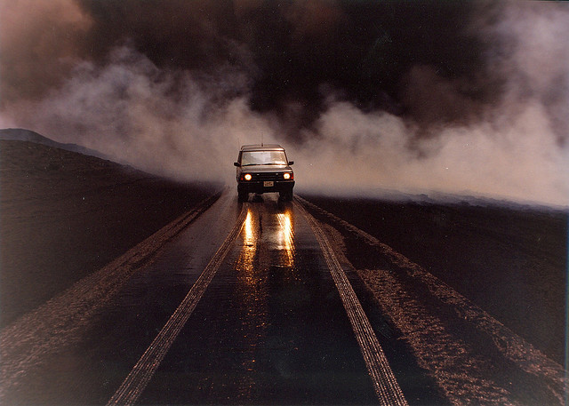
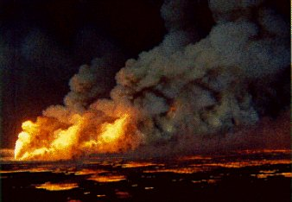
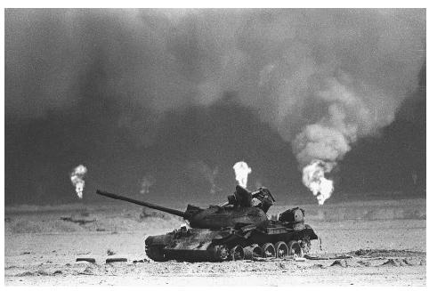
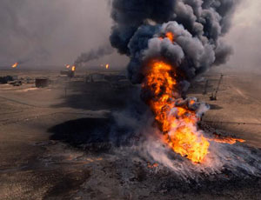

Slide 56
Oil Well Fire Smoke - 2
What are the known health effects?
At the time, the medical and environmental community feared exposure would result in catastrophic acute and chronic health effects. Air monitoring studies indicated that, except for particulate matter, the amounts of air contaminants at ground level were within the limits generally considered as safe for the general population.
The fires’ high combustion efficiency, the lofting effect created by the intense heat of the fires and solar effects, and the local wind and weather conditions combined to reduce the fires’ impact on military and civilian populations.

Slide 57
Oil Well Fire Smoke - 3
Many veterans described black nasal discharge, coughing up black mucous, eye and throat irritation, and the onset of skin rashes and shortness of breath. Some of these problems involved a worsening of an existing respiratory condition (e.g., asthma, bronchitis). High concentrations of particulate matter can provoke respiratory tract irritation and a worsening of symptoms in people with a predisposition to asthma or reactive airway disease.

Slide 58
Oil Well Fire Smoke - 4
Is there a way to test to confirm exposure?
No, there are no tests available that will specifically test for previous (19 years ago) exposure to oil well fires.
Is there a way to test for health effects?
All Vets with pulmonary symptoms, including SOB at rest or with exertion, or with decreased exercise tolerance in the absence of other known causes, should have a base line PFT, with testing both pre- and post-bronchodilator and a baseline chest X-ray. The exact periodicity with which these tests should be repeated is unclear, and should be based on clinical evaluation of the patient’s condition.

Slide 59
Oil Well Fire Smoke - 5
Are there specific treatments for the health effects secondary to exposure?
No. Pulmonary problems secondary to this exposure are treated the same way that the same symptoms or disorders are treated when from other causes or when idiopathic.
Additional diagnostic resources
Veterans that still have concerns about this exposure may be referred to the VA’s War Related Illness and Injury Study Center (WRIISC).

