Slide 1
RETURNING VETERANS WITH HEALTH CONCERNS AND EMERGING PROBLEMS
War Related Illness & Injury Study Center (WRIISC)

Slide 2
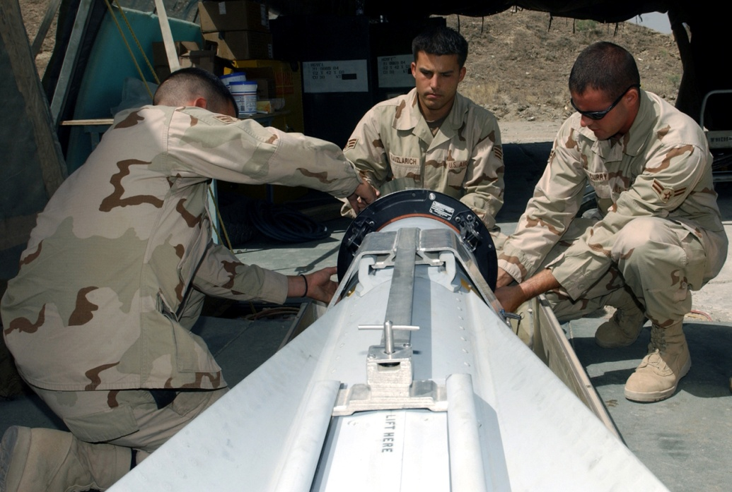
The War Related Illness and Injury Study Center (WRIISC) A national program in the Department of Veterans Affairs (VA), initially established in 2001 to address post-deployment health issues from the Gulf War.
Notes:
The WRIISC pronounced “risk” was first organized based on recommendations from the Institute of Medicine.
NJ and DC were established first, followed by Palo Alto in 2008.

Slide 3
ABOUT THE WRIISC
Deployed Veterans have unique healthcare issues and concerns. The WRIISC now serves Veterans from any era or conflict with war related illnesses and injuries through clinical assessments, education, and research.

Slide 4
WHERE WE ARE
Three National Locations Covering Three Regions
East Orange, New Jersey
Washington, DC
Palo Alto, California

Slide 5
WRIISC REGIONAL MAP

Slide 6
REASONS TO REFER
Complex health history with no known etiology (medically unexplained symptoms—MUS)
History includes many tests and treatment with little to no symptom improvement
Possible deployment-related environmental exposures
Second opinion is not available locally
Providers frustrated with lack in progress

Slide 7
REFERRAL PROCESS
Fax the following to the National Referral Program Coordinator at 202-495-5974
WRIISC Pre-screen form (10-0417) in the VA Handbook
Veteran’s DD214, if available
Primary Care Providers Complete the Referral process through CPRS
Notes Tab (NOT CONSULTS), New Note, WRIISC Assessment Note
Call your regional WRIISC Program

Slide 8
THE WRIISC CLINICAL TEAM
Physicians
Physician assistants
Nurses
Nurse practitioners
Specialists in environmental exposure assessments
Psychologists
Neuropsychologists
Social workers
Risk communication specialists
Health education specialists
Health care professionals that specialize in Complementary and Alternative Medicine (CAM) such as:
Acupuncturists
Yoga instructors

Slide 9
CLINICAL EVALUATIONS
Comprehensive Interdisciplinary Evaluation
Focus is on symptoms and improving function.
Comprehensive environmental exposure consults available for Veterans of any conflict - No referral necessary and phone consults available.
Duration of Exam
1 to 5 day evaluations as pre-determined by WRIISC clinical team and depending on location of program.
Based on complexity of case and the individual Veteran’s needs.

Slide 10
CLINICAL EVALUATION COMPONENTS
History and Physical
Psychological Evaluation
Neuropsychological Evaluation
Environmental Exposure Assessment
Social Work Interview
Education Session
Complementary and Alternative Medicine (CAM)
Labs, X-ray's, EKGs, PFTs

Slide 11
Exposure Assessment
Occupational and environmental medicine physicians conduct exposure evaluations
Also done as a stand alone service to any Veteran of any era
Can be done over the telephone for Veterans living around the U.S.

Slide 13
TREATMENT ROADMAP
Interdisciplinary Team meeting with Veteran and family members
Recommendations documented to Veteran and Primary Care Provider
Follow up care provided at VA health facility of the Veteran’s residence
WRIISC assessment one of many tools in the VA toolkit

Slide 14
CLINICAL FOLLOW UP
Follow up by Social Work at 1mo, 6 mo and 1 year post evaluation
Follow-up with VA primary care provider
Summary of findings and recommendations
Satisfaction Surveys—Veteran & Primary Care Provider
Follow-up health survey: 6 mo post eval
How satisfied?
Barriers to recommendation implementation?
Symptom management?

Slide 15
CLINICAL STATISTICS
The WRIISCs have been steadily expanding capacity since inception
WRIISC sites increased from 2 to 3 in 2007
Complex health evaluations in more than 1400 veterans to date
Patient Satisfaction Surveys overwhelmingly positive
“I am an absolute firm believer that the WRIISC was instrumental in changing my life for the better.”—Brent Casey, Gulf War Veteran (2010)

Slide 16
EDUCATION AND RISK COMMUNICATION

Slide 17
EDUCATION FOR VETERANS AND PROVIDERS
Risk Communication
Environmental Exposures and Assessment
PTSD
mTBI
Medically Unexplained Symptoms
Reintegration
Military Culture

Slide 18
OUTREACH AND NETWORKING
Structured outreach strategy to reach Veterans via presentations and face to face meetings with:
VAMC Directors and VISN Directors
Representatives of Veteran Support Organizations (VSOs)
VA and non-VA providers
Staff of Vet Centers
Military Community
Families

Slide 19
EDUCATION AND OUTREACH EFFORTS
Visibility
Penetration
Increase in
Referrals
Benefit to Veteran
Outreach

Slide 20
RESEARCH

Slide 21
WRIISC RESEARCH COLLABORATIONS
Mount Sinai School of Medicine
New Jersey Medical School
New York University
Stanford University
Johns Hopkins Medical School
Georgetown University
UC Berkeley
Harvard Medical School
University of Wisconsin
NASA

Slide 22
WRIISC RESEARCH
Basic Science Studies
Physiological Studies
Neuroimaging Studies
Behavioral studies
Clinical Treatment Trials
Health Services Research

Slide 23
SUMMARY
The WRIISC is a VA National Resource for Veterans of all eras with a holistic approach by a multi-disciplinary team of clinicians and scientists who focus on post-deployment health, managing symptoms and improving function.
Primary WRIISC components are comprehensive clinical evaluations, research, education and risk communication.
Once seen by the WRIISC, Veterans return to their VA facilities for follow up care.
Referrals are routed by the National Referral Program Coordinator–a two step process that includes the WRIISC referral form (10-0417) faxed to 202-495-5974 and the WRIISC assessment note in CPRS.
Website: www.warrelatedillness.va.gov

Slide 24
WRIISC CONTACT INFO
NATIONAL REFERRAL PROGRAM
FAX NUMBER: 202-495-5974
CA WRIISC: 1-888-482-4376 or
WRIISC.CA@VA.GOV
DC WRIISC: 1-800-722-8340 or WRIISC.DC@VA.GOV
NJ WRIISC: 1-800-248-8005 or WRIISC.NJ@VA.GOV
www.warrelatedillness.va.gov

Slide 25
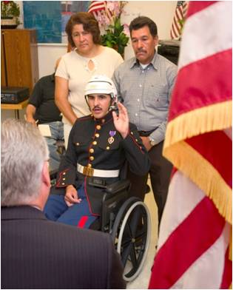
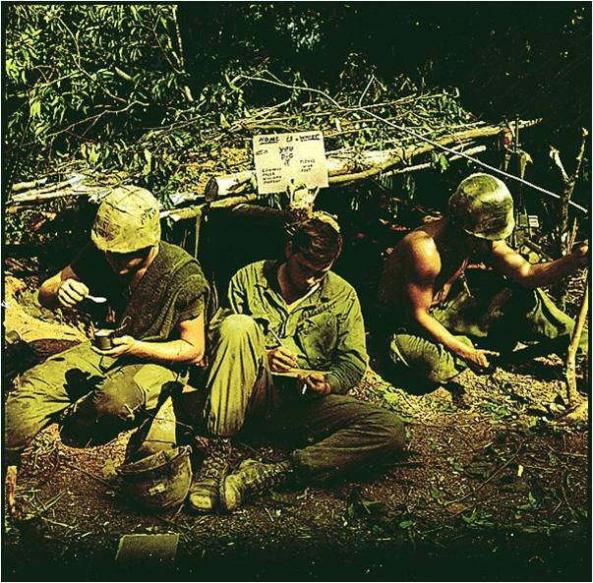
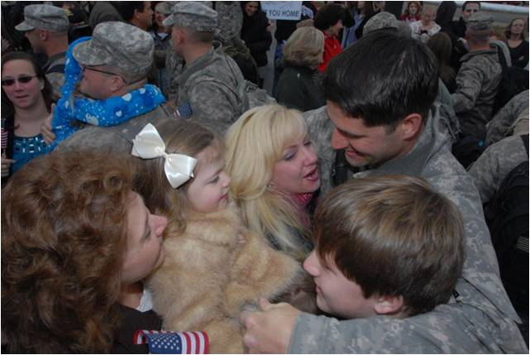

Slide 26
Questions??

