Slide 1
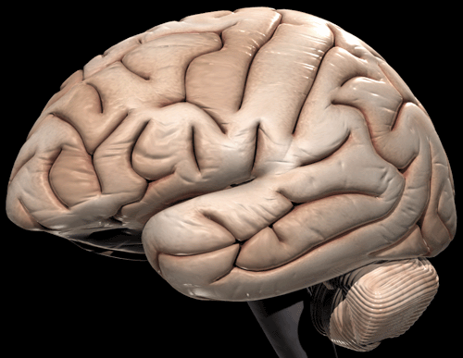
Traumatic Brain Injury
Diagnostic Challenges &
Emerging Tools
Julie C. Chapman, PsyD

Slide 2
VA/DOD Definition of TBI
A traumatically induced structural injury AND/OR
physiologic disruption of brain function
as a result of an external force
that is indicated by new onset or worsening of
at least one of the following clinical signs
immediately following the event

Slide 3
VA/DOD Definition of TBI
At least one of the following clinical signs immediately following the event:
Any period of loss of consciousness
Any loss of memory for events immediately before or after injury
Any alteration in mental state at the time of injury
Neurologic deficits
Intracranial lesion

Slide 4
How is TBI Diagnosed?
2nd Level TBI Evaluation:
  Interview
  Physical Examination
  Neurobehavioral Symptom Inventory
TBI is often retrospectively diagnosed

Slide 5
Severity of Injury
Three main indices:
  Duration of Loss of Consciousness (LOC) or Alteration of Consciousness (AOC)
  Post-Traumatic Amnesia (PTA)
  Glasgow Coma Scale (GCS)

Slide 6
Severity of Injury (VA/DOD)
Criteria | Mild | Moderate | Severe
LOC | 0 - 30 mins | 31 mins - 24 hrs | >24 hours
AOC | Moment - 24 hrs | >24 hours. Severity based on other criteria
PTA | 0 - 1 Day | 2 – 7 Days | >7 Days
GCS | 13 - 15 | 9 – 12 | <9
Structural Imaging | Normal | Normal or Abnormal | Normal or Abnormal

Slide 7
Diagnostic Challenges:
Self Report
Diagnostic criteria is based largely upon patient self-report, particularly in mild TBI.
Possible threats to diagnostic accuracy:
  Recall
  Cognitive difficulties
  Other factors

Slide 8
Diagnostic Challenges: Symptom Overlap
TBI
PTSD
  Insomnia
  Memory Problems
  Poor concentration
  Depression
  Anxiety
  Irritability
  Headache
  Dizziness
  Fatigue
  Noise/light intolerance
  Insomnia
  Memory problems
  Poor concentration
  Depression
  Anxiety
  Irritability
  Re-experiencing
  Avoidance
  Emotional numbing

Slide 9
Integrative Diagnostics
Patient
Self-Report
Objective Diagnostic Markers
GESTALT

Slide 10

All Hands on Deck
Epidemiology
Laboratory Science
Clinical Science

Slide 11
Integrative Diagnostics
Predictive Modeling

Slide 12
Integrative Diagnostics
Patient Influence During Measurement
LOW HIGH
Operator-
Independent
Measures
Operator-
Influenced
Measures
Operator-
Dependent
Measures
Structural Neuroimaging, Endocrine Tests,
Polysomnography
Functional Neuroimaging,
Cognitive Tests,
Sensorimotor
Patient self-
reported
measures

Slide 13
Integrative Diagnostics
Operator-
Independent
Measures
Operator-
Dependent
Measures
Degree of
Congruence
Operator-
Influenced
Measures

Slide 14
Markers for the Identification, Norming & Differentiation (MIND) of TBI and PTSD
The MIND Study

Slide 15
The MIND Study
Principal Investigator
Julie C. Chapman, PsyD
Co-Principal Investigator
Aaron Schneiderman, PhD
Tri-WRIISC Study (DC, East Orange, Palo Alto)
Led by Washington, DC WRIISC
Clinical Research Evaluation of OEF/OIF Veterans from the Epidemiological Study
Conceptualization from the Blast Injury Outcome Study

Slide 16
Integration of Epidemiologic & Clinical Sciences
New Generation Study (EES)
Epidemiologic Study
Mail, Telephone & Online Surveys of Health Outcomes
60,000 Veterans: 30,000 OEF/OIF & 30,000 Era
Population-based Sample
MIND Study (WRIISC)
Tri-WRIISC Study (DC, New Jersey, California)
Conceptualization from Blast Injury Outcomes (BIO) Study

Slide 17
Study Design
MIND Study n=800
24 Months Enrollment
Groups | TBI |  | PTSD |  | Deployed
 | Yes | No | Yes | No | Yes | No
Group 1 (TBI only) | X |  |  | X | X
Group 2 (PTSD only) |  | X | X |  | X
Group 3 (Both) | X |  | X |  | X
Group 4 (Neither) |  | X |  | X | X

Slide 18
Phase One Aims
MIND Study
Aim 1: To clinically validate the prevalence of TBI and PTSD in OEF/OIF Veterans estimated by the New Generation (Epi) Study.
Aim 2: To assess the effectiveness of VHA screening instruments for TBI and PTSD in OEF/OIF Veterans.

Slide 19
Phase Two Aims
MIND Study
Aim 1: To identify sensitive & specific markers for both conditions from each measurement modality.
Aim 2: To develop prediction models for both conditions using multi-system, objective measures and patient self-report.
Measures include:
-Cognitive -Advanced Neuroimaging
-Sensorimotor -Sleep (Actigraphy)

Slide 20
Phase Three Aims
MIND Study
Aim 1: To identify sensitive & specific markers for TBI from each measurement modality.
Aim 2: To develop prediction models for TBI using multi-system, objective measures and patient self-report.
Measures include:
- Neuroendocrine/Immunology
- Sleep (Polysomnography)

Slide 21
Prior Work
Neurobehavioral Study
Blast Injury Outcomes (BIO) Study
MIND Study conceptualized during BIO Study:
  Multi-modal measures
  Integrative methods
  Diagnostic profiles

Slide 22
Blast Injury Outcomes (BIO) Study:
PET, DTI, fMRI & Neurocognitive Measures
Julie C. Chapman, PsyD
Principal Investigator
Aim I: To characterize blast-related mild TBI (and PTSD) using multi-modal measures:
- Neuroimaging - Cognitive - Neurologic
- Psychosocial - Basic Physiologic

Slide 23
Blast Injury Outcomes (BIO) Study:
PET, DTI, fMRI & Neurocognitive Measures
Julie C. Chapman, PsyD
Principal Investigator
Aim II: To examine relationships between multi-modal measures for both conditions (TBI and PTSD).
Aim III: To complete diagnostic prediction modeling for both conditions.

Slide 24
Blast Injury Outcomes
Study Design
Groups | Mild TBI |  | PTSD |  | Deployed
 | Yes | No | Yes | No | Yes | No
Group 1 (TBI only, Deployed) | X |  |  | X | X
Group 2 (TBI + PTSD, Deployed) | X |  | X |  | X
Group 3 (PTSD only, Deployed) |  | X | X |  | X
Group 4 (Neither, Deployed) |  | X |  | X | X
Group 5 (Neither, NOT Deployed) |  | X |  | X |  | X

Slide 25
Structural Neuroimaging:
Diffusion Tensor Imaging (DTI)
Measures the movement of water molecules in neurons.
Diffusion is an intrinsic physical process independent of the MR effect & magnetic field.
White matter tracts can be visualized and estimated in vivo.

Slide 26
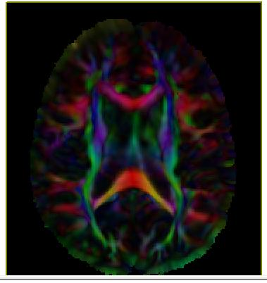
Blast Injury Outcomes (BIO) Study
Chapman
Notes:
Cut at Mid Thalamus

Slide 27
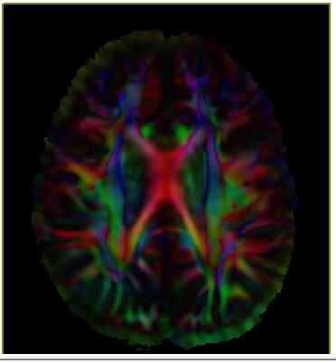
Blast Injury Outcomes (BIO) Study
Chapman
Notes:
Cut at Mid CC

Slide 28
Neurologic Measures
Heitger et al. 2009: Antisaccades and visual tracking more impaired in patients with post-concussive syndrome at avg of 140 days post-injury than controls
Wortzel et al. 2009: Presence of frontal release signs plus paratonia predicted cognitive and functional impairment in a acute TBI.
Chapman et al. 2010: Presence of visual tracking, frontal release signs and antisaccades predicted mTBI versus No TBI group.
Chapman et al. Screening for Mild Traumatic Brain Injury in the Presence of
Psychiatric Comorbidities. Arch Phys Med Rehabil, 2010;91:1082-6.

Slide 29
Mentors & Senior Colleagues
Jonathan H. Pincus, MD
Susumu Mori, PhD
Marshall Balish, MD, PhD
J. Wesson Ashford, MD, PhD
Marc R. Blackman, MD
Joel Scholten, MD
Eric Nylen, MD
Richard B. Rosse, MD
Barbara Sigford, MD

Slide 30
Students
Noah M. Meyers, MA
Christie Eickhoff, MS
Angela C. Cerkovich, MA
Lauren A. Roselli, BS
Jordan A. Jackson, BS
Patrick M. Sullivan, MS
Thomas H. Nassif, MS
Kathryn C. Edwards, BS
Carissa J. Mehos, BS

Slide 31
Contact Us
ADDRESS: War Related Illness & Injury Study Center
Veterans Affairs Medical Center
MS 127
Washington, DC 20422
PHONE: (202) 745-8249
EMAIL: Julie.Chapman@va.gov
Chapman.Research@va.gov
VISIT OUR WEBSITE:
www.warrelatedillness.va.gov/dc/

