Slide 1
The War Related Illness and Injury Study Center (WRIISC)
Susan L. Santos, PhD, M.S.
Assistant Director, Risk Communication & Education
War Related Illness & Injury Study Center
VA NJ Health Care System
East Orange, NJ

Slide 2
Disclaimer
The views expressed in this presentation are those of the author and do not necessarily represent the position of the Department of Veterans Affairs or the United States Government
I have no known conflicts of interest other than that I work for the Department of Veterans Affairs

Slide 3
Presentation Topics
History and Mission of the WRIISC
Location and Areas Served
Services Provided
How to Make a Referral

Slide 4
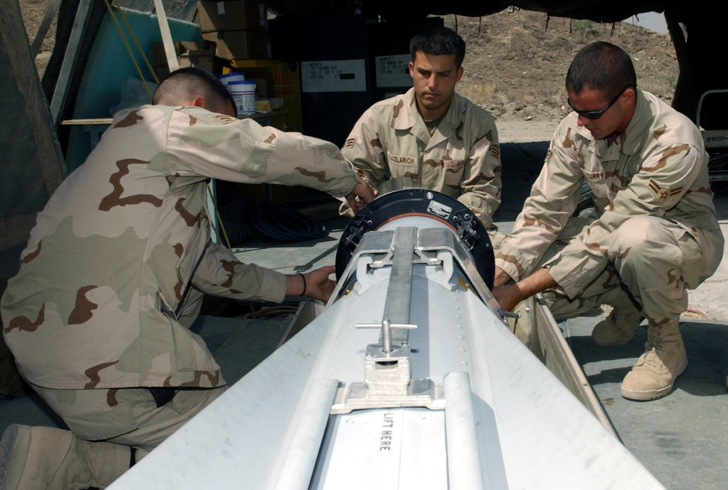
The War Related Illness and Injury Study Center (WRIISC)
A National program in the Department of Veterans Affairs (VA), established in 2001 to address post-deployment health issues from the Gulf War.

Slide 5
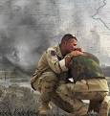

About the WRIISC
The mission of the WRIISC is to improve the health of Veterans with war related illnesses and injuries through clinical assessments, education, risk communication and research.
A key element of our mission is to provide education to providers on deployment related healthcare issues such as exposures and medically unexplained symptoms.

Slide 6
Where We Are
Three National Locations
East Orange, New Jersey
Washington, DC
Palo Alto, California

Slide 7
Geographic Regions

Slide 8
NJ WRIISC Region by WRIISC
VISN 1: ME, MA, NH, VT, RI, CT
VISN 2: Northern NY
VISN 3: NYC Metropolitan area and Northern NJ
VISN 4: Southern NJ, PA, DE
VISN 10: OH
VISN 11: MI, IL, IN
VISN 12: MI, IL, WI
VISN 15: MO, KS
VISN 23: IA, NE, MN, ND, SD

Slide 9

WRIISC Services
Clinical
Education/Risk Communication
Research

Slide 10
Clinical Services
Specialized clinical evaluation services for Veterans and their health care providers.
A multidisciplinary team who are experts in a wide variety of post-deployment health concerns that include environmental exposures and symptoms/syndromes that do not have a clear medical explanation.
The WRIISC supports primary care for Veterans in the VA Healthcare System.

Slide 11
The WRIISC Clinical Team
Medical doctors
Physician assistants
Nurses
Nurse practitioners
Specialists in environmental exposure assessments
Psychologists
Neuropsychologists
Social workers
Risk communication specialists
Health education specialists
Health care professionals that specialize in Complementary and Alternative Medicine (CAM) such as:
  Acupuncturists
  Yoga instructors

Slide 12

Clinical Assessments
Comprehensive medical evaluations of Veterans with environmental exposure concerns and medically unexplained symptoms for:
  Veterans with health problems from any era or conflict
  OEF/OIF Veterans with health concerns related to deployment

Slide 13

Clinical Assessments (cont.)
Screening evaluation for mild traumatic brain injury and PTSD in post-deployment Veterans.
Referrals are required from a VA health care provider.
Comprehensive recommendations to both the Veteran and primary care provider as a “roadmap.”

Slide 14
Clinical Evaluations
OEF/OIF
  1 or 2-day evaluation, based on the individual Veteran’s needs, to address immediate deployment related concerns
  Ensure primary care provider has been assigned
  Get Veteran smoothly transitioned into the VA system
Medically Unexplained Symptoms (MUS)
  Two day evaluation for Veterans of any conflict
  Focus on MUS (CFS, FM, IBS) and symptom management
Environmental Exposures
  Comprehensive exposure only consults for Veterans of any conflict
  No referral necessary
  Phone consults available

Slide 15

Clinical Evaluation Components
History and Physical
Psychological Evaluation
Neuropsychological Evaluation
Environmental Exposure Assessment
Social Work Interview
Education Session
Complementary and Alternative Medicine (CAM)
Labs, X-ray's, EKGs, PFTs
Treatment “Roadmap”

Slide 16
Clinical Follow Up
Follow up by social work at 1mo, 6 mo and 1 year post evaluation
Follow-up with VA primary care provider
  Summary of findings and recommendations
  Satisfaction Surveys—Veteran & Primary Care Provider
Follow-up health survey: 6 mo post eval
  How satisfied?
  Barriers to recommendation implementation?
  Symptom management?

Slide 17

Education for Veterans and Providers
Risk Communication
Environmental Exposures and Assessment
PTSD
mTBI
Medically Unexplained Symptoms
Reintegration
Military Culture

Slide 18

Research
Research focuses on advancing knowledge about post-deployment
health
Some studies systematically gather information on groups of Veterans to find common patterns of health problems
Other studies explore new ways of treating these problems to improve Veterans’ quality of life

Slide 19
Summary
The WRIISC was established to be a VA National Resource with staff that are experts in post-deployment health.
The WRIISC focus is on prevention – through post deployment care, research, education and communication.
  Comprehensive clinical evaluations are provided to Veterans post-deployment to:
    Help the individual Veteran and their providers.
    Identify emerging post-deployment health problems and concerns that may affect large numbers of Veterans Nationally.
Educating providers is a key part of our mission.

Slide 20
Referral Process
Primary Care Providers Complete the Referral Form in CPRS
Veteran’s DD 214 (Certificate of Release or Discharge from Active Duty)
Complete WRIISC Pre-screen form (10-0417) in the VA Handbook and fax to VACO 202-495-5974
Let the WRIISC know about your Veteran at:
http://www.warrelatedillness.va.gov

Slide 21
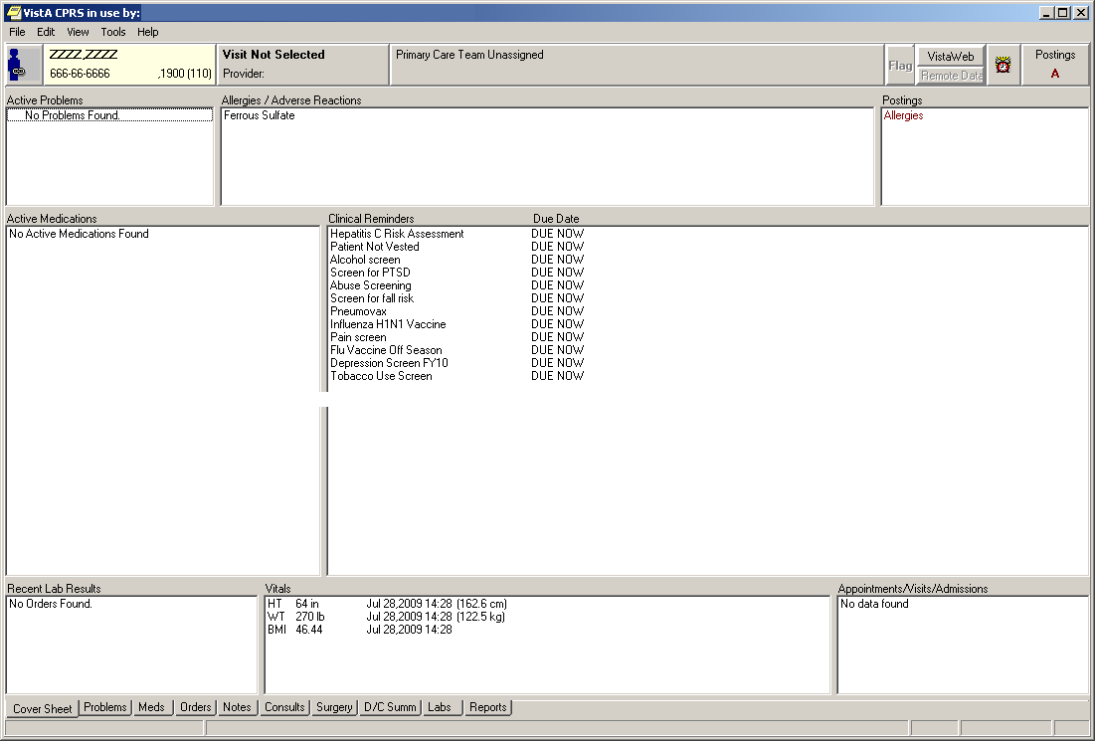
WRIISC Referral Form in CPRS
Click Notes

Slide 22
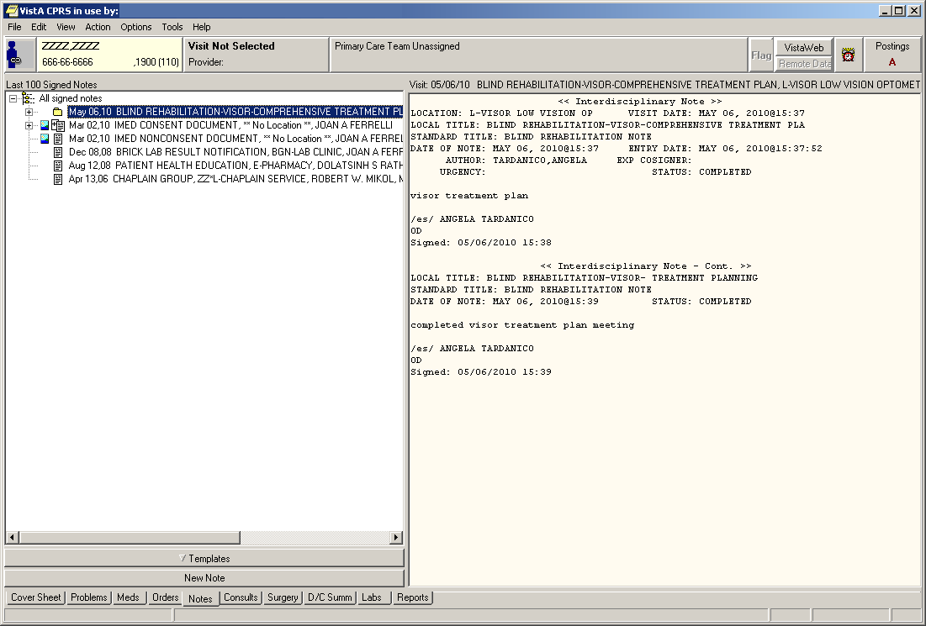
WRIISC Referral Form in CPRS
Click
New Note

Slide 23
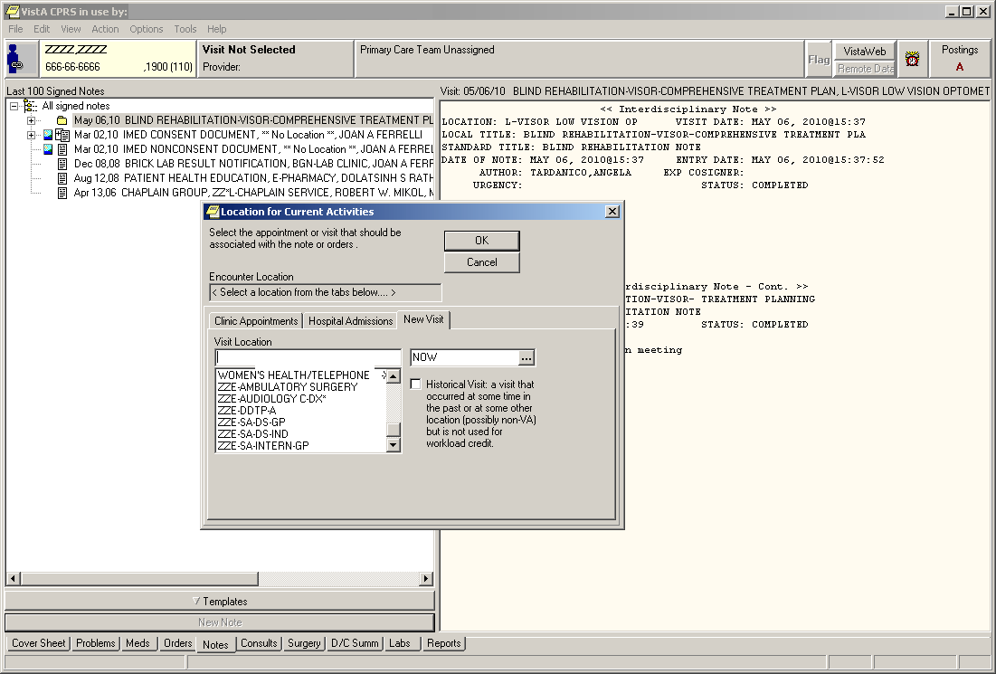
WRIISC Referral Form in CPRS
Select a location

Slide 24
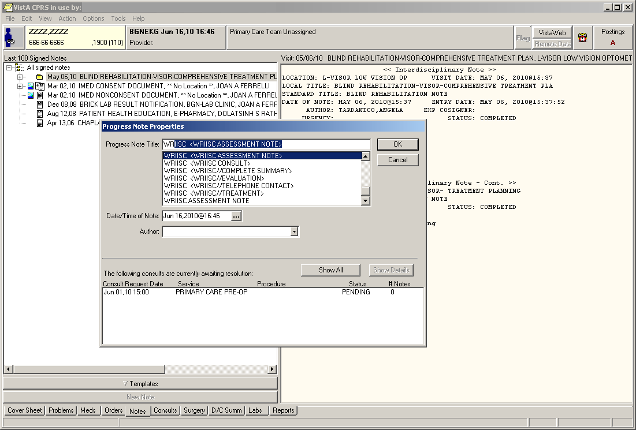
WRIISC Referral Form in CPRS
Start typing “WR..” until “WRIISC Assessment Note” appears, then hit OK

Slide 25

Questions??

